Slide 1
Quantitative Data Analysis:
A Companion for Accounting and Information Systems Research
Teaching Materials
Created by Willem Mertens, Amedeo Pugliese & Jan Recker

Slide 2
Copyright Notice
© Copyright 2017 W. Mertens, A. Pugliese & J. Recker. All Rights Reserved.

Slide 3

What these materials are about
Offering a guide through the essential steps required in quantitative data analysis
Introduction
Comparing Differences Across Groups
Assessing (Innocuous) Relationships
Models with Latent Concepts and Multiple Relationships: Structural Equation Modeling
Nested Data and Multilevel Models: Hierarchical Linear Modeling
Analyzing Longitudinal and Panel Data
Causality: Endogeneity Biases and Possible Remedies
How to Start Analyzing, Test Assumptions and Deal with that Pesky p-Value
Keeping Track and Staying Sane

Slide 4
Part 5:
Hierarchical Linear Modeling

Slide 5
Agenda
Theoretical background
  Multilevel research
  Assumptions, agreement and reliability
  Building the measurement model
  (Multilevel) regressions and Random Coefficient Modeling
Demonstration using HLM7
  Importing data
  Specifying the model
  Interpreting results

Slide 6

Theoretical background

Slide 7
Multilevel research: what is it?
Effect of group membership on individual outcomes
--> Top-down
E.g. effect of IQ (level 1), teacher expectations (level 2) on student performance
Between-group
School 1
Within-group
Within-group
Level 2
Class 1
Class 2
Class z
Level 1
Student 1
Student 2
Student x
Student 1
Student 2
Student y

Slide 8
Multilevel research: what is it?
Between-group
School 1
Within-group
Within-group
Level 2
Class 1
Class 2
Class z
Level 1
Student 1
Student 2
Student x
Student 1
Student 2
Student y
Level 2
Teacher expectations
Level 1
Student IQ
Student performance

Slide 9
Multilevel research: traditional approaches
  Aggregate individual-level variables
    Individual variance is lost (IQ)
    Effects get inflated because of the loss of variance
  Assign group-level variables to individuals
    Violation of ‘independence of observations’ (correlated error terms)
  ==> Hierarchical Linear Modeling

Slide 10
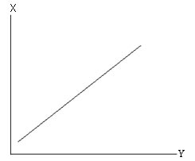
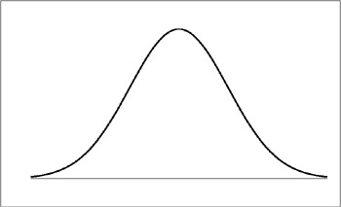
Assumptions, agreement and reliability (1)
Assumptions that apply for regression
  (Reliable and valid measurement model)
  Linearity
  Normality
  Independence
  Homoscedasticity (homogeneity of variance)
However:
  Independence and homoscedasticity only within-group
  Additional assumptions when using peer-ratings (e.g. students rate teacher)
    Inter-rater consistency
    Reliability of group means
    Inter-rater agreement
Notes:
Homoscedascity: the variance of Y is the same for different levels of X

Slide 11
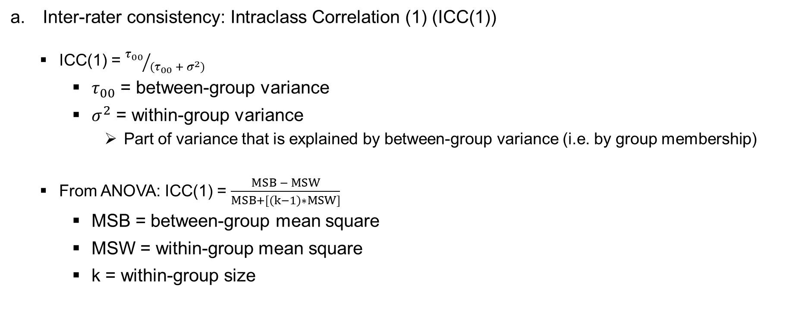
Assumptions, agreement and reliability (2)
Inter-rater consistency: Intraclass Correlation (1) (ICC(1))
  ICC(1) = ${τ_{00}}/{(τ_{00} + σ^{2})}$
    $τ_{00}$ = between-group variance
    $σ^{2}$ = within-group variance
      Part of variance that is explained by between-group variance (i.e. by group membership)
  From ANOVA: ICC(1) = $\frac{MSB − MSW}{MSB+[\left(k−1\right)∗MSW]}$
    MSB = between-group mean square
    MSW = within-group mean square
    k = within-group size
(Bliese, 2000)

Slide 12
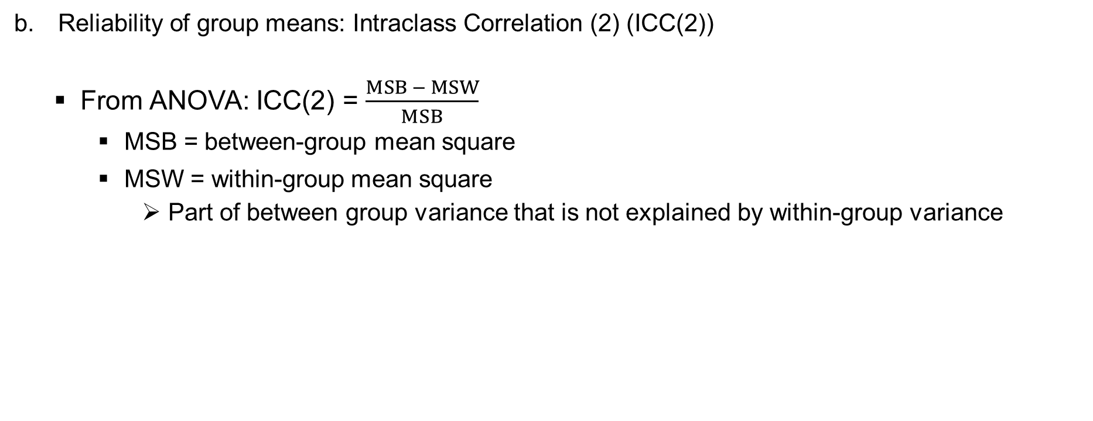
Assumptions, agreement and reliability (3)
Reliability of group means: Intraclass Correlation (2) (ICC(2))
  From ANOVA: ICC(2) = $\frac{MSB − MSW}{MSB}$
    MSB = between-group mean square
    MSW = within-group mean square
      Part of between group variance that is not explained by within-group variance
(Bliese, 2000)

Slide 13
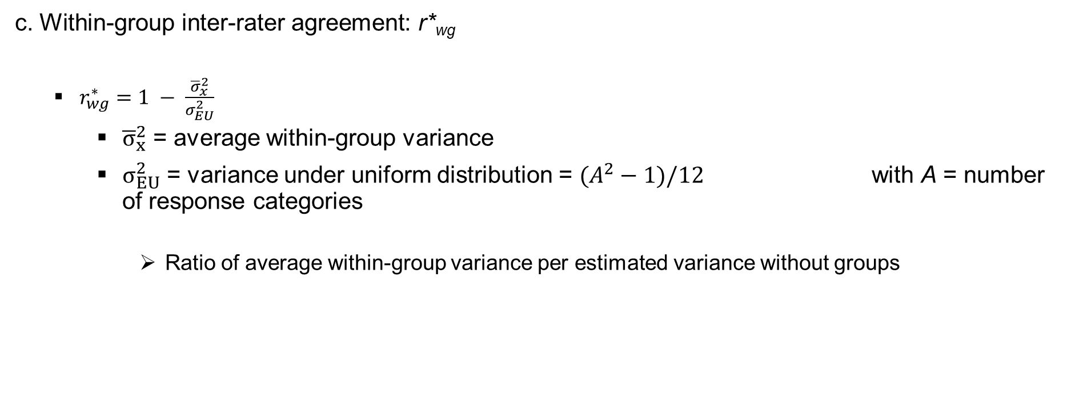
Assumptions, agreement and reliability (4)
c. Within-group inter-rater agreement: r*_{wg}
  $r_{wg}^{∗}=1 − \frac{{\overline{σ}}_{x}^{2}}{σ_{EU}^{2}}$
    ${\overline{σ}}_{x}^{2}$ = average within-group variance
    $σ_{EU}^{2}$ = variance under uniform distribution = $(A^{2}−1)/12$ with A = number of response categories
      Ratio of average within-group variance per estimated variance without groups
(Lindell, Brandt, & Whitney, 1999)

Slide 14
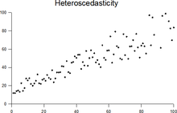
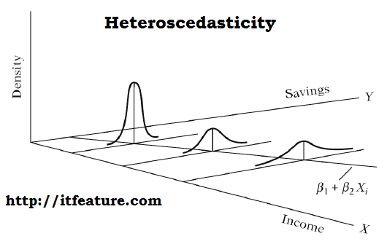
Recap: Homoscedasticity / Homogeneity of Variance
Two variables (e.g. regression): spread of errors/residuals is equal across different values of x

Slide 15
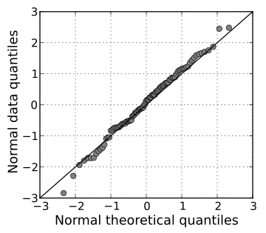
Recap: Normality
In many statistical tests
  Sampling distribution is normally distributed
  --> test normality of sample
    Visually testing normality of (sub-)sample data
      Histograms (see slide 10)
      Q-Q plots: theoretical vs. actual quantiles
Kurtosis (+)
Skew (+)
Kurtosis (+)
Skew (+)
"Normal normal qq" by Skbkekas - Wikipedia

Slide 16


Recap: Normality
    Statistical tests for normality of (sub-)sample data
      Compute descriptives including skew and kurtosis
      Convert skew and kurtosis to z-scores, e.g.:
      Shapiro-Wilk test: significant (p < .05) when NOT normal
must be ≤ 1.96
  Increase to 2.58 in larger samples and do not use in very large samples (n > 200)

Slide 17
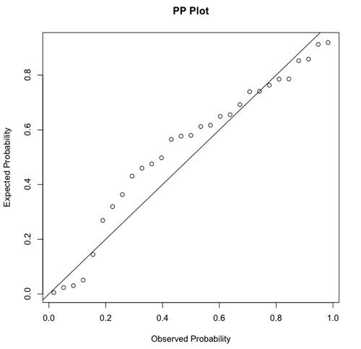
Recap: Normality
In regression-based models
  Errors/residuals, not indicators need to be normally distributed
  Same visual principles as Q-Q plot apply
residuals
Please note: in this case, both graphs do not represent the same data

Slide 18
What if assumptions are violated?
Correct data
  Exclude outliers
  Transform data, e.g.:
    Log-, square root and reciprocal (1/x) transformations shorten the right tale (i.e. correct positive skew)
    The same transformations applied to the reverse score (score – highest score + 1) correct for negative skew
Turn to tests that are robust against violations or to non-parametric tests, e.g.
  Mann–Whitney U for group comparisons
  Kendall's tau for dependence between two variables
  The same transformation has to be applied to variables that are compared directly

Slide 19
Building the measurement model
For individual-level variables (IQ)
  Classical approach to creating and evaluating scales (e.g., CFA, Cronbach’s Alpha)
For group-level variables (teacher expectations)
  Test for consistency, reliability of group means, agreement based on individual-level items
  Aggregate items to the group level (average)
  Create and evaluate scale based on aggregated items
For alternatives see: Peterson, M. F., & Castro, S. L. (2006). Measurement metrics at aggregate levels of analysis: Implications for organization culture research and the GLOBE project. The Leadership Quarterly, 17, 506-521.
(Peterson and Castro, 2006)

Slide 20
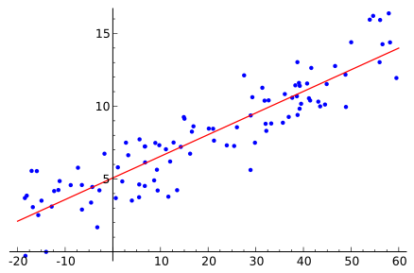
(Multilevel) regressions
Classical linear regression
$$Y_{i}=β_{0}+β_{1}X_{i}+r_{i}$$

Slide 21
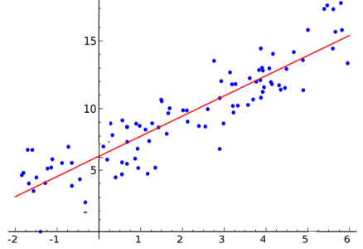
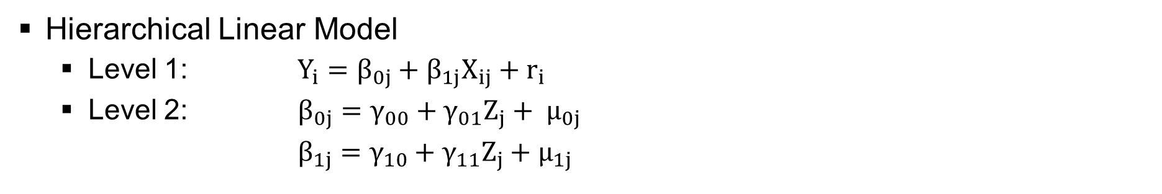
(Multilevel) regressions
Hierarchical Linear Model
  Level 1: $Y_{i}=β_{0j}+β_{1j}X_{ij}+r_{i}$
  Level 2: $β_{0j}=γ_{00}+{γ_{01}Z_{j}+ μ}_{0j}$
  $β_{1j}=γ_{10}+{γ_{11}Z_{j}+μ}_{1j}$
Class 1
Class 2
≠
≠

Slide 22
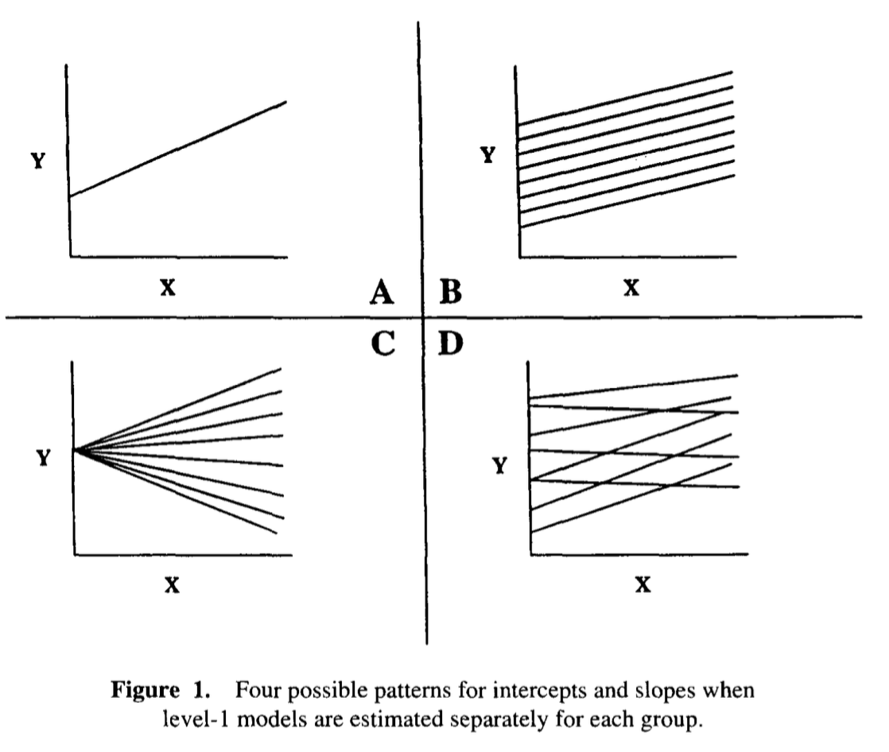
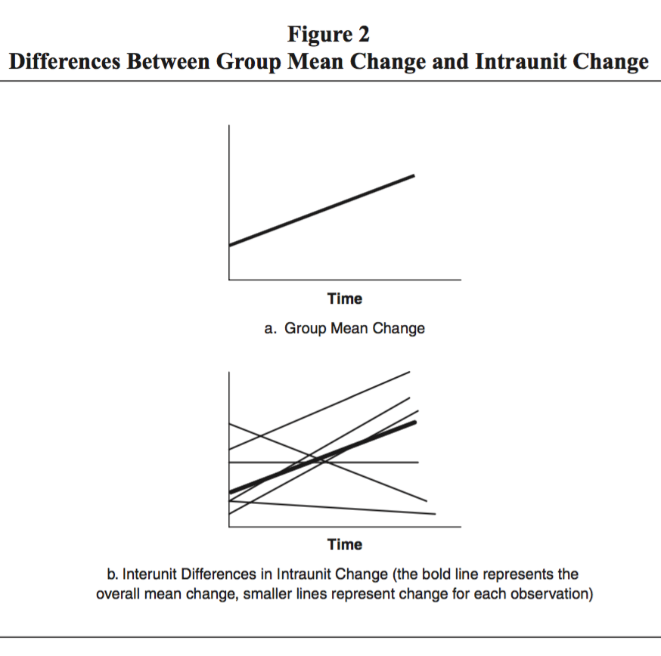
(Multilevel) regression / HLM /
Random Coefficient Modeling
Hoffmann 1997
Cross-sectional
Longitudinal

Slide 23
Different types of models
Hierarchical linear models
  2 Levels
  More levels
  E.g. student performance per class (per school)
Hierarchical multivariate linear models
  2 or more levels
  Multiple outcome variables
  E.g. student performance per class over time
Cross-classified multilevel models (see Leckie 2013)
  2 or more levels
  Units can belong to multiple groups
  E.g. student performance per class and neighbourhood

Slide 24
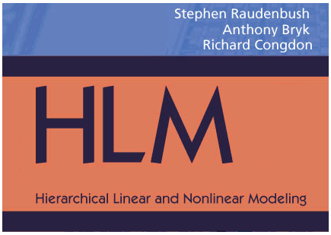
Application

Slide 25
Import data (the easy way)
Make level 1 and level 2 file
  Level 1: each student is one row (case)
  Level 2: each class/teacher is one row (case)

Slide 26
Recap: Structuring data
One row per case, one variable per column
Depends on unit of analysis (e.g. person)
Student | Age | Class | IQ | Performance | …
1 | 19 | 1 | 95 | 5.9 | …
2 | 53 | 1 | 93 | 6.3 | …
3 | 27 | 2 | 105 | 6.5 | …
4 | 2 | 107 | … | 4.7
… | … | … | … | … | …

Slide 27
Structuring data
Multilevel data: split into level 1 and level 2
Level 1
Level 2
Student | Class | IQ | Performance | …
1 | 1 | 95 | 5.9 | …
2 | 1 | 93 | 6.3 | …
3 | 2 | 105 | 6.5 | ...
4 | 2 | 107 | 4.7 | …
5 | 2 | 118 | 5.4 | …
6 | 2 | 79 | 5.5 | …
… | … | … | … | …
Class | Expectation | …
1 | 7 | …
2 | 5 | …
3 | 4 | …
… | … | …

Slide 28
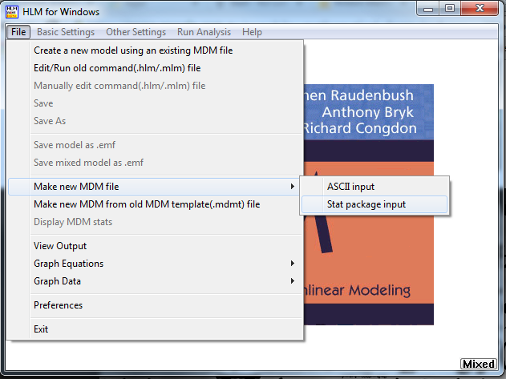
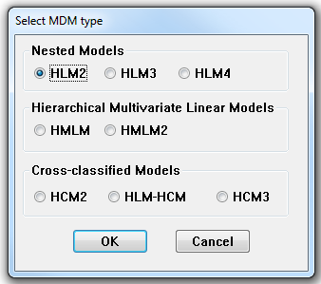
Import data (the easy way)
Make level 1 and level 2 file
  Level 1: each student is one row (case)
  Level 2: each class/teacher is one row (case)
Build Multivariate Data Matrix (MDM)

Slide 29
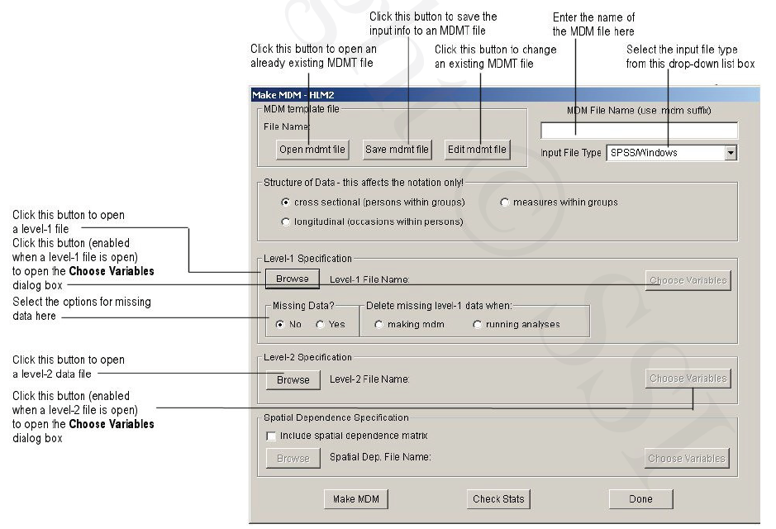
Import data (the easy way)

Slide 30
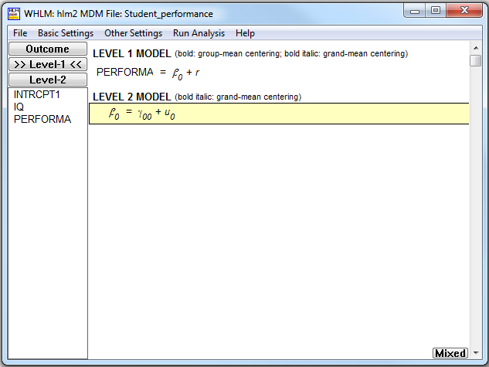
Specifying the model

Slide 31
Specifying the model
Mean centring
  RAW: original score
  Group: individual score minus group mean
    Does not control for between-group variance in level 1 variables when testing level 2 variables
  Grand: individual score minus total sample mean
    Yields intercepts and slope parameters that are easier to interpret
      Overall average becomes reference point
      E.g. if I have average intelligence, my group membership will have γ₀₀ influence on my performance

Slide 32
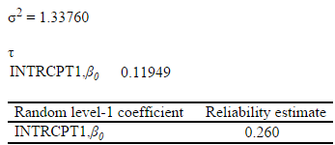
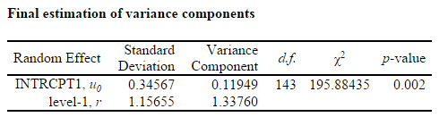
Interpreting the results
Based on basic model = one-way ANOVA
  “reliability estimate” = ICC(1)
  “final estimation of variance component” tests significance of between-group variance
Robust SE means robust against violations of assumptions --> if non-robust SE and robust SE differ you should check assumptions
  Residual plots like with regression
  Other assumptions: see Raudenbush and Bryk (2002)
Coefficient for intercept level 2 (γ₀₀) = average performance

Slide 33
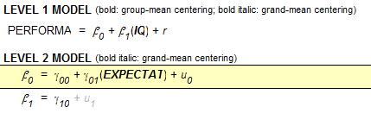
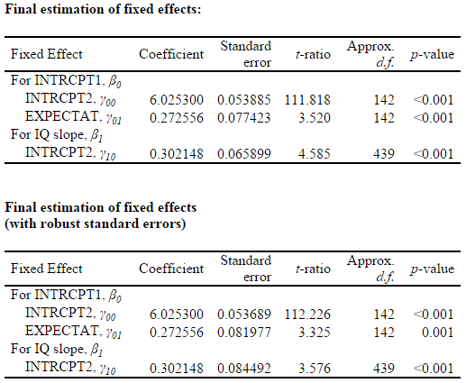
Interpreting the results
More advanced model
  Coefficient is similar to regression
  Coefficient is different from 0
  when t-ratio is significant

Slide 34
Test for multilevel mediation
(Unrealistic) example: teacher expectations --> IQ --> student performance
  Step 1: level 1 model: PERF_{ij} = β_{0j} + r_{ij};
  level 2 model: β_{0j} = γ₀₀ + γ₀₁* EXPECT_{ij} + u_{0j}
  Step 2: level 1 model: PERF_{ij} = β_{0j} + β_{1j}* IQ_{ij} + r_{ij}
  level 2 model: β_{0j} = γ₀₀ + γ₀₁* EXPECT_{ij} + u_{0j}
  Step 3: level 1 model: IQ_{ij} = β_{0j} + r_{ij}
  level 2 model: β_{0j} = γ₀₀ + γ₀₁* EXPECT_{ij} + u_{0j}
  Step 4: Interpret coefficients
    Coefficient of EXPECT not significant in Step 3? No mediation
    Coefficient of EXPECT equal in step 1 and 2? No mediation
    Coefficient of EXPECT significant in Step 1 and step 3, but not in step 2? Full mediation
    Coefficient of EXPECT significant in all steps, but lower in step 2 than 1? Partial mediation
  Krull and MacKinnon (1999, 2001)
  If full mediation: Level 1: PERF_{ij} = β_{0j} + β_{1j}* IQ_{ij} + r_{ij}
  Level 2: β_{0j} = γ₀₀ + u_{0j}
  β_{1j} = γ₁₀ + γ₁₁* EXPECT_{j} + u_{1j}

Slide 35
References
Referred to in slides
Bliese, P. D. (2000). Within-group agreement, non-independence, and reliability: implications for data aggregation and analysis. In K. J. Klein & S. W. J. Kozlowski (Eds.), Multi-level theory, research and methods in organizations: Foundations, extensions, and new directions (pp. 349-381). San Francisco, CA: Jossey-Bass
Lindell, M. K., Brandt, C. J., & Whitney, D. J. (1999). A Revised Index of Interrater Agreement for Multi-Item Ratings of a Single Target. Applied Psychological Measurement, 23(2), 127-135. doi: DOI: 10.1177/01466219922031257
Peterson, M. F., & Castro, S. L. (2006). Measurement metrics at aggregate levels of analysis: Implications for organization culture research and the GLOBE project. The Leadership Quarterly, 17(5), 506-521. doi: http://dx.doi.org/10.1016/j.leaqua.2006.07.001
Krull, J. L., & MacKinnon, D. P. (1999). Multilevel Mediation Modeling in Group-Based Intervention Studies. Evaluation Review, 23(4), 418-444. doi: 10.1177/0193841x9902300404
Krull, J. L., & MacKinnon, D. P. (2001). Multilevel Modeling of Individual and Group Level Mediated Effects. Multivariate Behavioral Research, 36(2), 249-277. doi: 10.1207/S15327906MBR3602_06
Hofmann (1997) An Overview of the Logic and Rationale of Hierarchical Linear Models. Journal of Management, 23(6), 732-744
Key resources
K. J. Klein & S. W. J. Kozlowski (2000), Multi-level theory, research and methods in organizations: Foundations, extensions, and new directions. San Francisco, CA: Jossey-Bass
S. W. Raudenbush and A. S. Bryk (2002), Hierarchical Linear Models: Applications and data analysis methods. Thousand Oaks, CA: Sage Publications, Inc.
G. D. Garson (2012), “Introductory guide to HLM with HLM 7 software (Chapter 3)” in G. D. Garson (editor), Hierarchical Linear Modeling: Guide and Applications. Thousand Oaks, CA Sage Publications, Inc. ; can be downloaded from http://www.sagepub.com/upm-data/47529_ch_3.pdf
Software: http://www.ssicentral.com/hlm/resources.html
Leckie, G. (2013). Cross-Classified Multilevel Models - Concepts. LEMMA VLE Module 12, 1-60. http://www.bristol.ac.uk/cmm/learning/course.html

Slide 36
End of Part 5
© Copyright 2017 W. Mertens, A. Pugliese & J. Recker. All Rights Reserved.

