Slide 1
Quantitative Data Analysis:
A Companion for Accounting and Information Systems Research
Teaching Materials
Created by Willem Mertens, Amedeo Pugliese & Jan Recker

Slide 2
Copyright Notice
© Copyright 2017 W. Mertens, A. Pugliese & J. Recker. All Rights Reserved.

Slide 3

What these materials are about
Offering a guide through the essential steps required in quantitative data analysis
Introduction
Comparing Differences Across Groups
Assessing (Innocuous) Relationships
Models with Latent Concepts and Multiple Relationships: Structural Equation Modeling
Nested Data and Multilevel Models: Hierarchical Linear Modeling
Analyzing Longitudinal and Panel Data
Causality: Endogeneity Biases and Possible Remedies
How to Start Analyzing, Test Assumptions and Deal with that Pesky p-Value
Keeping Track and Staying Sane

Slide 4
Part 7:
Endogeneity & Self-Selection: Propensity Score Matching & Selection Models

Slide 5
Agenda
  Making Causal claims with Observational Data
  Randomized assignment vs Observational data
  Sources of Endogeneity & Self-Selection Problem
  Specifying the right model
Instrumental Variable & 2 Stage Least Squares
  Concepts and Applications
Propensity Score Matching
  Concepts and Applications
Summary and Takeaways

Slide 6
Why are you here?
Our RQ is a causal-like (e.g.):
Does giving incentives to CEOs improve firm performance?
Does adopting ERP system reduce faulty manufacturing?
We wish to assess whether offering $1 in stock option (adopting an ERP system) improves performance (reduces faults) – everything else being equal
We have observational data (e.g. survey or archival), hence no-random assignment of your units to the treatment / control conditions
Notes:
Go to the with-board and draw the causal relationship.
Firms choosing to give incentives or adopting ERP systems may be different from those who do not.
Memberships to these groups are not randomly distributed and the equality in expectation condition is not necessarily met.

Slide 7
Making causal claims with observational data
Units are non-randomly assigned to the (levels of) treatment/control condition:
  Self-Select themselves (sick people going to hospital have poorer health afterwards)
  Differ across characteristics correlated with the outcome (wealthy families send kids to good schools)
Making causal claims requires meeting stringent conditions:
  The cause precedes the effect (time)
  ###
  333
Notes:
Inability to ensue the everything else constant assumption.
Potential confounds that make it hard to make causal claims – misattribution problem

Slide 8
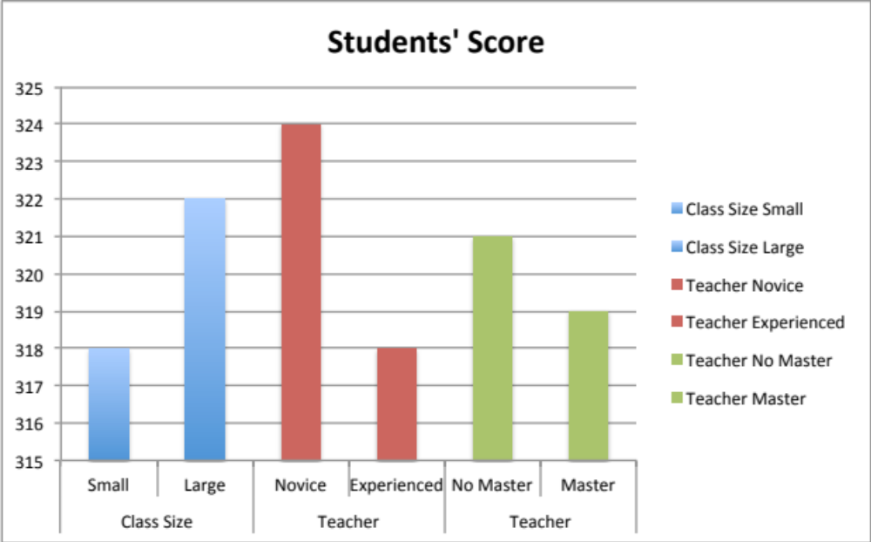
A classic in education research
Does class size affect students’ performance?
Does teacher experience (qualification) affect students’ performance?
Notes:
This is a typical example of selection on outcome – hence self-selection problem – because kids / teachers are allocated to different classes based on the assumed or prior performance
Whiteboard to write equation PERF = a + b1(CLASS_SIZE) + b[COVARIATES] + e

Slide 9
A classic in education research
Early results suggested that:
Students in larger classes perform better
Students in classes with novice and less qualified teachers have better results
Does it make sense? What justifies these results?
Class size and teacher allocation are endogenous & depend on factors affecting the outcome:
Poorly performing students are allocated to smaller classes
More experienced teachers are assigned to larger and more problematic cohorts

Slide 10
The WAJ problem: refinancing the w/shops
HoS ask for evidence of the effectiveness of w/shops prior to refinancing them
Proxy for Effectiveness: # of individual journal submissions after the w/shops
Six months later, WAJ present their evidence:
S1: Staff (not) attending w/shops have submitted (1.9) 2.9 articles
S2: Staff (not) attending w/shops submitted (1.9) 2.0 articles
Would you re-finance w/shops based on results from S1 or S2?
Notes:
Wait until they reply to

Slide 11
The WAJ problem: attendance is a choice
We are comparing two groups that are potentially different”
Staff choose to attend the w/shops based on their need to acquire training
  Staff familiar with stats are more likely to attend (inflating our findings)
  Staff less familiar with stats are more likely to attend (works against our findings)
(Selection on dependent variable)

Slide 12
The WAJ problem: attendance is a choice
We are comparing two groups that are potentially different
Attending and not-attending staff differ along other dimensions:
  Background
  Nationality
  Gender
(Selection on covariates)

Slide 13
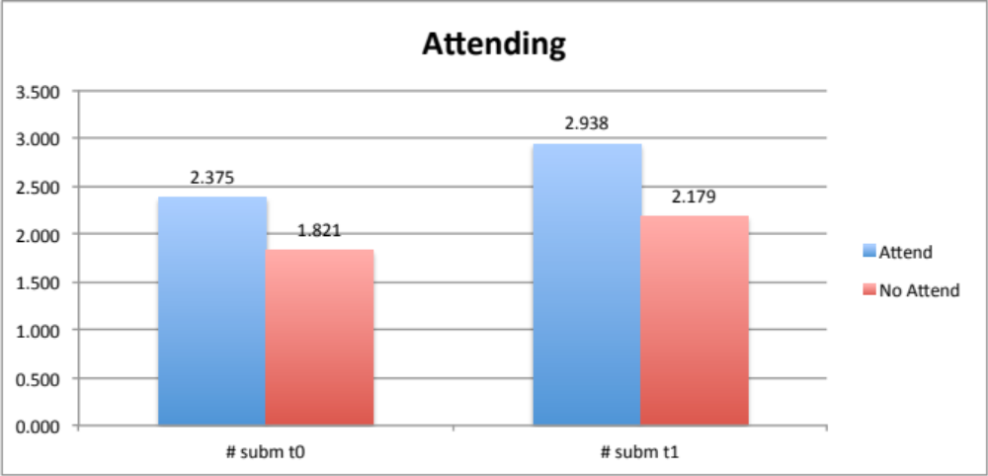
Self-selection: who goes to w/shops?
The two groups are not identical – staff attending w/shops are more productive ex-ante
Overestimate the effectiveness of w/shops: it is confounded with the ex-ante ability of attending staff

Slide 14
The WAJ problem (3): the ideal state
Test the effectiveness of w/shops in an ideal state:
Randomly select staff attending (treatment) and non-attending (control) the w/shops
Compare the # journal submissions between the two groups (t-test)
What do we have instead?
Attendance to w/shop
# submissions year 1
+
+
# submissions year 0

Slide 15
The WAJ problem (4): identification strategy
We cannot compare Attending vs Not Attending Staff but…
We have the following data points for each staff member:
  # jnl submissions at T1
  Attendance to the w.shops (dummy)
  # jnl submissions at T0
  Gender (dummy for female)
  Nationality (dummy for local)
  Background (Science) (dummy if BA in Science)
First stop is a correlation matrix

Slide 16
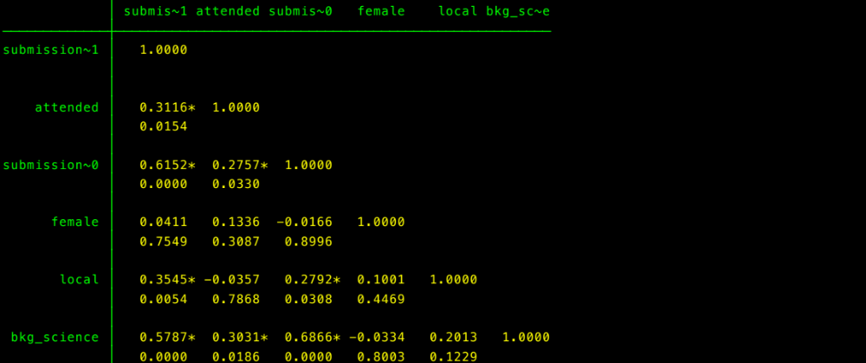
First Stop: The Correlation Matrix
Main Predictor
Must be Included in OLS
No need to be Included in OLS
Should be Included in OLS
Must be Included in OLS

Slide 17
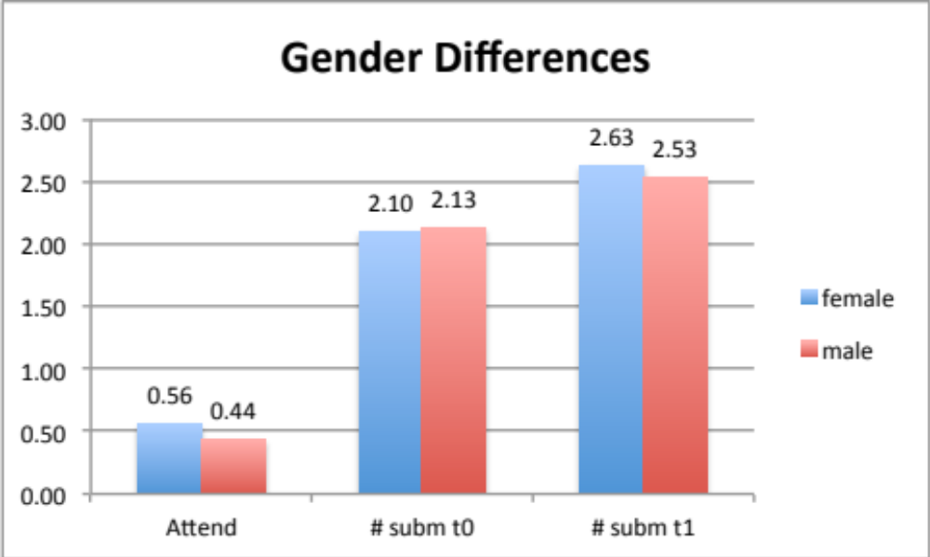
Gender differences
There are gender differences in terms of attendance but not in terms of submissions.
Not a control variable in the model

Slide 18
Model Specification 1
Attendance to w/shop
# submissions year 1
# submissions year 0
Gender

Slide 19
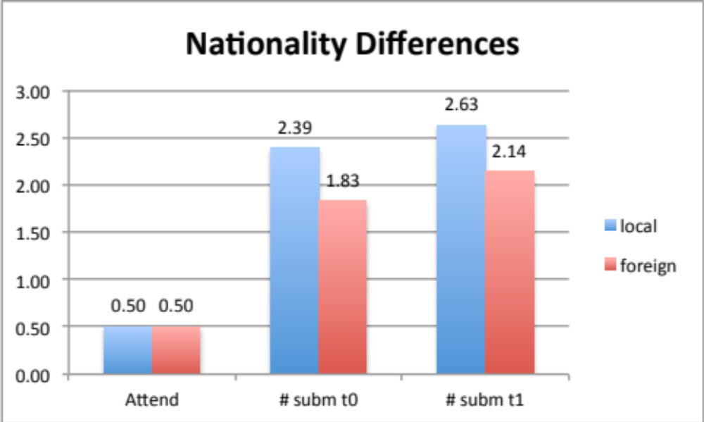
Nationality differences
There are differences across nationalities in terms of performance but not attendance.
Advised to include nationality as a control variable to improve estimation precision (R²) but not to address endogeneity issue. This is a commonly mis-placed criticism in empirical research

Slide 20
Model Specification 2
Attendance to w/shop
# submissions year 1
# submissions year 0
Gender
Nationality

Slide 21
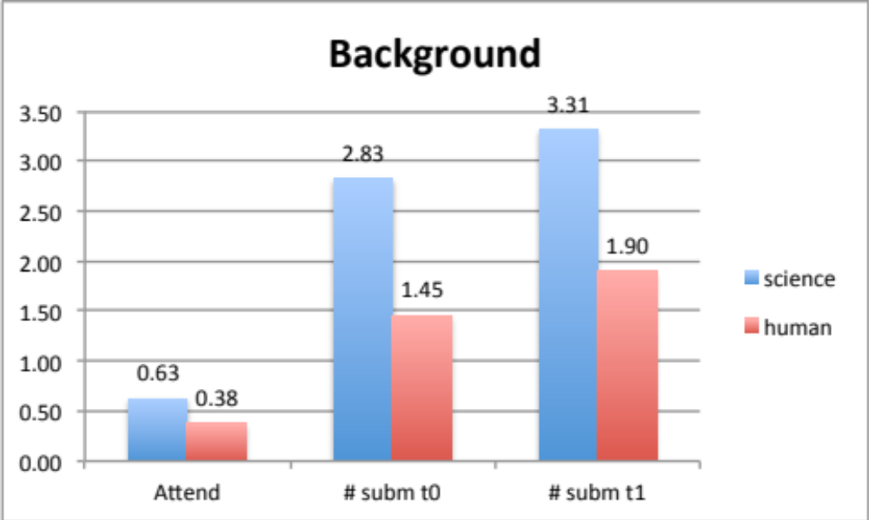
Background Differences
There are differences across background affecting both performance and attendance.
Background is a necessary covariate otherwise an omitted correlated variable problem arises

Slide 22
Model Specification 3
Attendance to w/shop
# submissions year 1
# submissions year 0
Gender
Nationality
Background

Slide 23
Model specification: selecting covariates
Covariate | Correlated with DV | Correlated with Main Predictor | Included in the model?
Gender | No | No | No | Not necessary
Nationality | Yes | No | Yes | Improves estimation. Does not affect the bias
Bckg_Science | Yes | Yes | Yes | Biased estimation: omitted correlated variable
Submissions_T0 | Yes | Yes | Yes | Biased estimation: reverse causality
Choosing the right covariates involves two steps:
  What is theoretically relevant? – prior literature
  What correlation patterns emerge in the data? – project specific

Slide 24
Towards a less biased model
Model | Dependent Variable | Main Predictor | Covariates | Inclusion/Exclusion
1 | # journal submission T1 | Attendance W/shops | Gender | Should not be included
2 | # journal submission T1 | Attendance W/shops | Nationality | Included to improve estimation precision
3 | # journal submission T1 | Attendance W/shops | Background | Must be included. Otherwise omitted correlated variable
4 | # journal submission T1 | Attendance W/shops | # journal submission T0 | Must be Included. Otherwise reverse causality
Sub_T1 = α + β₁ Att + β₂ Bckg + β₃ Local + β₄ Sub_T0 + ε

Slide 25
Model Comparisons
 | Model 1 | Model 2 | Model 3 | Model 4 | Model 5
Attended | .76(3.56) | .76(3.52) | .80(4.02) | .43(2.34) | .35(1.99)
Female |  | -.001(-.01) | -.097(-.48) | .016(.009) | .036(.22)
Local |  |  | .90(4.52) | .64(3.62) | .51(2.96)
Background |  |  |  | 1.15(6.15) | .63(2.77)
Submission_T0 |  |  |  |  | .41(3.53)
Intercept | 2.17(14.0) | 2.18(12.01) | 1.73(9.94) | 1.45(8.31) | .94(4.21)
Adj-R-sqr | .097 | .097 | .21 | .42 | .48
 | Biased | Biased | Bias – but improved precision | Bias – but control for omitted correlated variable | Unbiased – control for omitted correlated variable and selection on outcome

Slide 26
Potential sources of endogeneity
Reverse causality
Omitted correlated variable
Ex:
Asses if Sales F.casts issues in addition to Earnings F.casts improves info quality.
Reverse causality: analysts issue Sales forecasts when info is more precise (and feel more comfortable doing so)
Confounds: better analysts issue Sales F.cast (Sales F.cast do not really add value) and improved estimation
Endogeneity causes a mis-attribution problem

Slide 27
Conditions to Claim Causality
The gold standard requires a time machine…
Give someone a fast swimming suit (treatment) & take time on 100 m stroke then..
… go back in time, give the same subject a standard swimming suit and take the time
Can we do that? Not really … I guess ☺
We choose groups that are equal in expectations (on the outcome) & assign to treatment or control conditions
The techniques are useful to determine whether we can meet this condition or not.

Slide 28
Self-Selection: theory
Means that the observed units non-randomly assigned:
  Random assignment vs Choice
‘Selection occurs when observations are non randomly sorted into discrete groups, resulting in the potential coefficient bias in estimation procedures such as OLS’
(Maddala 1991)
The choice of allocating or not a unit in a group may depend on attributes and characteristics that can potentially affect the outcome.

Slide 29
When do we worry?
Our RQs imply some causality:
Establish whether X affects Y
Test whether X has an impact on Y
Some examples:
Do incentives to middle managers improve productivity?
Does hiring a Big-N auditor improve audit quality?
Do support structures affect employee outcomes (MIS Q)
The majority of our research does not imply causality nor we should claim it

Slide 30
A fundamental problem: our data
We are comparing units (e.g. individuals, groups, firms, systems) that are different:
Along dimensions other than our treatment
In ways that can affect our outcome
Y = α + β₁ X₁ + β₂ X ₂+ ε

Slide 31
Endogeneity: a technical note
Y = α + β₁ X1+ β₂ Cov_1 + β₃ Cov_2 + ε
β₁ is unbiased only if COV (X1, ε) ≠ 0
The unexplained portion of variance of DV is not correlated with X1 – this is hard to verify ex-post (see WAJ data)
Ex:
EARN_t1= α + β₁ EDU_t0+ β₂ Cov_1 + β_{k} Cov_k + ε
EDU is not randomly assigned: it depends on Ability and ex-ante wealth (EARN_t0)

Slide 32
Ok, we have a problem. And now?
Understand the source of endogeneity:
Observable – data are available
  OLS Multiple Regression
  Stratification
  Propensity Score Matching
  Instrumental Variable Estimation
  2 Stages Least Squares
Non-observable – no data available
  2 Stages Least Squares – Inverse Mills Ratio
  Modeling change (fixed-effects)

Slide 33
Available instruments
Making sure that we can compare the groups and estimate a B-coeff that is unbiased and reflects the relationship between theoretical constructs
OLS – Multiple Regression
Propensity Score Matching (PSM)
Instrumental Variable Estimation (IVE)
2 Stages Least Squares
Simultaneous Equation Modeling
Panel and fixed effects (modeling change)
Difference in Difference

Slide 34
Recap
Our RQ is causal like: X → Y – potentially impactful contribution
Observed data do not ensure randomization in the assignment of units to treatment/control groups to the (levels of) main predictor
Equality in expectations is not met: units self-select into treatment/control groups
Compare groups that are different along dimensions that affect our outcome
As a result: mis-attribution of an effect to the treatment

Slide 35
IVE & 2-Stage Least Squares: an overview
The equality in expectation condition is not met: COV(X1, ε) ≠ 0
B-coeff on main predictor is biased because ε correlate with main predictor
A solution is finding another (or multiple) variable (Instrument) that:
  Correlates with the predictor
  Does not (conceptually) correlate with the outcome
How feasible is finding such a variable that satisfies both conditions?

Slide 36
What is an Instrument?
Error
X
end
Y
IV_1
IV_2
Instrument is correlated with X but not with Y

Slide 37
Example
Q: Does having a Health Insurance affect medical expense?
Use data from the US Social Security Survey - people >65 yrs old
OLS model: Med_Exp = α + β₁ Health_Insurance + β_{k} Controls + ε
Subscribing a Health Insurance is a choice and our OLS estimation will suffer from endogeneity problems.
A number of tools help detecting endogeneity and ‘correct’ for it

Slide 38
Model Comparison
 | OLS | 2SLS (one IV) |  | 2SLS (two IVs)
 |  | First Stage | Second Stage | First Stage | Second Stage
DV | Medical Expenses | Health Insurance | Medical Expenses | Health Insurance | Medical Expenses
Health Insurance | .074 (2.89)
Health Insurance_HAT |  |  | -.85 (-4.30) |  | -.96(-5.20)
Illness | .44 (47.06) | 0.11(3.12) | .44 (43.59) | .011(3.25) | .44(43.12)
Age | -.003 (-1.35) | -.01(-11.97) | -.012 (-4.23) | -.008(-11.06) | -.012(-4.75)
LN(Income) | 0.17 (1.27) | .05(9.64) | .097 (4.35) | .05(8.99) | .11(4.95)
SSIncome (IV_1) |  | -.19(-14.1) |  | -.19(-13.43)
Firm_Location (IV_2) |  |  |  | .11(5.78)
Intercept | 5.7 (37.53) | .95(16.86) | 6.58 (28.09) | .91(15.91) | 6.69(29.97)
Adj-R² | .1749 | .068 | .079 | .071 | .049
Durbin-Chi2 |  | 25.09(p=0.000) |  | 37.21(p=0.000)
Wu-Husman |  | 25.13(p=0.000) |  | 37.40(p=0.000)

Slide 39
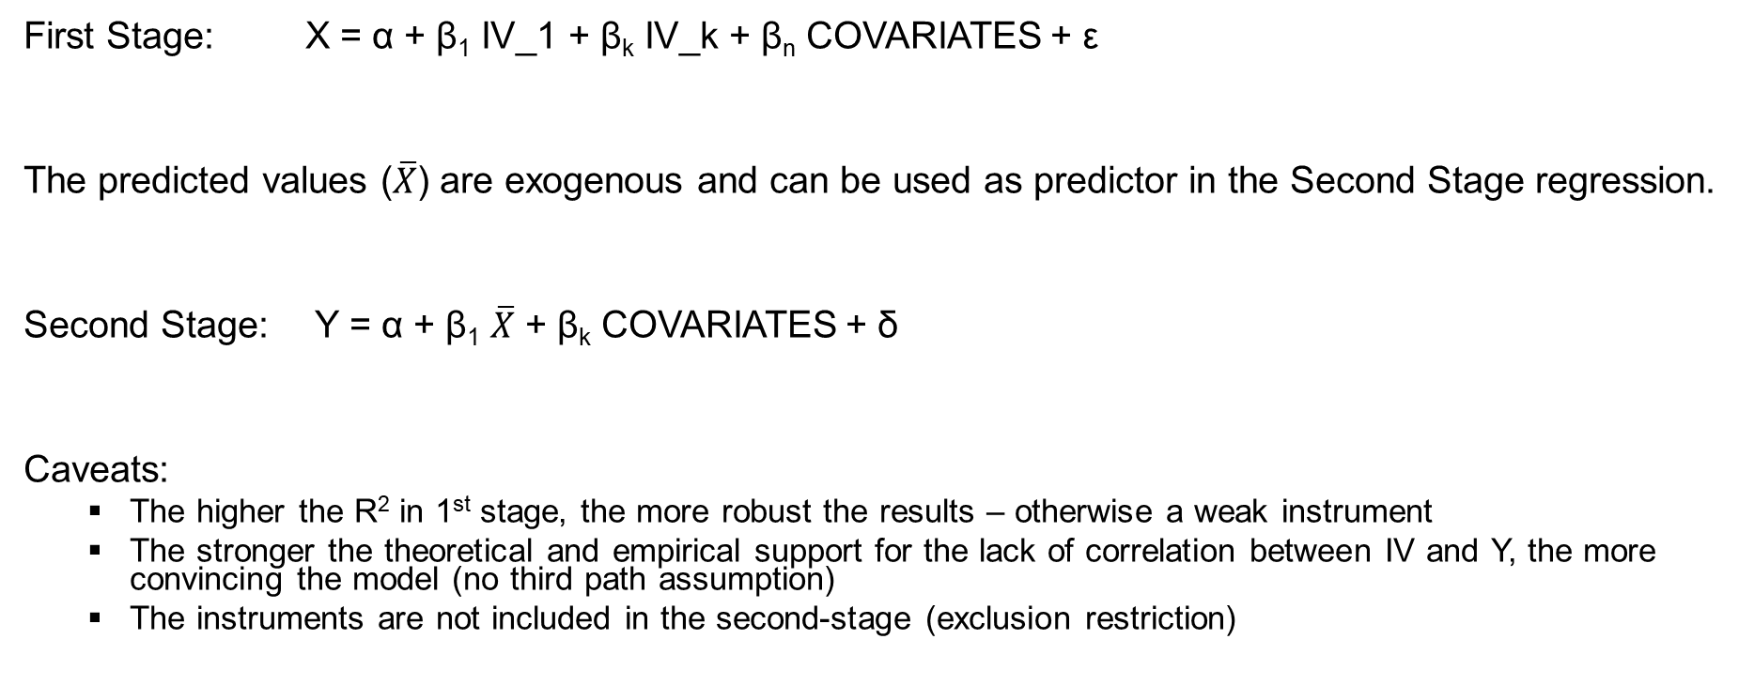
The Mechanics of IVE and 2SLS
First Stage: X = α + β₁ IV_1 + β_{k} IV_k + β_{n} COVARIATES + ε
The predicted values ($\overline{X}$) are exogenous and can be used as predictor in the Second Stage regression.
Second Stage: Y = α + β₁ $\overline{X}$ + β_{k} COVARIATES + δ
Caveats:
  The higher the R² in 1st stage, the more robust the results – otherwise a weak instrument
  The stronger the theoretical and empirical support for the lack of correlation between IV and Y, the more convincing the model (no third path assumption)
  The instruments are not included in the second-stage (exclusion restriction)

Slide 40
IVE and 2SLS: a note of caution
These tools do not solve the endogenity problems – at best they mitigate it or indicate there is little we can do about it.
A few things help in the write up of the method/analysis section:
Understand the source of endogeneity (theory): what drives the selection?
Find a credible & robust Instrument (s) that predict a large portion of the Main Predictor (F-Stat>10) and high R²
Specify alternative tests with different Instruments (first-stage) and exclusion restrictions (second-stage) and justify the choice
Report test for Multicollinearity from the second-stage regression

Slide 41
Propensity Score Matching (PSM): overview
Observations are not randomly assigned to the treatment/control conditions
  B-coeff will result in a biased under (over) estimation of the relationship IV → DV
No Instrument available to predict our endogenous variable
PSM means finding a ‘match’ for treated units (e.g. controls) to enable comparison and estimate the effect
The more accurate the matching procedure, the better the estimation

Slide 42
The logic of PSM
Matching means ‘reverse engineering’ the randomization process.
Instead of assigning units to treatment/control – we identify controls ex-post.
This is necessary in two cases:
  Data include treated and control units that have not been randomly assigned (e.g. kids attending Catholic or Public Schools)
  Data include only treated units (e.g. firms subject to ATO investigation) but no controls
Q: How to find the right peers?
How to find non-treated units that are similar across dimensions that are likely to affect the outcome variable?

Slide 43
Example
In 80’s a debate in the US about whether family should be given vouchers to enrol kids into Catholic schools.
Q: do Catholic schools enhance students’ achievements?
The National Educational Longitudinal Studies (1988) has the following data:
  Student’s attendance to Catholic or Public School
  Student’s achievement on Math tests in yr8 and yr12
  Family-related variables (e.g. income)
  Parents’ characteristics (e.g. education, employment conditions)

Slide 44
A substantive question of interest
A simple comparison across the two groups suggests that Catholic schools enhance students’ ability (in Math tests)
  Catholic (N=592; Math_12= 54.53)
  Public (N=5079; Math_12=50.64)
Large and sig difference suggests that Catholic schools offer better education
Students are not randomly assigned to the type of Schools – self-selection
  Students attending Catholic or Public schools are not comparable.
Data Example

Slide 45
Model Comparison
 | OLS | OLS with Family Income | OLS with Family Income Math8 | PSM Average Treatment Effect | PSM Average Treatment on the Treated
Catholic | 3.89(9.51) | 2.68(6.82) | 1.67(7.29) | 2.66 (4.16) | 1.66 (4.34)
Fam_Income |  | 1.29(23.88) | .33(10.13)
Math_8 |  |  | .78(104.1)
Intercept | 50.64(382.81) | 38.42(72.90) | 7.15(16.72)
Adj-R-sqrd | 0.0157 | 0.11 | 0.69

Slide 46
The mechanics of PSM
PSM does two things:
First, identify pairs of observations that are comparable. ‘Matching’ is based on our input and knowledge of the selection process.
PSM tells us that obs X₁₂₃ (treated) and X₄₅₆ (non-treated) are comparable across the chosen dimensions: the only difference is the treatment condition.
Compares ‘paired’ obs and returns an Average Effect of the Treatment
This gives a ‘bias-correct’ estimation of the effect of the treatment on the outcome

Slide 47
PSM: key issues to remember
Identification of peers? What drives the selection process? (theory)
  Family Income
  Previous Math Score in Yr 8
Specify strong selection model (propensity of going to Catholic school) – R²
How many peers for a comparison? 1 or many?

Slide 48
Takeaways
Think about your data: are the groups randomly assigned to the (levels of) treatment? If not you need to have a bias-correction strategy
    What are the potential confounds?
    What is the direction of causality?
Carefully craft the research design ex-ante
    Use natural or quasi-experiments (change in legislation, deaths, lottery)
    Work with the limitations of the data and clearly discuss them in the paper/thesis
No statistical remedy helps without a theoretical knowledge of the issue
No remedy exists to endogeneity problems: OLS, 2SLS and PSM provide a way to correct the estimation bias. Sometimes problems are insurmountable

Slide 49
When to use which tool?
Source of Endogeneity | Examples today | Tool | PROs / CONs
Self-Selection (on the outcome) | Submission at T0 (in the WAJ example) Math Score (in the Catholic School example) | OLS with lag variable | Parsimonious but not effective. Only if data are non-stationary
 |  | IVE 2Stage Least Square | If a good Instrument is available
 |  | Inverse Mills Ratio (Heckman procedure) | Data is not available
Selection on Observable Covariates | Background (WAJ example) Family Income (Catholic School Example) | OLS IVE & 2SLS PSM | The choice is entirely driven by the quality of the Instrument. OLS can be efficient as well. PSM or 2SLS as robustness tests
Selection on Unobservable Covariates |  | 2SLS IMR Fixed Effect Analysis | All conclusions can be potentially biased

Slide 50
We are not alone…
Colleagues in a number of disciplines have similar problems and share solutions:
Epidemiology
Biostatistics
Education
Economics
Resources
U of Winsconsin Madison: http://www.ssc.wisc.edu/sscc/
Institute for Digital Research & Education @ UCLA https://idre.ucla.edu
Harvard School Pol Science http://gking.harvard.edu/category/research-interests/methods/causal-inference

Slide 51
End of Part 7
© Copyright 2017 W. Mertens, A. Pugliese & J. Recker. All Rights Reserved.

