Slide 1
Scientific Research in Information Systems: A Beginner’s Guide (2nd edition)
Teaching Materials
Created by Professor Jan Recker

Slide 2
Copyright Notice & Citation
© Copyright 2021 Jan Recker. All Rights Reserved.
Recker, J. (2021): Scientific Research in Information Systems: A Beginner’s Guide.
2nd edition, Springer.
Available at Springer, Amazon, and other booksellers

Slide 3
Potential Course Design on Basis of the Book

Slide 4
Course Overview
This course will provide an introduction and overview of scientific research in Information Systems. It will discuss elementary scientific principles of research, explore key decisions in identifying research questions, designing a study, developing and using theory, research methods, and discuss challenges in paper writing, publishing, and scientific ethics.
The course will be taught in an interactive style where we jointly discuss learnings, critique articles, attempt to apply what we have learned to improve and extend our own research and publications, and work together to reach a deeper understanding of how to produce significant Information Systems research. The course will feature readings, lectures as well as student presentations and discussions in the classroom.

Slide 5
Learning Outcomes
Students learn to…
  ...understand principles of scientific inquiry such as replicability, independence, and precision.
  …evaluate phenomena and research problems of interest to information systems scholars
  ...apply discipline and technical knowledge to analyze and evaluate scientific processes and outcomes in information systems.
  … distinguish, evaluate, and compare different research methods used in information systems research
  …frame important research questions and design research studies appropriate to address these research questions.
  …develop written communication skills to structure, explain and defend scientific thinking.
  …appreciate ethical issues in planning, conduct, and publishing of information systems research.

Slide 6
Possible Schedule
Week | Topic | Lecture | Practical
1 | Scientific principles | 3h
2 | Research questions | 3h
3 | Practical session |  | 3h
4 | Research design | 3h
5 | Quantitative methods | 3h
6 | Practical session |  | 3h
7 | Qualitative methods | 3h
8 | Design methods | 3h
9 | Practical session |  | 3h
10 | Computational and mixed methods | 3h
11 | Scientific Writing | 3h
12 | Practical session |  | 3h
13 | Ethics | 3h
14 | Recap and exam preparation | 3h

Slide 7
Possible Assignments
Exercise #1
Presentation on an assigned seminal paper
  The presentation should be no longer than 10 minutes and should instigate a classroom discussion.

Slide 8
Possible Assignments
Exercise #2
Written critique of an assigned research paper.
  The critique should be between 2 and 4 pages long and should examine significance of the study, application and development of theory, and choice and application of research method. It should end in recommendations for improving the study through alternative/additional choices for theory, design or method.
  This exercise can be adapted to function as a virtual journal paper review:
    Your critique must include:
    a recommendation to the editor (accept, minor revisions, major revisions, reject),
    a clear description of the major areas for improvement in the paper,
    recommendations for how to address them.
    Your review will be assessed based on the extent to which your recommendation and areas for improvement fairly reflect the paper’s quality and whether your recommendations are feasible and likely to help the paper.

Slide 9
Overview
Content
Part 1: Basic Principles of Research
Part 2: Conducting Research
Part 3: Publishing Research

Slide 10
Chapter 1:
Introduction to Information Systems Research

Slide 11

Why are you studying information systems?

Slide 12
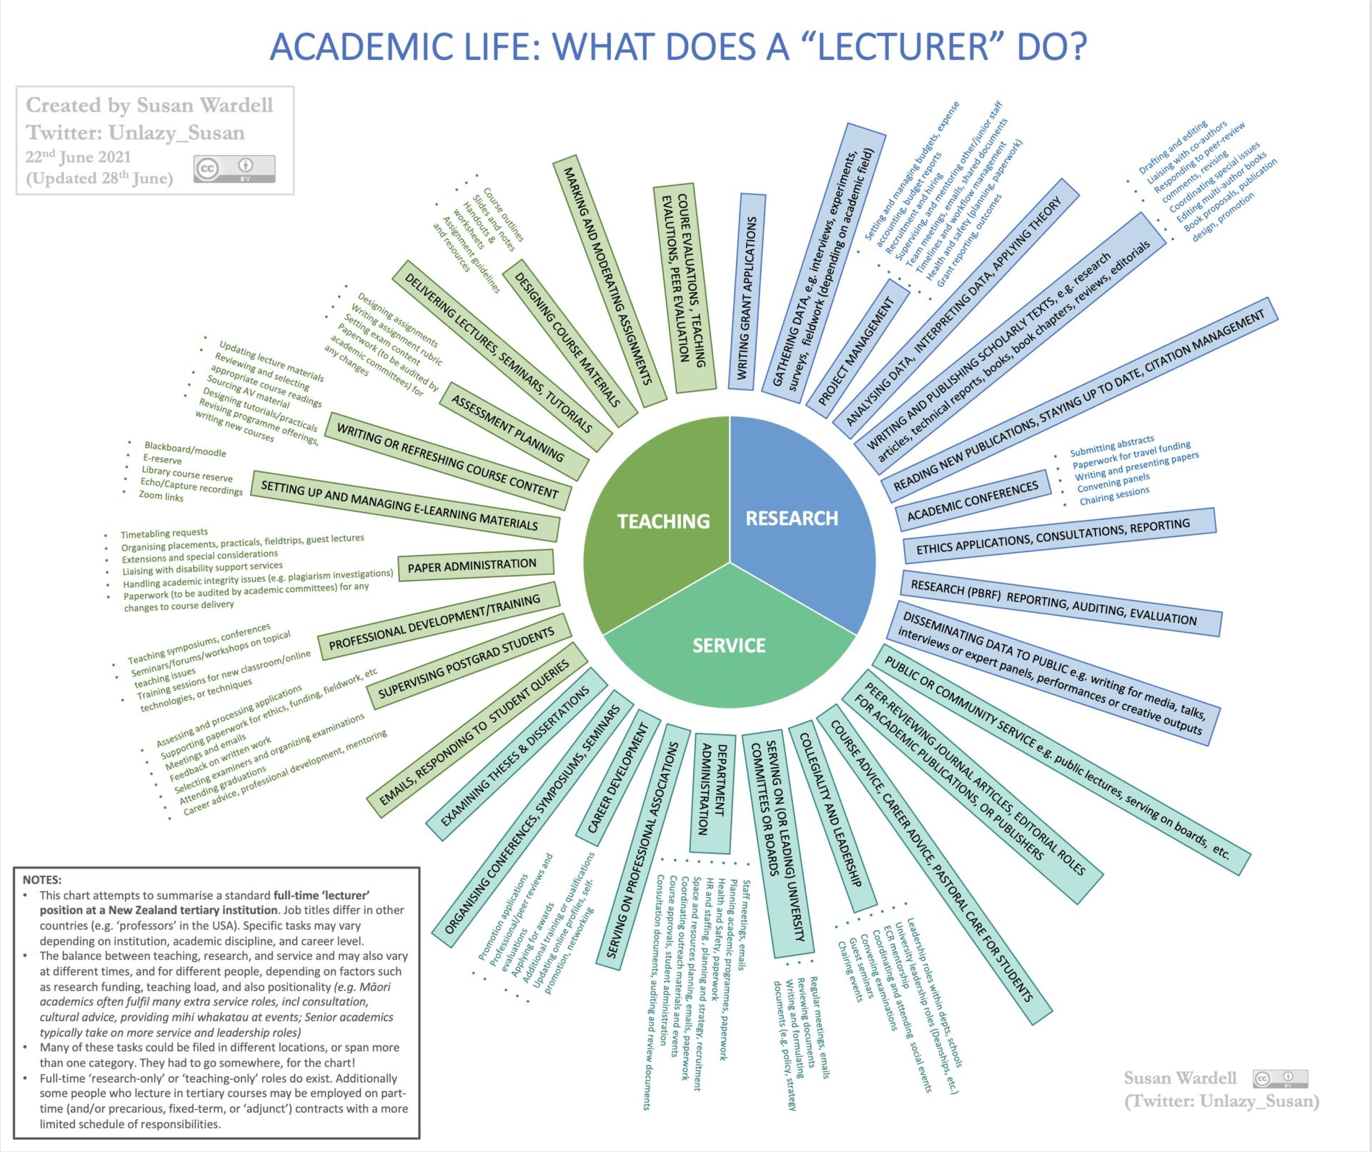
What does a professor do?

Slide 13
Let‘s get going:
What is Research?
What is a famous study you have heard of?

Slide 14
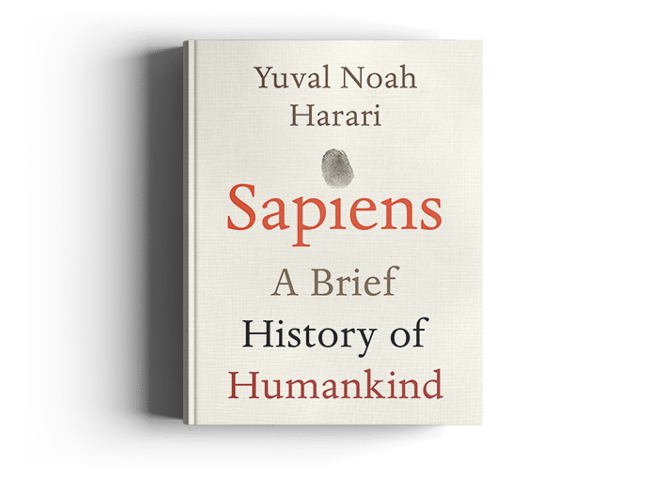
The Scientific Revolution: Mankind realizes they do not know everything.
The willingness to admit ignorance. Science assumes that we don’t know everything. Even more critically, it accepts that the things that we think we know could be proven wrong as we gain more knowledge. No concept, idea or theory is sacred and beyond challenge.
The centrality of observation. Having admitted ignorance, science aims to obtain new knowledge. It does so by gathering observations and then using formal tools such as logic or mathematics to connect these observations into comprehensive theories.
The acquisition of new powers. Science is not content with creating theories. It uses these theories in order to acquire new powers, and in particular to develop new technologies.

Slide 15
What are we researching in IS?
What is Information Systems research about?
Give some examples of IS research that you know of.

Slide 16
What are we researching in IS?
What is Information Systems research about?
Information Technology
Value
supports
enables
Change

Slide 17
Definition of IS research
The information systems research discipline is concerned with examining the development, use, and impact of digital information and communication technology.

Slide 18
Two key aspects of that definition (1)
A focus on digital technologies, that is, technologies that rely on digitisation, the encoding of analogue information into digital format (essentially, bits and bytes that contain 0s and 1s).
This makes IS research dynamic and fast-moving: these artefacts change all the time!

Slide 19
Two key aspects of that definition (2)
The study of development, use, and impacts is very broad and heterogenous:
What is development
What do we mean by use?
What could be impacts?
This makes IS research diverse and challenging: different theories and methods are needed to study all these aspects!

Slide 20
There are many ways of doing research on Information Systems
Scholars in information technology, software engineering, and computer science study the technical and computational attributes of digital technology as such.
Scholars in behavioural, cognitive, and psychological sciences study individuals’ exposure, use, appropriation, and general behaviours [within digital technology domains].
Scholars in organisational science, management, and business study how corporate environments shape, and are shaped by, digital technology.
Economists study the large-scale effects of digital technology diffusion and innovation on organisations, markets, and societies.

Slide 21



Which BBT Character are You?
Theoretical Scientist
  Mostly developing theory
  Example
    Seidel, Recker, Vom Brocke (2013): Sensemaking and Sustainable Practicing
    Developing an account for how sustainability initiatives evolve through the use of IS
Experimental Scientist
  Mostly evaluating theory
  Example:
    Recker et al. (2011): Do Ontological Deficiencies in Modeling Grammars Matter?
    Developing and empirically testing the consequences of ontological characteristics of certain attributes on behaviours
Engineer
  Applies theory in the design of artefacts
  Example
    Recker, J. (2021). Improving the State-Tracking Ability of Corona Dashboards
    Using state-tracking theory for identify principles for making Corona Dashboards more effective

Slide 22
What/who is an Example for…
Sheldon in IS?
Leonard in IS?
Wolowitz in IS?

Slide 23
Types of research
Conceptual research
  is concerned with an analysis of a problem at hand without a commitment to any (technologically-driven) solutions
Formal research
  Is concerned with describing concepts in mathematical terms (so as to remove any potential ambiguity with respect to their interpretation) and presenting theorems with corresponding proofs to provide more insight into these concepts

Slide 24
Types of research
Technological research
  Is concerned with the development of sophisticated software artifacts to prove that certain ideas can indeed be realized and to reason about the comparative strengths and weaknesses of various architectural approaches
  E.g., Workflow Systems (YAWL) or Process Mining (Celonis)
Experimental research
  typically addresses a limited set of properties of a phenomenon (e.g., a property of a technology or person, or a method), and examine these properties in controlled settings
  E.g., experiments in medicine or physics

Slide 25
Types of research
Empirical research
  sets off to study phenomena in real-life practice, and to build or confirm theories about how the phenomena came to be about.
  can be based on case studies, surveys, action research, grounded theory, or other methods.
  E.g., Technology Acceptance, Success factor models

Slide 26

What impacts are we studying - does IS research matter?
The “knowledge” a business school sells is “vulgar” and “stupid,” that business ethics and corporate social responsibility are mere “window dressing,” a “fig leaf to cover the conscience of B-school deans,” and that the business school will most likely be the “most ostentatious building” on a university campus.
Parker […] claims that business schools are essentially “places that teach people how to get money out of the pockets of ordinary people and keep it for themselves. In some senses, that’s a description of capitalism, but there is also a sense here that business schools actually teach that ‘greed is good.’”
https://poetsandquants.com/2018/04/30/another-cheap-shot-at-the-value-of-an-mba/

Slide 27
Motivation
During a visit to the London School of Economics at the height of the financial crisis, the Queen of England asked a simple question, “Why did academic economists fail to foresee the crisis?”
Richard T. Watson, Introductory Statement at the Green IS panel at ICIS 2012.

Slide 28
Motivation
Imagine if the Queen were to visit a highly reputable Information Systems department, she might start with the following simple question. “How is information systems different from computer science?”
Richard T. Watson, Introductory Statement at the Green IS panel at ICIS 2012.

Slide 29
Motivation
Our IS colleague gives an answer his grandmother might understand: “Computer scientists study how to make computers work better, whereas in Information Systems we study how to make organizations work better.”
Richard T. Watson, Introductory Statement at the Green IS panel at ICIS 2012.

Slide 30
Motivation
The Queen, thinking she understood the answer, continued, “Did Information Systems academics help build the Web, e-commerce, social media, and all those iproducts that Apple makes?”
Richard T. Watson, Introductory Statement at the Green IS panel at ICIS 2012.

Slide 31
Motivation
At this point, the Dean volunteers to answer, hoping it will advance his chances of a knighthood, “My Information Systems department doesn’t build things, it builds theories,” he proudly proclaims.
Richard T. Watson, Introductory Statement at the Green IS panel at ICIS 2012.

Slide 32
Motivation
Like the economists,” states the Queen.
Richard T. Watson, Introductory Statement at the Green IS panel at ICIS 2012.

Slide 33

What are significant challenges?

Slide 34
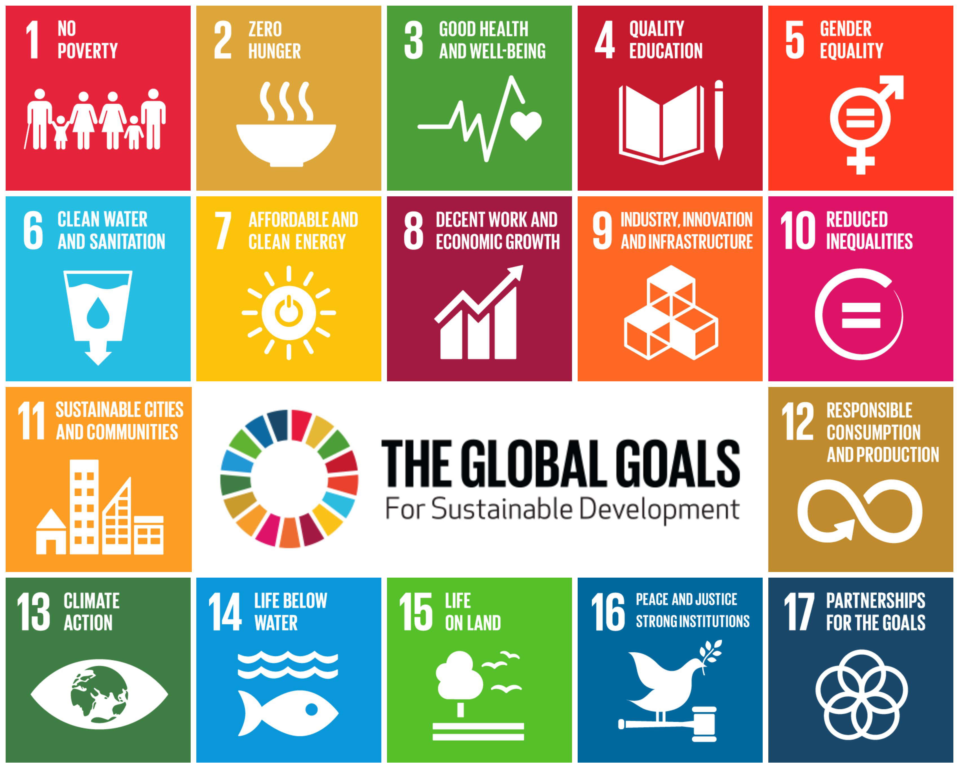
What are significant challenges?
https://www.youtube.com/watch?v=DdLqiTvFwJk&list=PLKR0pDgsbqtVRIh6B-yzrELEtnRE6UI5M

Slide 35
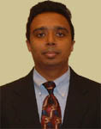
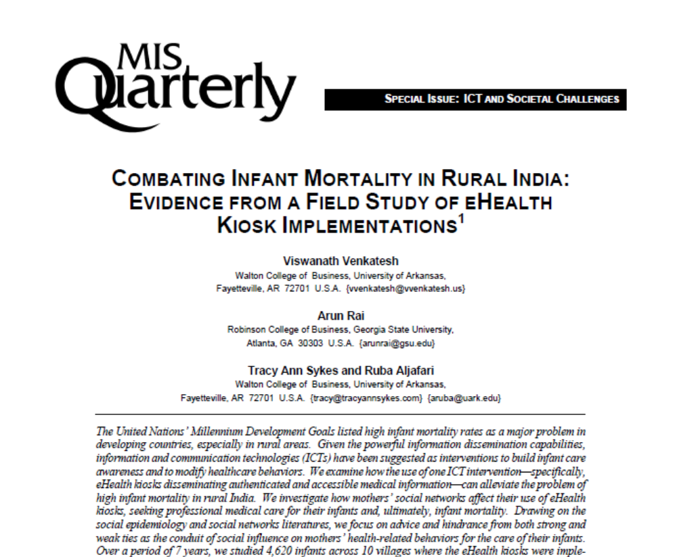
Some Examples
Venkatesh, V., Rai, A., Sykes, T. A., & Aljafari, R. (2016). Combating Infant Mortality in Rural India: Evidence from a Field Study of eHealth Kiosk Implementations. MIS Quarterly, 40(2), 353-380.

Slide 36

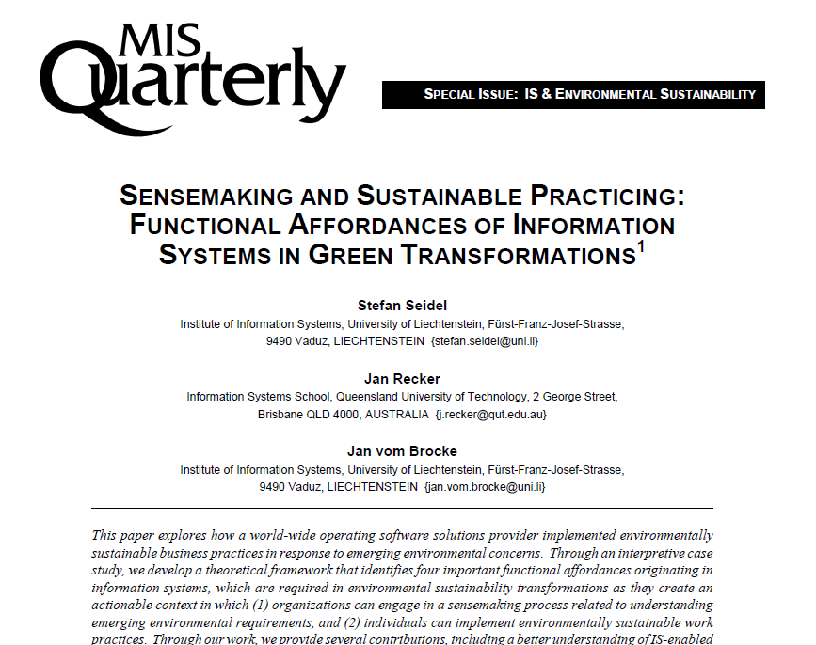
Some Examples
Seidel, S., Recker, J., & vom Brocke, J. (2013). Sensemaking and Sustainable Practicing: Functional Affordances of Information Systems in Green Transformations. MIS Quarterly, 37(4), 1275-1299.

Slide 37
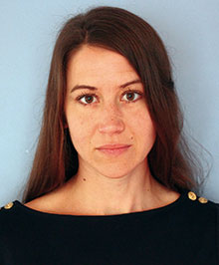
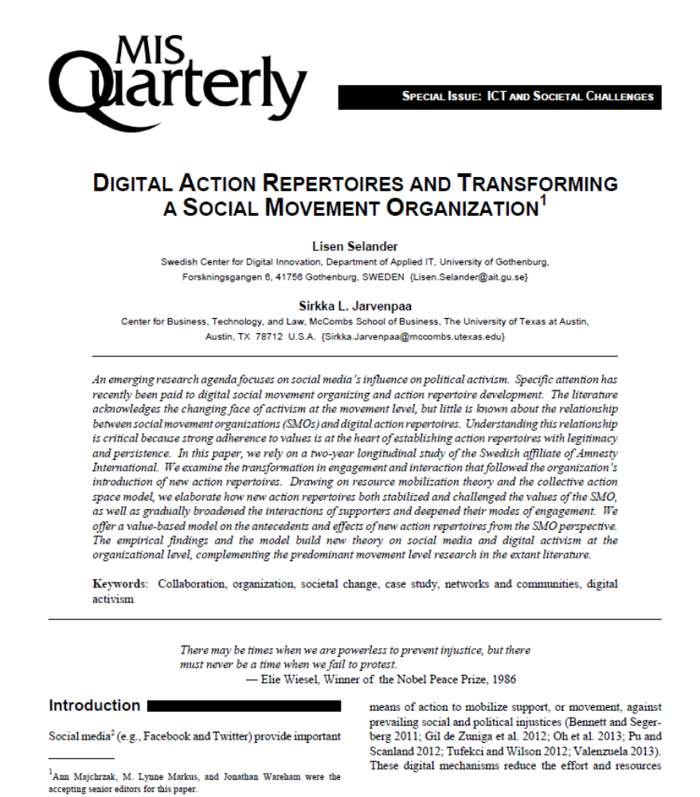
Some Examples
Selander, L., & Jarvenpaa, S. L. (2016). Digital Action Repertoires and Transforming a Social Movement Organization. MIS Quarterly, 40(2), 331-352.

Slide 38
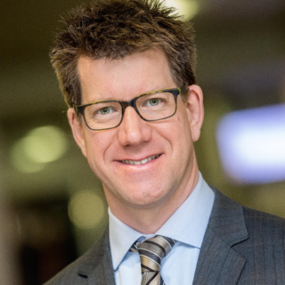
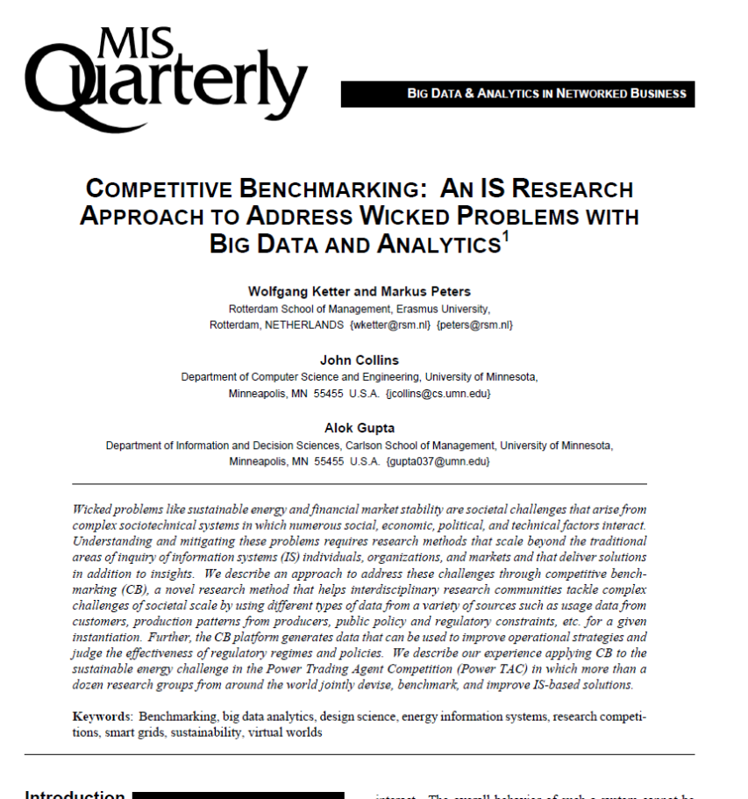
Some Examples
Ketter, W., Peters, M., Collins, J., & Gupta, A. (2016). Competitive Benchmarking: An IS Research Approach to Address Wicked Problems with Big Data and Analytics. MIS Quarterly, 40(4), 1057-1080.
https://www.youtube.com/watch?v=jVpqlyzZyf8

Slide 39
What do you need to do when you pursue research in your studies?
Demonstrate your ability to conduct research and scholarship that make a unique contribution and meet the standards of credibility and verifiability
Example: PhD
  “The Doctor of Philosophy degree is awarded in recognition of a student's erudition in a broad field of learning and for notable accomplishment in that field through an original and substantial contribution to [the body of] knowledge.”
From the QUT Doctor of Philosophy Regulations (IF49)

Slide 40
How do you know you are not on the right track?
Common misleading views on what research is about:
  The great idea
  “I have just had this great idea! I do not know if anyone else has ever had the same idea, because I’ve not checked, and I’m rather new in this field. Anyway, my idea is brilliant, so I really would like to share it with you all.”

Slide 41
How do you know you are not on the right track?
Common misleading views on what research is about:
  Other people’s idea
  “I have just read this great book that I really like a lot. I’ll just give you a short resume of the interesting points in the book and apply it to this situation over here.”

Slide 42
How do you know you are not on the right track?
Common misleading views on what research is about:
  The software hacker
  “I have just built this great computer system/software tool/mobile application. It is not based on previous theories or empirical findings. I am not very theoretical myself, but the system has a lot of fantastic features, and the interface is neat. Plus, people could really use it.”

Slide 43
How do you know you are not on the right track?
Common misleading views on what research is about:
  The theory hacker
  “I have come up with this theory/conceptual framework/model/methodology. It is not related to other theories/conceptual frameworks/models, or any empirical data for that matter. Most of the concepts have been defined differently by all the big shots in the field, but I just do not like their categories so I have invented my own. And I think it is surely better (I haven’t checked that either).”

Slide 44
What matters to research?
Ambition
  The ambition to complete a doctoral degree to enter (or progress) an academic career is different from the ambition to pursue a research degree as recognition of thought leadership for industry or corporate careers.
  What is your ambition?
Dedication
  The enthusiasm that you need to work on a novel and intrinsically complex challenge for a substantial amount of time
  Are you dedicated?
Commitment
  The willingness to free time and resources to work dedicatedly on the research
  Are you free to commit yourself?

Slide 45
Research is a challenging task
Fewer than 65 percent of people who start PhD programs finish them (Bowen, W. and N. Rudenstine. 1992). More recent data paints a similar picture: Attrition in residential doctoral programs is as high as 50 percent in face-to-face programs (de Vise, 2010) and 50–70 percent in online programs (Rigler Jr. et al., 2017). In Germany, attrition rates are said to be about 15 percent of doctoral students in social science disciplines and about 25 percent in engineering disciplines (Franz, 2015).
Ten percent of doctoral students claim to have considered suicide, and 54 percent of doctoral students have felt so depressed at various stages that they had difficulty functioning (OnlinePhDPrograms.Net).
In one study, 43 percent of participating graduate students reported experiencing more stress than they could handle, with PhD students expressing the greatest stress. More than half listed stress or burnout as a major concern, about a quarter cited feeling like outsiders, and nearly a third listed their relationships withprofessors as a cause of stress (Patterson, 2016).
Why is that?

Slide 46
Instead of taking in more knowledge, you have to create knowledge
Most common reason is that students do not understand the formal cause of earning a research degree.
  Elementary school is like learning to ride a tricycle.
  High school is like learning to ride a bicycle.
  College is like learning to drive a car.
  A master’s degree is like learning to drive a race car.
  Students often think that the next step (a research degree) is more of the same, like learning to fly an airplane.
  On the contrary, a research degree (like a PhD) is like learning to design a new car.

Slide 47
How do you create new knowledge?
The body of knowledge is the current accumulation of theories, evidence and methods in a certain domain (e.g. medicine, management, education etc).
Typically consists of theories that have been evidenced – i.e., not falsified (yet).
Also consists of methods that have been used to evidence or falsify theories.
Sometimes can be innovative and important new evidence.
Is available in the scientific community in the form of paper, articles and books.

Slide 48
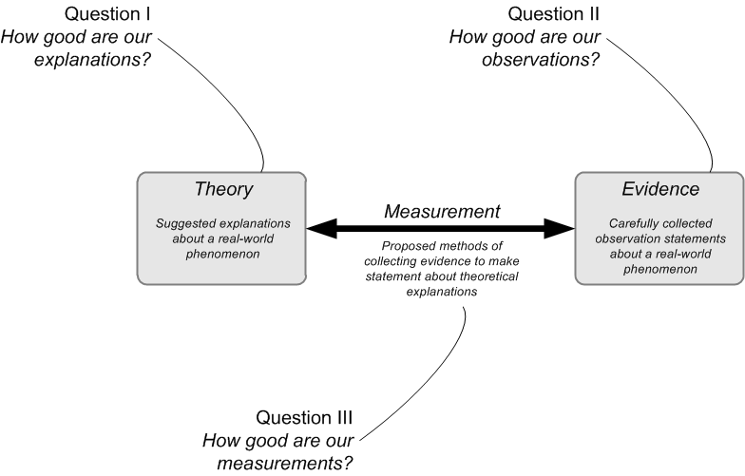
What is the body ofknowledge?

Slide 49
Examples for IS research that address questions I, II or III
From my own work
  Question 1:
    Seidel, S., Recker, J., and vom Brocke, J. "Sensemaking and Sustainable Practicing: Functional Affordances of Information Systems in Green Transformations", MIS Quarterly (37:4) 2013, pp. 1275-1299.
  Question 2:
    Recker, J. and Lekse, D. "A Field Study of Spatial Preferences in Enterprise Microblogging", Journal of Information Technology (31) 2016.
  Question 3:
    Schmiedel, T., vom Brocke, J., and Recker, J. "Development and Validation of an Instrument to Measure Organizational Cultures’ Support of Business Process Management", Information & Management (51:1) 2014, pp. 43-56.

Slide 50

Example Question 2:
Implementing Enterprise Social Networks at Woolworths Group
Recker, J., & Lekse, D. (2016). A field study of spatial preferences in enterprise microblogging. Journal of Information Technology, 31(2), 115-129.

Slide 51
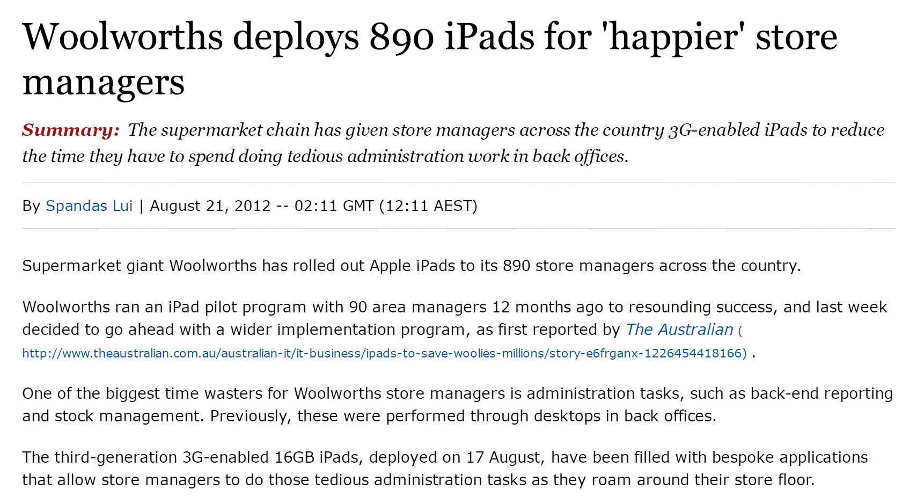
Implementing Enterprise Social Networks at Woolworths Group

Slide 52

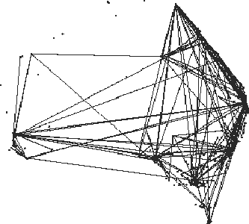

Slide 53
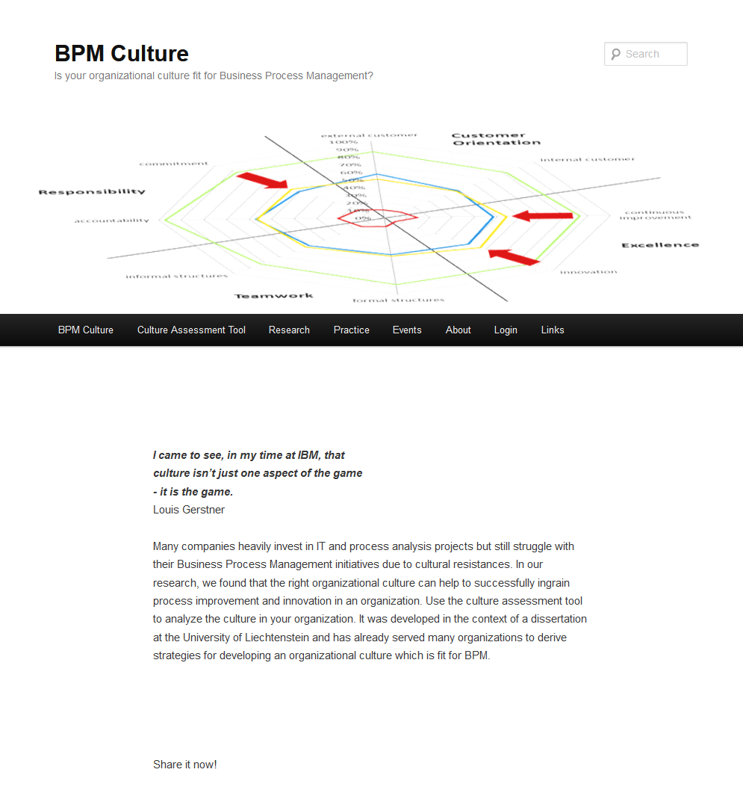
Example Question 3:
http://www.bpm-culture.org
Can we measure whether an organization’s culture is ready for Business Process Management?
Schmiedel, T., vom Brocke, J., & Recker, J. (2014). Development and Validation of an Instrument to Measure Organizational Cultures’ Support of Business Process Management. Information & Management, 51(1), 43-56.

Slide 54
Example Question 3:
The following four cultural values and their subdimensions are critical to the success of BPM initiatives:
Customer Orientation
To what extent does the organization take the perspective of external customers?
To what extent does the organization take the perspective of internal customers?
Excellence
To what extent is the organization open for continuous process improvement?
To what extent is the organization open for process innovations?
Responsibility
To what extent does the organization foster accountability to process objectives?
To what extent does the organization foster commitment to process objectives?
Teamwork
To what extent do formal structures support cross-departmental teamwork?
To what extent do informal structures support cross-departmental teamwork?
Schmiedel, T., vom Brocke, J., & Recker, J. (2014). Development and Validation of an Instrument to Measure Organizational Cultures’ Support of Business Process Management. Information & Management, 51(1), 43-56.

Slide 55
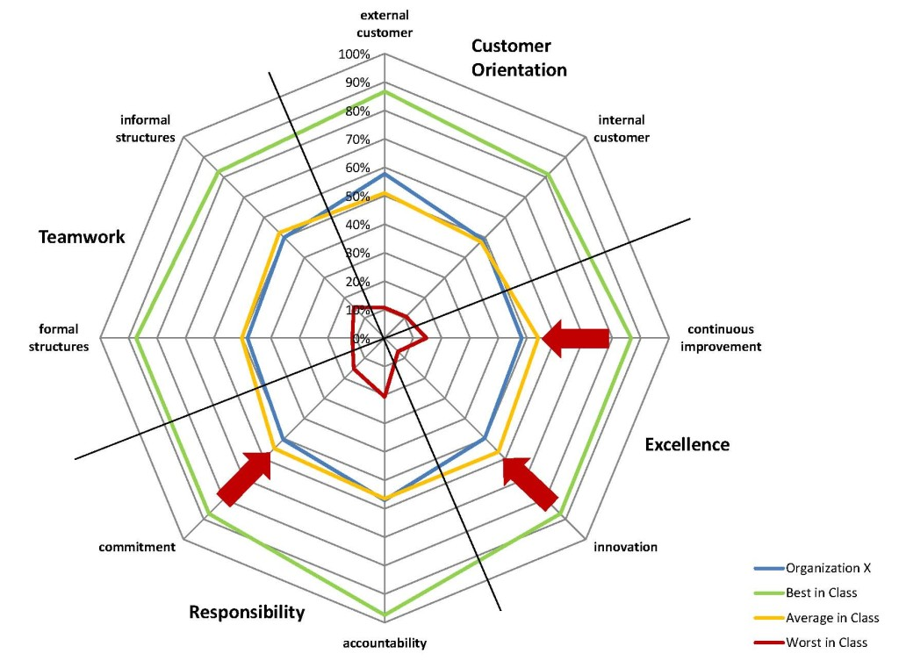
Example Question 3:
http://www.bpm-culture.org/limesurvey3/index.php/275895?newtest=Y&lang=en
Hilti
Ivoclar Vivadent
Landesbank Berlin
Lufthansa Technik
Oerlikon Balzers
Oerlikon Mechatronics
ThyssenKrupp Presta
Schmiedel, T., vom Brocke, J., & Recker, J. (2014). Development and Validation of an Instrument to Measure Organizational Cultures’ Support of Business Process Management. Information & Management, 51(1), 43-56.

Slide 56
What one can do with better measures
BPM Culture
Process performance
BPM Methods
Schmiedel, T., Recker, J., & vom Brocke, J. (2020). The Relation between BPM Culture, BPM Methods, and Process Performance: Evidence from Quantitative Field Studies. Information & Management, 57(2), 103175. https://doi.org/10.1016/j.im.2019.103175

Slide 57
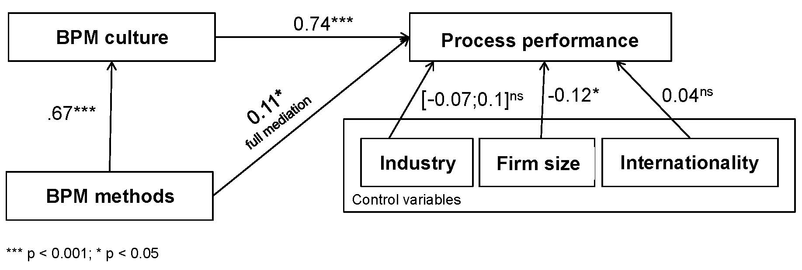
What one can do with better measures
Schmiedel, T., Recker, J., & vom Brocke, J. (2020). The Relation between BPM Culture, BPM Methods, and Process Performance: Evidence from Quantitative Field Studies. Information & Management, 57(2), 103175. https://doi.org/10.1016/j.im.2019.103175

Slide 58
End of Chapter 1
© Copyright 2021 Jan Recker. All Rights Reserved.

Slide 59
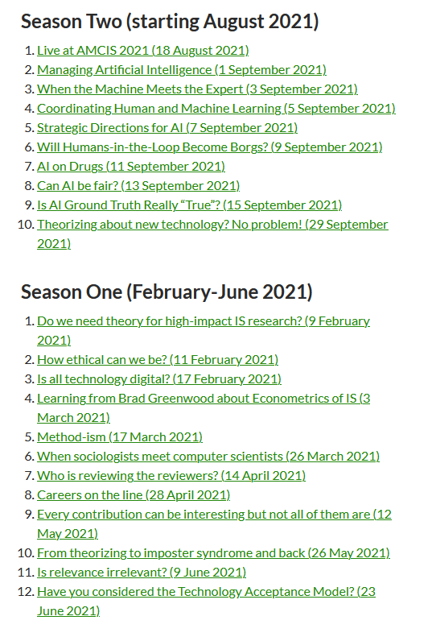

Do you like podcasts?

