Slide 1
Scientific Research in Information Systems: A Beginner’s Guide (2nd edition)
Teaching Materials
Created by Professor Jan Recker

Slide 2
Copyright Notice & Citation
© Copyright 2021 Jan Recker. All Rights Reserved.
Recker, J. (2021): Scientific Research in Information Systems: A Beginner’s Guide.
2nd edition, Springer.
Available at Springer, Amazon, and other booksellers

Slide 3
Overview
Content
Part 1: Basic Principles of Research
Part 2: Conducting Research
Part 3: Publishing Research

Slide 4
Chapter 2:
Information Systems Research as a Science

Slide 5
What have we covered in the last session?
What is research?
What is information systems as a research field?
Why is research hard?

Slide 6
What do we cover in this session?
What are knowledge contributions we make through research?
What are principles of science?
How do we construct research questions worth pursuing?

Slide 7
How do you create new knowledge?
The body of knowledge is the current accumulation of theories, evidence and methods in a certain domain (e.g. medicine, management, education etc).
Typically consists of theories that have been evidenced – i.e., not falsified (yet).
Also consists of methods that have been used to evidence or falsify theories.
Sometimes can be innovative and important new evidence.
Is available in the scientific community in the form of paper, articles and books.

Slide 8
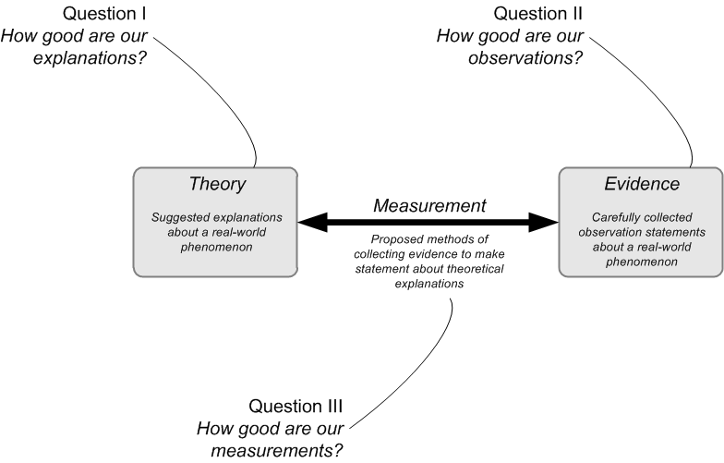
What is the body of knowledge?

Slide 9
Examples for IS research that address questions I, II or III
From my own work
  Question 1:
    Seidel, S., Recker, J., and vom Brocke, J. "Sensemaking and Sustainable Practicing: Functional Affordances of Information Systems in Green Transformations", MIS Quarterly (37:4) 2013, pp. 1275-1299.
  Question 2:
    Recker, J. and Lekse, D. "A Field Study of Spatial Preferences in Enterprise Microblogging", Journal of Information Technology (31) 2016.
  Question 3:
    Schmiedel, T., vom Brocke, J., and Recker, J. "Development and Validation of an Instrument to Measure Organizational Cultures’ Support of Business Process Management", Information & Management (51:1) 2014, pp. 43-56.

Slide 10

Example Question 2:
Implementing Enterprise Social Networks at Woolworths Group
Recker, J., & Lekse, D. (2016). A field study of spatial preferences in enterprise microblogging. Journal of Information Technology, 31(2), 115-129.

Slide 11
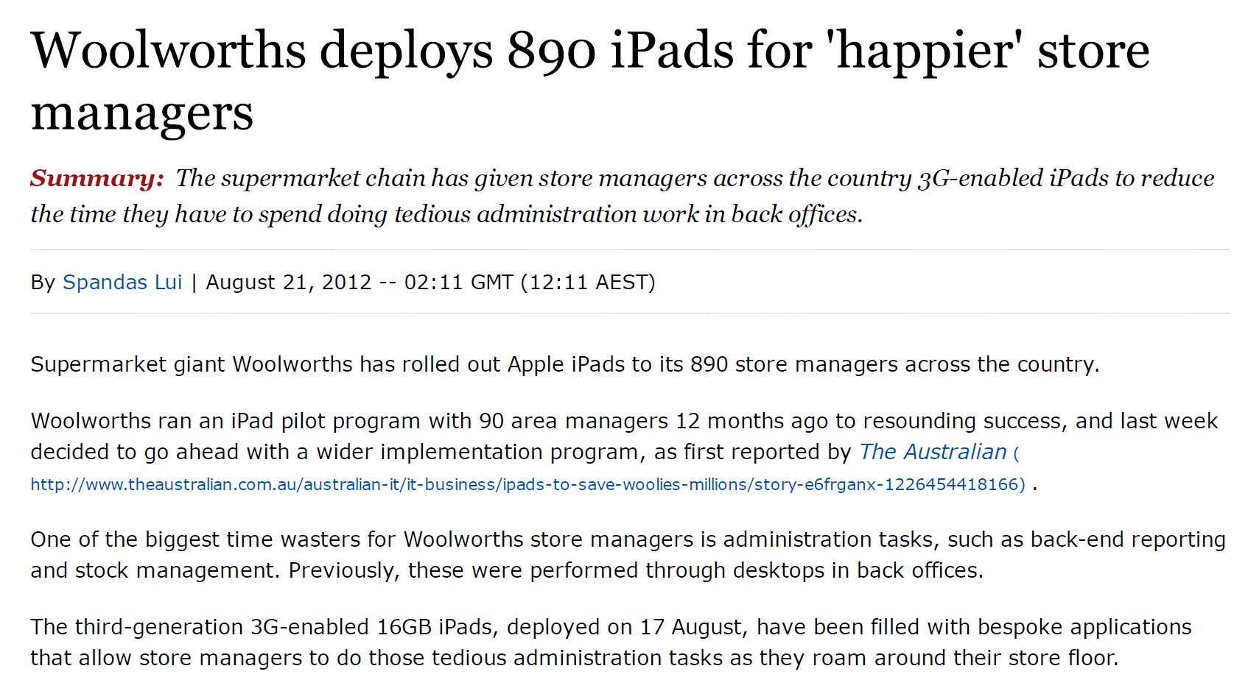
Implementing Enterprise Social Networks at Woolworths Group

Slide 12

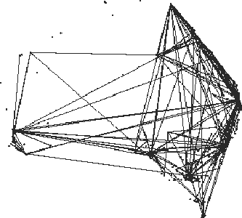

Slide 13
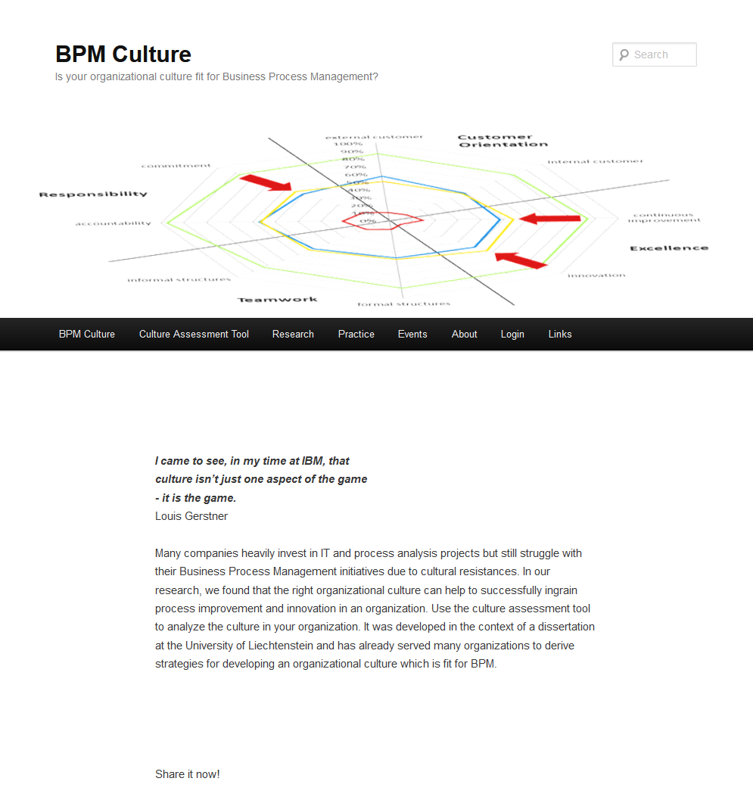
Example Question 3:
http://www.bpm-culture.org
Can we measure whether an organization’s culture is ready for Business Process Management?
Schmiedel, T., vom Brocke, J., & Recker, J. (2014). Development and Validation of an Instrument to Measure Organizational Cultures’ Support of Business Process Management. Information & Management, 51(1), 43-56.

Slide 14
Example Question 3:
The following four cultural values and their subdimensions are critical to the success of BPM initiatives:
Customer Orientation
To what extent does the organization take the perspective of external customers?
To what extent does the organization take the perspective of internal customers?
Excellence
To what extent is the organization open for continuous process improvement?
To what extent is the organization open for process innovations?
Responsibility
To what extent does the organization foster accountability to process objectives?
To what extent does the organization foster commitment to process objectives?
Teamwork
To what extent do formal structures support cross-departmental teamwork?
To what extent do informal structures support cross-departmental teamwork?
Schmiedel, T., vom Brocke, J., & Recker, J. (2014). Development and Validation of an Instrument to Measure Organizational Cultures’ Support of Business Process Management. Information & Management, 51(1), 43-56.

Slide 15
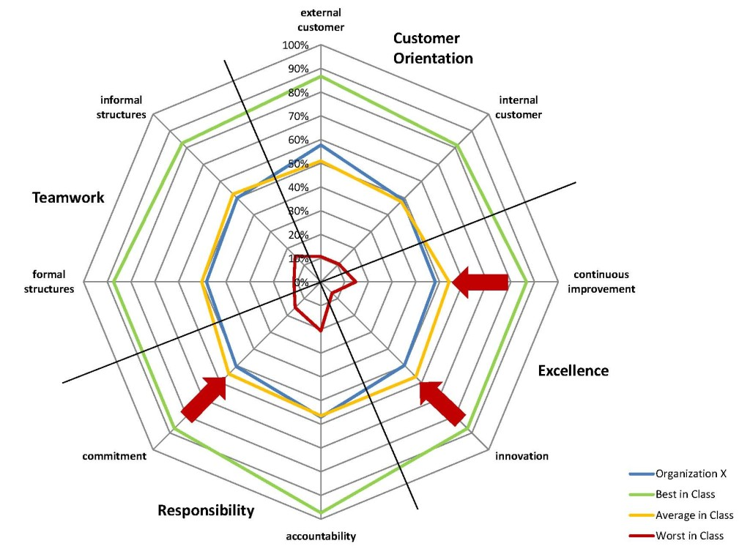
Example Question 3:
http://www.bpm-culture.org/limesurvey3/index.php/275895?newtest=Y&lang=en
Hilti
Ivoclar Vivadent
Landesbank Berlin
Lufthansa Technik
Oerlikon Balzers
Oerlikon Mechatronics
ThyssenKrupp Presta
Schmiedel, T., vom Brocke, J., & Recker, J. (2014). Development and Validation of an Instrument to Measure Organizational Cultures’ Support of Business Process Management. Information & Management, 51(1), 43-56.

Slide 16
What one can do with better measures
BPM Culture
Process performance
BPM Methods
Schmiedel, T., Recker, J., & vom Brocke, J. (2020). The Relation between BPM Culture, BPM Methods, and Process Performance: Evidence from Quantitative Field Studies. Information & Management, 57(2), 103175. https://doi.org/10.1016/j.im.2019.103175

Slide 17
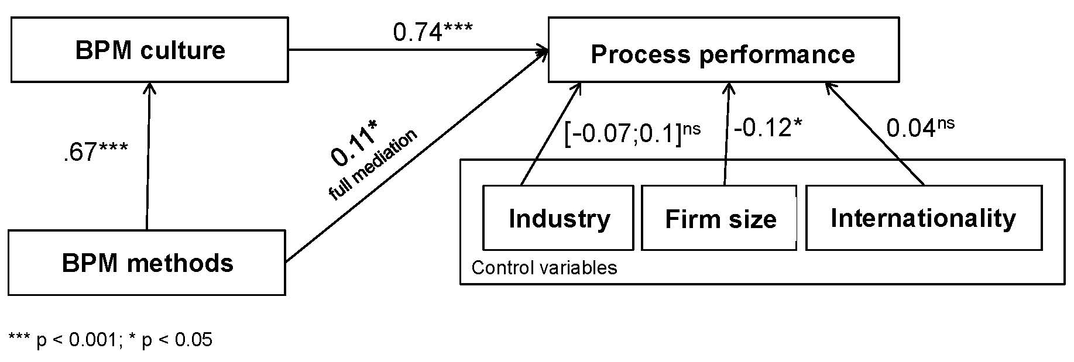
What one can do with better measures
Schmiedel, T., Recker, J., & vom Brocke, J. (2020). The Relation between BPM Culture, BPM Methods, and Process Performance: Evidence from Quantitative Field Studies. Information & Management, 57(2), 103175. https://doi.org/10.1016/j.im.2019.103175

Slide 18

Doing IS Research “Scientifically”
Let’s start with understanding the vocabulary

Slide 19
What is Science
  “the intellectual and practical activity encompassing the systematic study of the structure and behavior of the physical and natural world through observation and experiment.”
The goal of science is to discover laws and propose theories that can explain [natural or social, tangential or latent] phenomena in the worlds that concern us.
  Mostly real worlds but also imaginary, virtual or perceived worlds.
Scientific inquiry attempts to provide principles that govern the research process and allow you to distinguish science from other forms of research.

Slide 20
What is Science
  What is important to realize:
    Science is both a product and a process
      Product: the body of knowledge
      Process: doing things scientifically
    It is exciting (science = discovery of new)
    It is ongoing (science = never finished)

Slide 21
Information Systems Research as a Science is a product.
IS research is a social science
  involves people, and the relationships between them and other things (in particular IT artefacts)
  studies “IT in (social) use”: individuals, groups, organizations, networks, communities, societies
  invariably includes measurement error
    Phenomena as well as measurements are often vague, imprecise, non-deterministic, and ambiguous.
  is open to methodological and paradigmatic pluralism:
    quantitative and qualitative
    positivist and interpretive
    Descriptive, explanatory, predictive, and prescriptive

Slide 22
Information Systems Research as a Science is a product.
Science is ongoing:
All scientific knowledge is a set of suggestions.
  Describes the current accumulation of what we know, what we can measure, what we purport to explain.
Examples:
  Is the earth flat? Is it round?
  Is Pluto a planet?

Slide 23
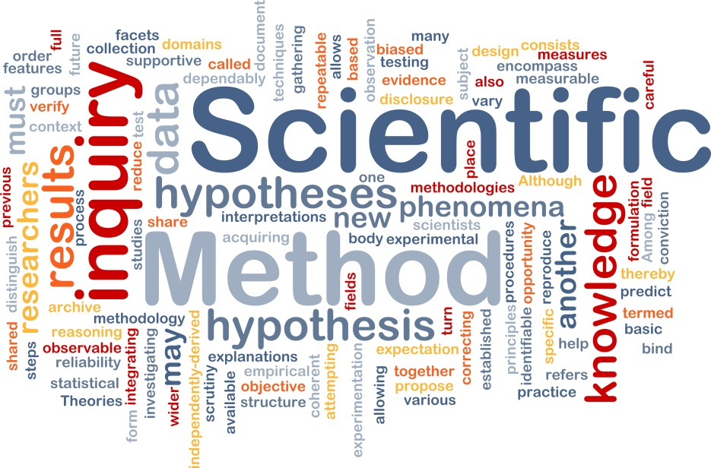
Information Systems Research as a Science is a process.
How do we do science?
Scientists have developed a pattern for doing science. This pattern relies on systematically testing to see if what we think about the universe, is in fact, real.
What are the characteristics of these patterns/the ‘scientific way of doing things’?

Slide 24
What are principles of science?
Replicability
  the procedures by which research outputs are created should be conducted and documented in a manner that allows others outside the research team to independently repeat the procedures and obtain similar, if not identical, results.
Where is this of relevance? Do we know famous examples?

Slide 25
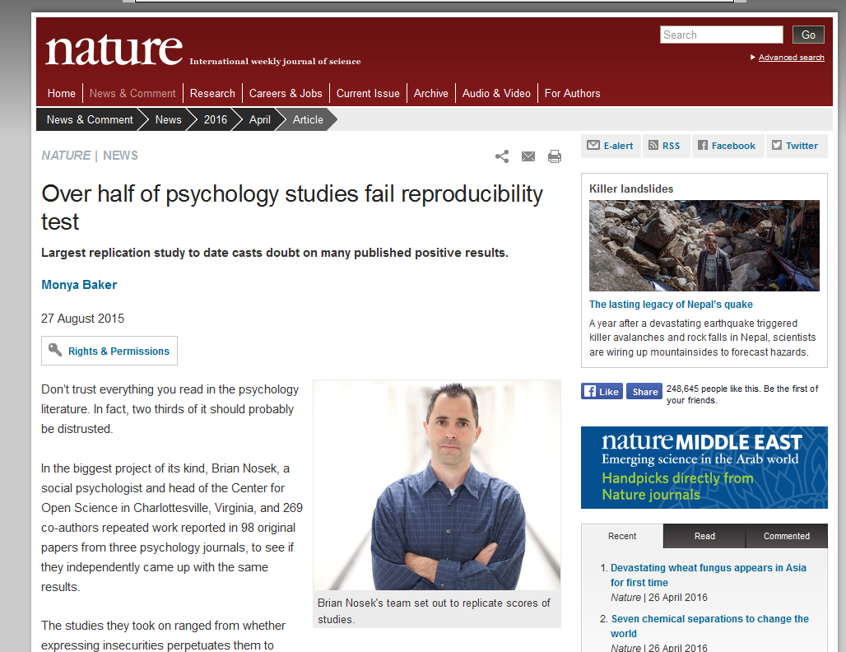
Replicability
http://www.nature.com/news/over-half-of-psychology-studies-fail-reproducibility-test-1.18248

Slide 26
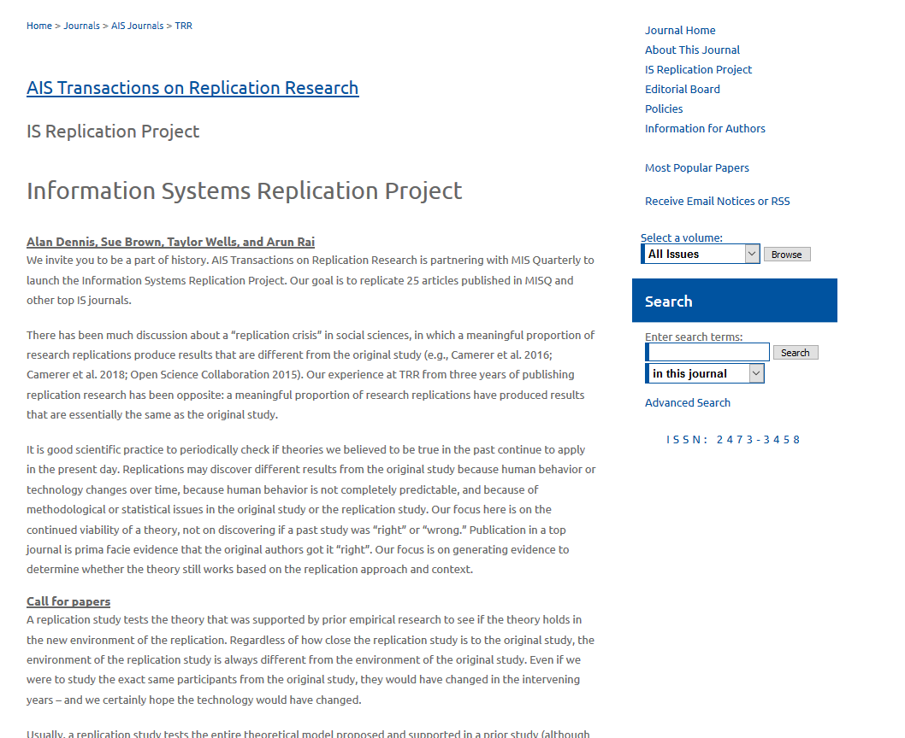
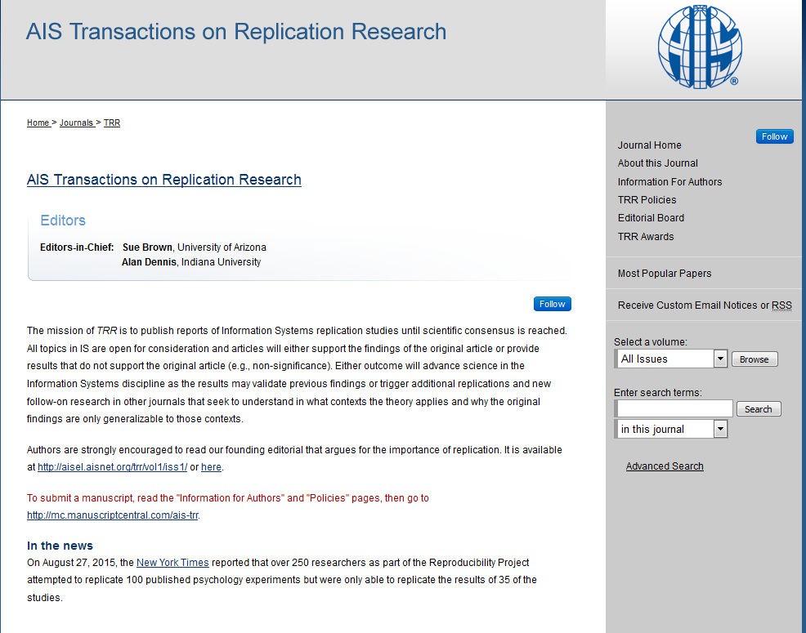
Replicability in IS
http://aisel.aisnet.org/trr/

Slide 27
What are principles of science?
Independence
  concerns the extent to which the research conduct is impartial and freed from any subjective judgment or other bias stemming from the researcher or research team itself.
Where is this of relevance? Do we know famous examples?

Slide 28

Independence Example: Research or Consulting?

Slide 29

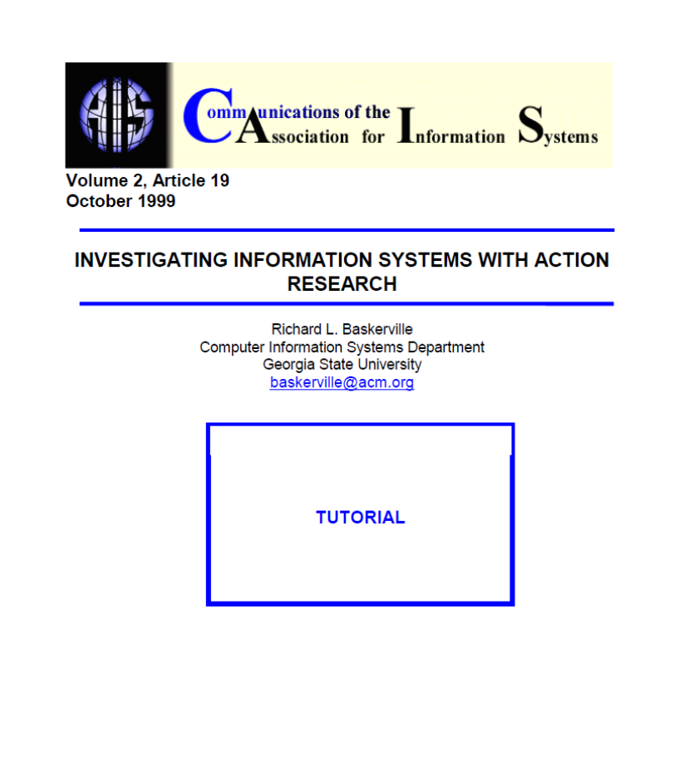
Independence in IS

Slide 30
What are principles of science?
Precision
  in all scientific research the concepts, constructs, and measurements should be as carefully and precisely defined as possible to allow others to use, apply, and challenge the definitions, concepts, and results in their own work.
Where is this of relevance? Do we know famous examples?

Slide 31

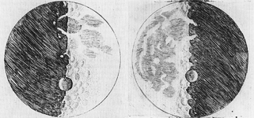
Precision: Example

Slide 32


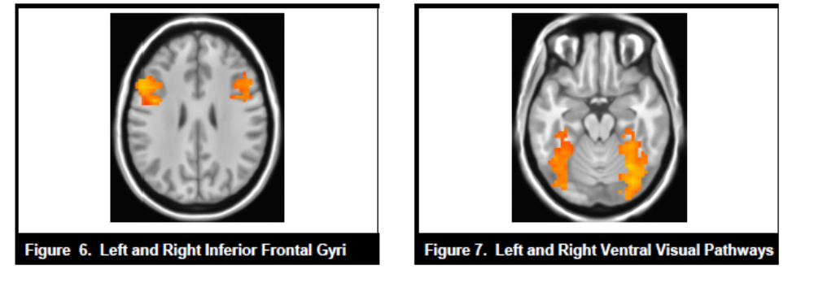
Precision in IS

Slide 33
What are principles of science?
Falsification
  describes the logical possibility than an assertion, hypothesis, or theory can be contradicted by an observation or other outcome of a scientific study or experiment.
Where is this of relevance? Do we know famous examples?

Slide 34
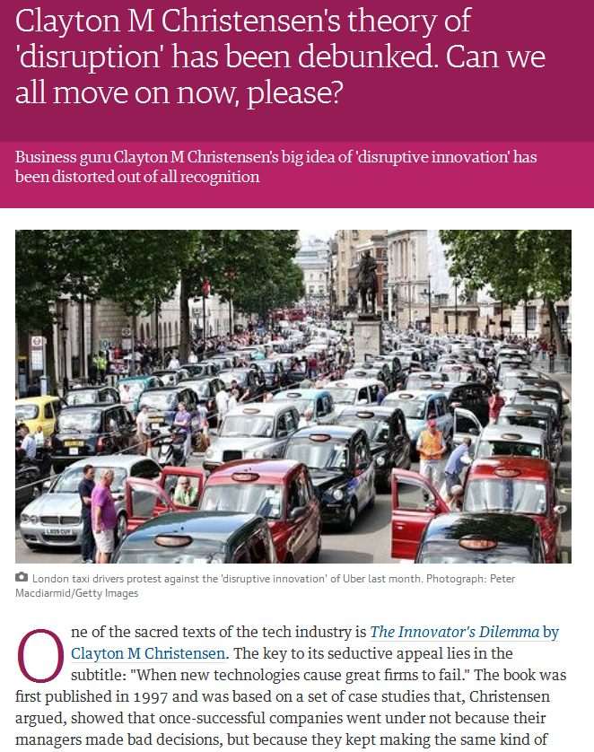
Falsification: Examples
Religion: “God’s love is incomprehensible”
Rain Dance Ceremony: “if you are pure of heart and you do the rain dance ceremony correctly, it will rain tomorrow”
Disruptive Innovation

Slide 35
Research Questions

Slide 36
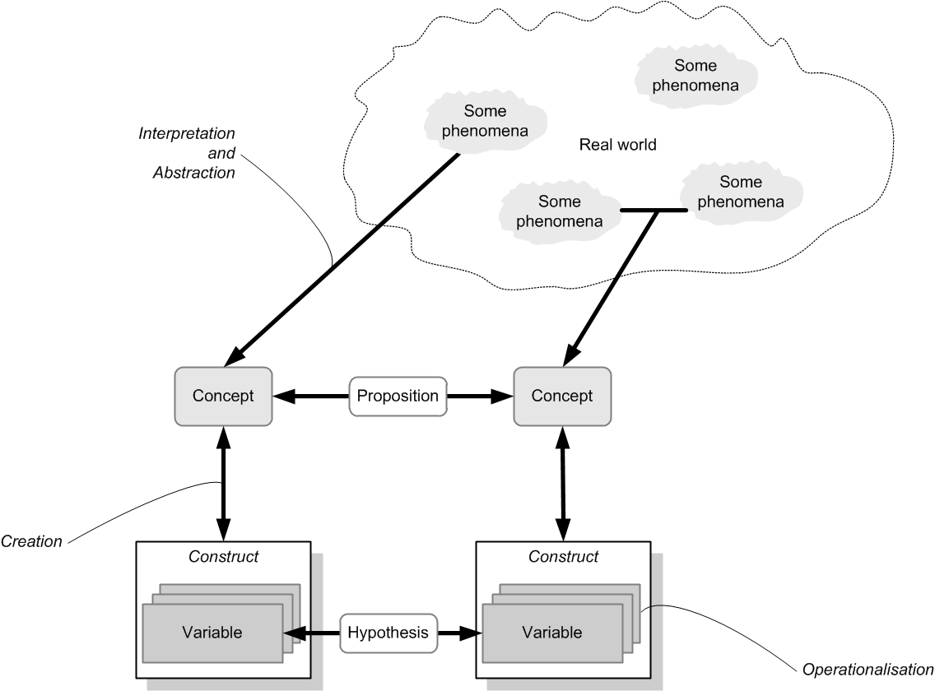
Relevant research terminology

Slide 37
Basic Notions
Conceptualization
  Is the mental process by which fuzzy and imprecise concepts are their constituent components are defined in precise terms.
    E.g., what does prejudice actually mean to you? Are there different kinds of prejudice (e.g. race, gender, age, religion)?
  Important process in the social sciences because of the imprecision and ambiguity of many concepts
    What is satisfaction?
    What is empathy?
    Is there a difference between empathy and compassion?

Slide 38
Basic Notions
Concept
  describes an abstract or general idea inferred or derived from specific instances that we perceive in the real world. Concepts are thus mental representations that we develop, typically based on experience.
  can be of real phenomena (dogs, clouds, pain) as well as of some latent phenomena that we can agree upon (truth, beauty, prejudice, usefulness, value, and so forth).
  give us a vocabulary to reason about some real-world phenomena and a means to ascribe characteristics or properties to those phenomena and their relationships.
  can be linked to one another via propositions

Slide 39
Basic Notions
Propositions
  link concepts to one another
  suggested tentative or conjectured relationships between two or more concepts that are stated in a declarative manner
  Typically linked via some justificatory mechanism → then we are talking theorizing!

Slide 40

What are Research Questions
I believe that the choice of research problem – choosing the phenomena we wish to explain or predict – is the most important decision we make as a researcher. We can learn research method. Albeit with greater difficulty, we can also learn theory-building skills. With some tutoring and experience, we can also learn to carve out large numbers of problems that we might research. Unfortunately, teasing out deep, substantive research problems is another matter. It remains a dark art.
Ron Weber, former EIC MIS Quarterly (2003)

Slide 41
Research questions
- Common Problems
The “elevator speech” problem: You cannot tell me which question you are asking unless you engage in a 5-min monologue. At that time I will have left the elevator.

Slide 42
Research questions
- Common Problems
The “so what” problem: You have a research question, but it simply doesn’t matter to anyone. Research in an applied discipline such as information systems “apply” knowledge to practical problems (for instance, how new technology shapes the work practices of employees).

Slide 43
Research questions
- Common Problems
The “solving-the-world” problem: Your research question is indeed important. But it simply cannot be answered given the resource constraints – it’s basically only you, and/or the time constraints – you have around 2–3 years, depending on the regulations prescribed by your institution, and typically you don’t know enough yet to find the solution quickly.

Slide 44
Research questions
- Common Problems
The “insolvability” problem: Your question simply cannot be answered meaningfully. Sometimes this is because of a logical problem in the question, because the information needed to answer the question cannot be logically or legally obtained, or because the answer is so hard to obtain that feasibility of the research within the constraints is not possible.

Slide 45
Research questions
- Common Problems
The “multitude” problem: You are simply asking too many questions. In turn, most of your questions are too narrow, too irrelevant, too grand, or otherwise deficient. I always tell my students that a good study sets out to answer one question. Maybe two. Nothing is gained by setting out to answer six questions.

Slide 46
Research questions
- Types of “improper” research questions
Obvious questions: “Are there challenges in using information technology?”
  Of course there are. Obvious questions have answers to which everyone would agree.
Irrelevant questions: “What is the influence of weather on the salaries of technology professionals?”
  There is no reason to believe that there is any influence whatsoever.
Absurd questions: “Is the earth flat after all?”
  Absurd questions have answers to which everyone would disagree.
Definitional questions: “Is technology conflict characterized by disagreement?”
  That is simply a matter of creating a concept that says it does. Definition is a mere form of description, not research.
Affirmation questions: “Can a decision-support tool be developed to facilitate decision-making for senior retail executives?”
  I sure hope so. There is no reason to believe that it cannot be done.

Slide 47
Research questions
- Important elements
Asking a research question is the logical, necessary, and inevitable conclusion to a set of arguments.
These arguments stress that there is
  an important problem domain with
  an important phenomenon that deserves attention from the research community and that relates to
  an important problem with the available knowledge about this type of phenomenon.

Slide 48
Example
Organizations invest heavily in new information technology, seeking benefits from these investments.
Many of these benefits never materialize because employees do not use the technologies.
The literature to date has only studied why individuals accept new technologies but not explicitly why individuals reject technologies. This is a problem.
Therefore: “Why do people reject new information technology?”
Centefelli RT, Schwarz A (2011) Identifying and testing the inhibitors of technology usage intentions. Inf Syst Res 22(4):808---823.

Slide 49
Motivating a Research Question:
- The Gap vs the Hook
The Gap is usually the argument that something hasn’t been done yet.
  This is weak because some things shouldn’t be done.
The Hook is a strategy to find a problem that someone cares about
  Can be academic, theoretical, practical…
Grant, A.M., and Pollock, T.G. "Publishing in AMJ—Part 3: Setting the Hook " Academy of Management Journal (54:5) 2011, pp 873-879.

Slide 50
Good Hook versus Bad Gap
Bad Gap:
  “nobody has studied…”
  “the literature is silent on…”
Good Gap = Problem:
  Resolve a contradiction in the literature
  Extending the literature to account for specific, important phenomena / understandings / contexts (and why)
  Solve a puzzle for practice that is important but not addressed by the literature
  Show how existing literature may mislead our thinking
  Challenge assumptions we take for granted and develop alternatives.
Remember: You are part of a conversation in the field

Slide 51

Gap-Spotting versus Problematization
Example for gap-spotting:
  As the Covid-19 pandemic spread across the globe in 2020, at the beginning we had very little knowledge about the virus, its infection rates, and its possible cures or vaccinations. The problem was a gap of knowledge.
Sandberg, J., & Alvesson, M. (2011). Ways of Constructing Research Questions: Gap-spotting or Problematization? Organization, 18(1), 23-44.

Slide 52
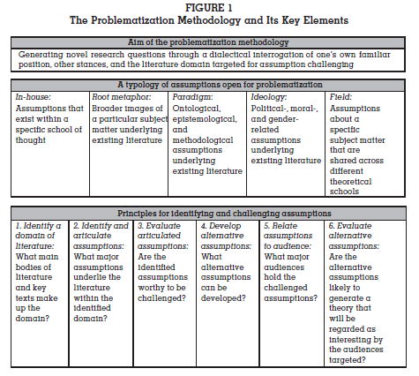
Gap-Spotting versus Problematization
A “gap” in knowledge is a typical problem with the available knowledge, but it is not necessarily the best or only problem.
Other problems are
  Inconsistent observations
  Competing theoretical explanations
  Outdated or false assumptions
Alvesson, M., and Sandberg, J. "Generating Research Questions Through Problematization," Academy of Management Review (36:2) 2011, pp 247-271.

Slide 53
Specification of a research question
Research questions are typically one of two types based on the issues they address:
“What,” “who,” and “where” questions tend to focus on issues we seek to explore or describe because little knowledge exists about them.
“How” and “why” questions are explanatory as they seek to answer questions about the causal mechanisms that are at work in a particular phenomenon.

Slide 54
Type-1 questions
Type 1 questions seek to learn what the situation of a phenomenon looks like. We ask these questions about phenomena that are new to the world.
Example:
At the onset of the Covid-19 pandemic, the world realised that there was a new virus. The first step was then to find out everything about it: what it looks like, what it does, what its genetic structure is, where it occurs, who can be infected by it, and so forth.

Slide 55
Type-2 questions
Type 2 questions seek to explain the cause and effect mechanisms behind why and how something works.
Example:
we wanted to find out how the Covid- 19 virus infects people so we could devise treatments and vaccinations that hinder the mechanism by which the virus infects people.
Type 2 questions often temporally succeed type 1 questions as it is difficult to explain a phenomenon without first systematically exploring and describing it.

Slide 56
Principles to reflect on why a RQ is justified:
Feasible: Adequate subjects of study are available, technical expertise is available, time and money are available, and the scope is manageable.
Interesting: You are confident that you can maintain an interest in the topic and maintain your own motivation to study it for several years. If you are not interested in pursuing the answer to the question, no one will be interested in hearing about the results.
Novel: An answer to the question will confirm or refute previous findings or provide new findings.
Ethical: Pursuing and answering the question will not violate ethical principles for the conduct of research, and will not put the safety of the investigators or subjects at risk.
Relevant: both the question and the future answer(s) are important in the sense that they inform scientific knowledge, industry practice, and future research directions.

Slide 57
End of Chapter 2
© Copyright 2021 Jan Recker. All Rights Reserved.

