Slide 1
Scientific Research in Information Systems: A Beginner’s Guide (2nd edition)
Teaching Materials
Created by Professor Jan Recker

Slide 2
Copyright Notice & Citation
© Copyright 2021 Jan Recker. All Rights Reserved.
Recker, J. (2021): Scientific Research in Information Systems: A Beginner’s Guide.
2nd edition, Springer.
Available at Springer, Amazon, and other booksellers

Slide 3
Overview
Content
Part 1: Basic Principles of Research
Part 2: Conducting Research
Part 3: Publishing Research

Slide 4
Chapter 3:
Planning your Research

Slide 5
What have we covered last time?
What are general principles of science?
  Independence
  Replicability
  Precision
  Falsification
How do we construct research questions worth pursuing?
  Motivation, Specification, Justification
  Type-1 and type-2 questions
  Gap-spotting and problematization

Slide 6
What do we cover today?
Research Design
  Induction, Deduction, Abduction
  Exploration, Rationalization, Validation
  Research Design Choices
  Research Methodology
  The Role of Literature in Research Design

Slide 7


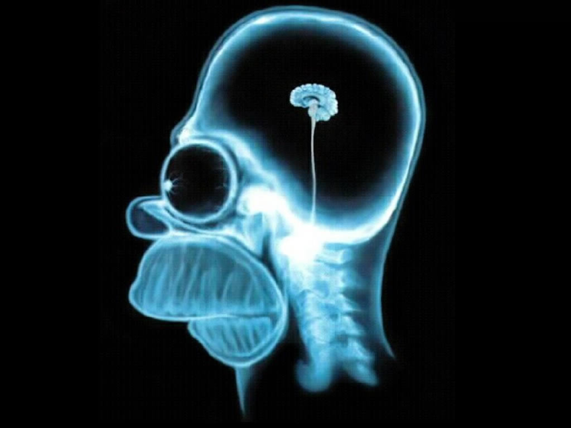
Research Design – WarmUp Example

Slide 8
A Simple Example – or not?
How do we define smart?
How do we define job satisfaction?
What do we measure?
Where/how do we measure?
How do we plan to collect and analyse any data?

Slide 9
Research Design - Overview
Once your research question is well specified, the next challenge is to craft a plan of action to answer the question and test your theory about its answer.
That is what we call a research design.
A research design is the blueprint for the collection, measurement, and analysis of data.
  Typically requires a combination of reasoning skills such as induction, deduction, and abduction.
  Typically also involves different research strategies such as exploration, rationalization, and validation.

Slide 10
Induction vs Deduction (vs Abduction)
Induction
  A form of logical reasoning that involves inferring a general conclusion from a set of specific facts or observations.
  allows tentative hypotheses and propositions to be formulated that declare general conclusions or theories. used to infer theoretical concepts and patterns from observed data or known facts to generate new knowledge by proceeding from particulars to generals.
  Example:
    Every life form we know of depends on liquid water to exist.
    Therefore: All life, including that we don’t know of, depends on liquid water to exist.
  Problems:
    Inductive arguments cannot be proven or justified, only supported or not supported.
    Inductive arguments can be weak or strong. The induction “I always hang pictures on nails. Therefore: All pictures hang from nails” is an example of a weak induction because the observation is too limited to lead to such a broad generalisation.
  Verdict:
    an accepted and often useful pathway for constructing explanations or hypotheses because conclusions are offered based on educated predictions: “I studied phenomenon X in Y number of cases and I have always found the particular relationship or phenomena Z to be at work. Hence, the evidence collected in my observation leads me to formulate the tentative proposition that Z is related to X in this or that way.”

Slide 11
Induction vs Deduction (vs Abduction)
Deduction
  a form of logical reasoning that involves deriving arguments as logical consequences of a set of more general premises. It involves deducing a conclusion from a general premise (i.e., a known theory), to a specific instance (i.e., an observation).
  commonly used to predict the results of hypotheses or propositions, an approach to science called the hypothetico-deductive model: a hypothesis is treated as a premise, and from it some not obvious conclusions are logically derived, tested, and revised if necessary.
  an attempt to test concepts and patterns known from theory using new empirical data
  Example:
    All men are mortal.
    Socrates is a man.
    Therefore, Socrates is mortal.
  Problems:
    Deductive soundness and validity: we can deduce logically sound but if the premise is incorrect, the deduction becomes invalid: “Only quarterbacks eat steak. John eats steak. Therefore, John is a quarterback.”
  Verdict:
    Induction and deduction both play an important role in many scientific processes, from setting up a plan to collect data to the intellectual challenges of developing new theory. However, neither is sufficient or complete.

Slide 12
Induction vs Deduction (vs Abduction)
Abduction
  the process of making sense of an observation by drawing inferences about the best possible explanation.
  not a process of inference or deduction but a trial-and-error search for a satisfactory explanation for an observed consequence after the fact.
  also called a form of educated or informed guessing.
  involves a creative process rather than a logical process
  Verdict:
    Abduction is an operation geared toward the discovery of entirely new ideas (e.g., a new theory) rather than a mode of justification (through deduction) or formal inference (through induction).

Slide 13
Induction vs Deduction vs Abduction
Form of reasoning | Example
Induction | Observation: These beans are from this bag. Reasoning: These beans are white. Conclusion: All the beans from this bag are white.
Deduction | Premise: All the beans in this bag are white. Observation: These beans are from this bag. Conclusion: These beans are white.
Abduction | Rule: All the beans from this bag are white. Observation: These beans are white and near the bag. Conclusion: These beans are probably from this bag.

Slide 14
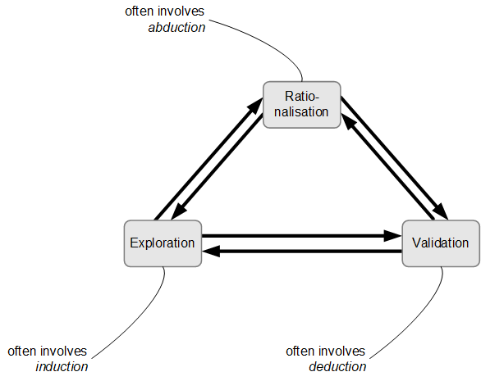
Why these distinctions matter.
Good research involves strategies for exploration, rationalization, and validation
Different research methods can be used as a tool to support inductive, deductive, or abductive reasoning.

Slide 15
Why these distinctions matter.
Exploration
  The systematic discovery of things or phenomena encountered in common experience.
Rationalisation
  Making sense of the puzzle or problem that interests us.
Validation
  Subjecting an emergent or existing theory to rigorous examination and testing.

Slide 16
Research Design - Example
The emphasis of any one study can be on either end (1,2,4) or in combination (e.g., 3). Often, only so-called research programs (combinations of multiple studies) can achieve all (5).
The choice of emphasis is influenced by
  Maturity of the field
  Accepted methods
  Availability of evidence
  Research interests
2
5
3
1
4

Slide 17
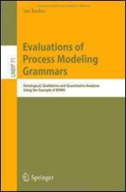
Research Design - Example
My PhD: A research program on ontological evaluation of process modelling grammars
Research elements
  Recker, J. "Opportunities and Constraints: The Current Struggle with BPMN," Business Process Management Journal (16:1) 2010, pp 181-201.
  Recker, J., Rosemann, M., Indulska, M., and Green, P. "Business Process Modeling: A Comparative Analysis," Journal of the Association for Information Systems (10:4) 2009, pp 333-363.
  Recker, J., Indulska, M., Rosemann, M., and Green, P. "The Ontological Deficiencies of Process Modeling in Practice," European Journal of Information Systems (19:5) 2010, pp 501-525.
  Recker, J., Rosemann, M., Green, P., and Indulska, M. "Do Ontological Deficiencies in Modeling Grammars Matter?," MIS Quarterly (35:1) 2011, pp 57-79.
  Recker, J. Evaluations of Process Modeling Grammars: Ontological, Qualitative and Quantitative Analyses Using the Example of BPMN Springer, Berlin, Germany, 2011.

Slide 18
Choosing a Research Design

Slide 19
How do we choose?
Spectrum | One end of Continuum |  | Other End of Continuum
Aim | Exploratory | vs. | Explanatory
Method | Qualitative | vs. | Quantitative
Boundary | Case | vs. | Statistical
Setting | Field | vs. | Laboratory
Timing | Cross-sectional | vs. | Longitudinal
Outcome | Descriptive | vs. | Causal
Ambition | Analysing | vs. | Designing
The key benchmark against which your research design must be aligned is the problem
statement as specified in the research question(s), so the research design must
match logically the research question, not the other way around. It dictates, for example, whether a more qualitative, explorative inquiry is warranted or a more quantitative, statistical one.

Slide 20
Research Design Considerations
Data:
  What type of data is required? What type of data might be available?
  Where can I collect observations or other forms of evidence?
  How will I sample the relevant data?

Slide 21
Research Design Considerations
Risks:
  What are the potential dangers associated with execution of the research design? For example, what is the likelihood of a case organisation not being available for study anymore? What are strategies available to minimise or mitigate these risks?

Slide 22
Research Design Considerations
Theory:
  How much literature concerning the phenomena of interest is available?
  What are problems with the knowledge base? What findings have been produced to date that might have an impact on my work and influence choices in my research design?

Slide 23
Research Design Considerations
Feasibility:
  Can the research design be executed within the constraints associated with a study (e.g., the PhD program) such as time limitations, resource limitations, funding, experience, geographic boundaries, and others?
  Is guidance available to me to support me in the study?

Slide 24
Research Design Considerations
Instrumentation:
  How will my constructs of interest manifest in reality? How can they be measured?
  Will my construct operationalisation be appropriate given the choice of research methodology and set of data available?

Slide 25
Research Methodology
Describes the strategy of inquiry used to answer the research question(s).
Probably the most critical choice to be made in research design.
Specifies the procedures carried out in a research study.
Main Strategies of Inquiry:
  Quantitative methods
  Qualitative methods
  Design science methods
  Computational methods
  Mixed methods

Slide 26
1. Quantitative Methods
  Procedures that feature research methods such as experiments or surveys and which are characterized by an emphasis on quantitative data (think of these procedures as having a focus on “numbers”).
  approach phenomena through quantifiable evidence, and often rely on statistical analysis of many cases (or across intentionally designed treatments in an experiment) to create valid and reliable general claims.

Slide 27
Quantitative Methods - Overview
A set of methods and techniques to answer questions (e.g. about the interaction of humans and information technologies), with an emphasis on quantitative data
Quantitative data means that data is collected about quantities of something, and where numbers represent values and levels of constructs and concepts
We interpret such numbers as evidence of how a particular phenomenon works.

Slide 28
Quantitative Methods - Overview
Because of the focus of numbers, there is typically an association with statistics (the study of the collection, organization, analysis, and interpretation of data).
Ontologically, quantitative research is based on the idea that theories can be proposed that can be falsified by comparing theory to carefully collected empirical data.
Example: Einstein’s theory of relativity really became trusted when in 1919, Eddington’s eclipse observation showed that Einstein’s predictions were correct and Newton’s predictions incorrect.

Slide 29
Popular Quantitative Research Methods
Field experiment
Lab experiment
Simulation
Survey

Slide 30

Quantitative Methods - Exercise
We want to find out whether the blockage of Online Games on work computers has a noticeable positive effect on work performance.
Key questions:
  What are the constructs?
  What are appropriate measures?
  How do we design the study?
  How can we demonstrate
    Reliability?
    Validity??
    Causality???

Slide 31
2. Qualitative Methods
  Procedures that feature research methods such as case study, ethnography or phenomenology and which are characterized by an emphasis on qualitative data (think of these procedures as having a focus on “words”).
  emphasize understanding of phenomena through direct observation, communication with participants, or analysis of texts, and may stress contextual subjective accuracy over generality.

Slide 32
Qualitative Methods - Overview
are strategies of empirical inquiry that investigate phenomena within a real-life context.
are helpful especially when the boundaries between phenomena and context are not apparent, or when you want to study a particular phenomenon in depth.
are well suited for exploratory research where a phenomenon is not yet fully understood, not well researched, or still emerging.
are also ideal for studying social, cultural, or political aspects of a phenomenon.
stresses on the “why" and “how" of things rather than the “what," “where" and “when" of things. It involves detailed study of a small sample or group.

Slide 33
Examples
Alan Peshkin’s 1986 book God's Choice: The Total World of a Fundamentalist Christian School published by the University of Chicago Press
  Peshkin studies the culture of Bethany Baptist Academy by interviewing the students, parents, teachers, and members of the community, and spending eighteen months observing, to provide a comprehensive and in depth analysis of Christian schooling as an alternative to public education.
  Paskin's work represents qualitative research as it is an in-depth study using tools such as observations and unstructured interviews, without any assumptions or hypothesis, and aimed at securing descriptive or non-quantifiable data on Bethany Baptist Academy specifically, without attempting to generalize the findings to other schools.
Victor of Aveyron (https://en.wikipedia.org/wiki/Victor_of_Aveyron)
  broke new ground in the education of the developmentally delayed.

Slide 34
Quantitative “vs” Qualitative Research
 | Quantitative | Qualitative
Purpose | to explain & predict; to test, confirm and validate theory | to describe & explain; to explore and interpret; to generate theory
Research Process | focused; deals with known variables; uses established guidelines; static designs; context free; objective | holistic approach; unknown variables; flexible guidelines; 'emergent' design; context bound; subjective
Form of Reasoning | deductive - from general case (theory) to specific situations | inductive - from specific situation to general case
Nature of Findings | numerical data; statistics; formal and 'scientific' | narrative description; words and quotes; personal voice; literary style
Researcher Beliefs | there is at least some objective reality that can be measured | there are multiple, constructed realities that defy easy measurement or categorization
Research Literature | relatively large | relatively limited
Research Question | confirmatory or predictive | exploratory or interpretive
Research Skills | statistics and deductive reasoning, and able to write in a technical and scientific style | inductive reasoning, attentiveness to detail, and able to write in a more literary, narrative style

Slide 35
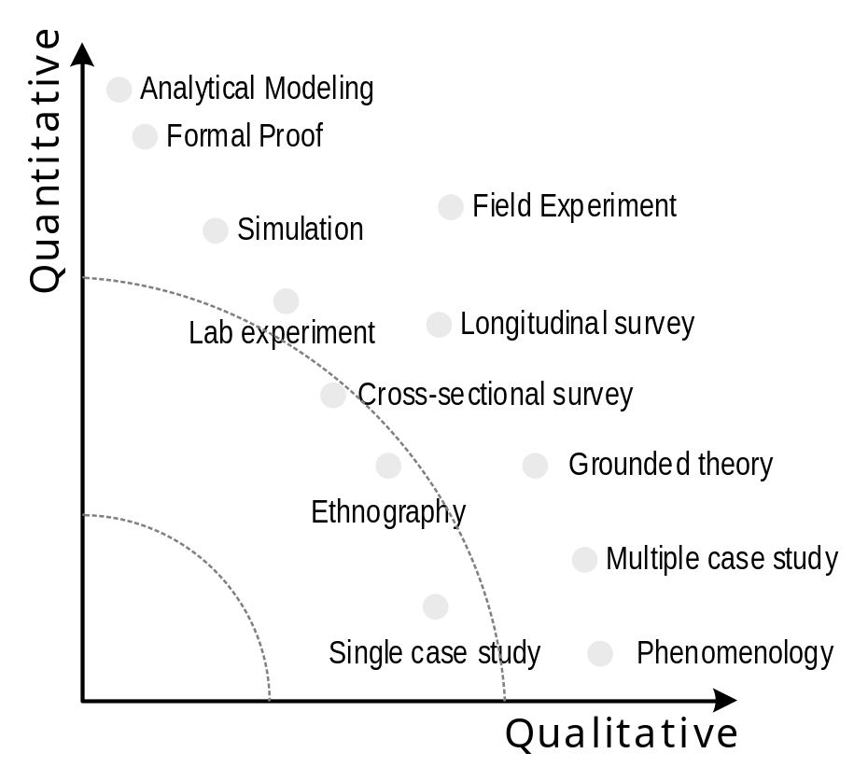
Qualitative “vs” Quantitative research is not a dichotomy

Slide 36
3. Design Science Methods
  Procedures that feature methods to build and evaluate novel and innovative artefacts (such as new models, methods or systems) as outcomes and which are characterized by an emphasis on the construction of the artefact and the demonstration of its utility (think of these procedures as having a focus on “artefacts”).
  a research paradigm in which a designer answers questions relevant to human problems via the creation of innovative artefacts, thereby contributing new knowledge to the body of scientific evidence. The designed artefacts are both useful and fundamental in understanding that problem.

Slide 37

The Artifact as Knowledge
Human-created, artificial objects.
In design science, the research interest is on creating or changing such artefacts with the aim of improving on existing solutions to problems or perhaps providing a first solution to a problem.
Different types of artefacts exist
  Constructs (vocabulary and symbols)
  Models (abstractions and representations)
  Methods (algorithms and practices)
  Instantiations (implemented and prototype systems)
  Design theories (improved models of design or design processes)

Slide 38
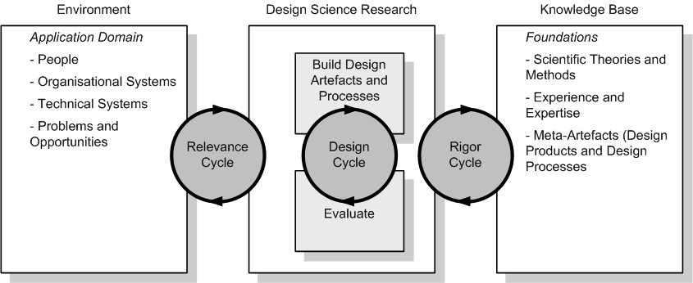
Design Science Methods - Overview
Hevner, A.R. "A Three Cycle View of Design Science Research", Scandinavian Journal of Information Systems (19:2) 2007, pp. 87-92.

Slide 39
4. Computational Methods
  Procedures that involve the use of digital software tools for research processes such as
    data generation or discovery,
    data processing or cleansing, and
    data analysis or interpretation.
  Rely on algorithms to support, augment, or automate manual research activities carried out on basis of digital trace data.

Slide 40
Digital trace data
Evidence of activities and events that are logged and stored digitally.
Example:
  Pentland et al. (2021) studied digital trace data in the form of the electronic medical records data of more than 57,000 patient visits to four dermatology clinics. They noticed in the data several sudden changes in record-keeping that occurred simultaneously in all four clinics. When they asked the clinical staffs to explain what had happened, they were unaware that anything had changed at all. Through the analysis of the digital trace data, Pentland et al. identified a change in policy and the advent of flu season as the two main drivers for the record-keeping process having changed.
Pentland, B. T., Vaast, E., & Ryan Wolf, J. (2021). Theorizing Process Dynamics with Directed Graphs: A Diachronic Analysis of Digital Trace Data. MIS Quarterly, 45(2), 967-984.

Slide 41
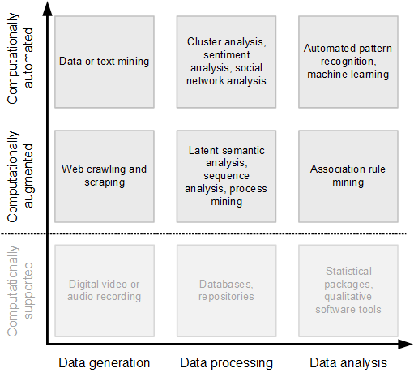
Computational research tools

Slide 42
Computational research tools
Augmentation tools: complement and amplify, rather than supplant, human activity.
Examples: Latent semantic analysis, web crawlers
Automation tools: carry out algorithmic data generation, processing, or analysis with little to no human intervention or oversight.
Examples: Text mining, social network analysis, sentiment analysis, pattern recognition

Slide 43
5. Mixed Methods
  Procedures that feature combinations of different methods in either sequential or concurrent fashion.
  Usually involve mixing of quantitative and qualitative strategies (think of these procedures as having a focus on “numbers and words”).
  More recently, also involves the mixing of design and qualitative/quantitative methods, or the mixing of different computational methods.

Slide 44
Purposes of Mixed Methods Research
Triangulation: establish convergence of and corroborate results from multiple methods and designs used to study the same phenomenon.
Complemetarity: elaboration, enhancement, illustration, and clarification of the results from one method with results from another method.
Initiation: finds paradoxes and contradictions in the study from one method that lead to a re-framing of the research questions using another method.
Development: using the finding from one study to inform the other method.
Expansion: widen the breadth and range of research by using different methods for different components of an inquiry.

Slide 45
Purposes of Mixed Methods Research
Triangulation: establish convergence of and corroborate results from multiple methods and designs used to study the same phenomenon.
Complemetarity: elaboration, enhancement, illustration, and clarification of the results from one method with results from another method.
Initiation: finds paradoxes and contradictions in the study from one method that lead to a re-framing of the research questions using another method.
Development: using the finding from one study to inform the other method.
Expansion: widen the breadth and range of research by using different methods for different components of an inquiry.
Venkatesh, V., Brown, S.A., and Bala, H. "Bridging the Qualitative-Quantitative Divide: Guidelines for Conducting Mixed Methods Research in Information Systems," MIS Quarterly (37:1) 2013, pp 21-54.

Slide 46
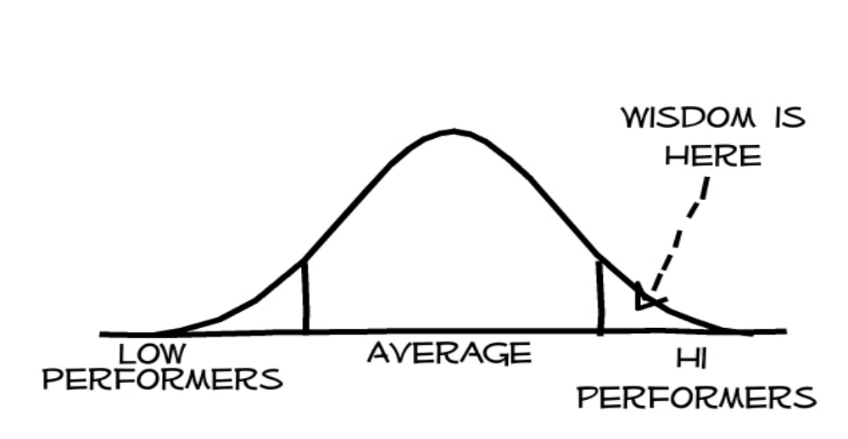
Example: Research on Positive Deviance

Slide 47

The origin of Positive Deviance: Stew!
Sociology and nutrition research in the 1960s found
  In any poor community, usually a few families, the Positive Deviants, manage to stay healthy, or raise healthy kids, despite their poverty.
  Examining their practices revealed a number of violations of “norms”.
    E.g., washing their hands more often,
    cooking food differently, consuming
    crops considered taboo
  Widespread adoption of these practices
  can result in large scale community
  change.

Slide 48





Research Setting

Slide 49
Mixed Method Design
Study of Positive Deviance, Management and Leadership
Involved qualitative exploration of 19 stores across Australia
Measurement development and theorizing through engagement with literature
Cross-sectional multi-level survey (managers and dept. managers)
Data Collection I
Data Analysis I
Inference I
Research questions I
QL
QL
QL
Meta-inference
Conversion
QN
Research questions II
QN
QN
QN
Data Collection II
Data Analysis II
Inference II

Slide 50
Sampling
Positive Deviants!
Sales
Customer penetration

Slide 51



Qualitative Conduct

Slide 52



Vignettes

Slide 53

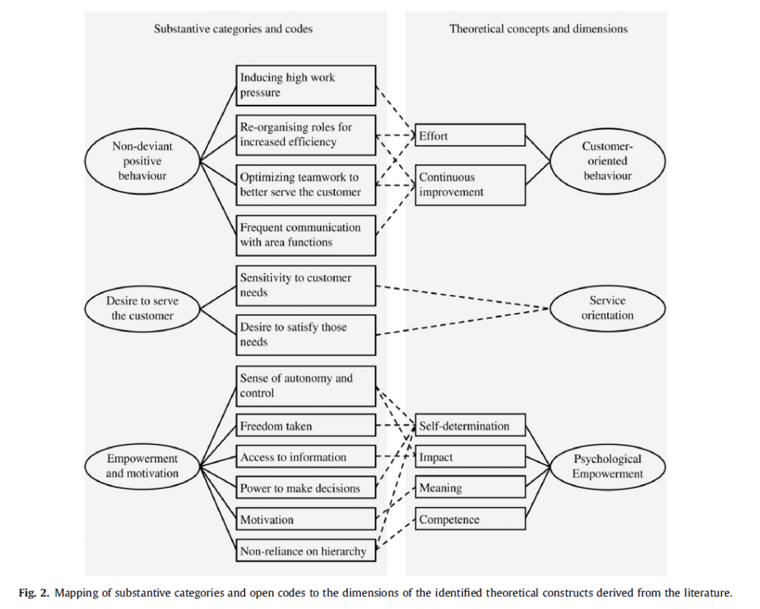
Mixed Method
Findings
Mertens, W., Recker, J., Kummer, T.-F., Kohlborn, T., Viaene, S. (2016): Constructive Deviance as a Driver for Performance in Retail. Journal of Retailing and Consumer Services, Vol. 30, pp. 193-203.

Slide 54
Choosing between the different methodological options

Slide 55
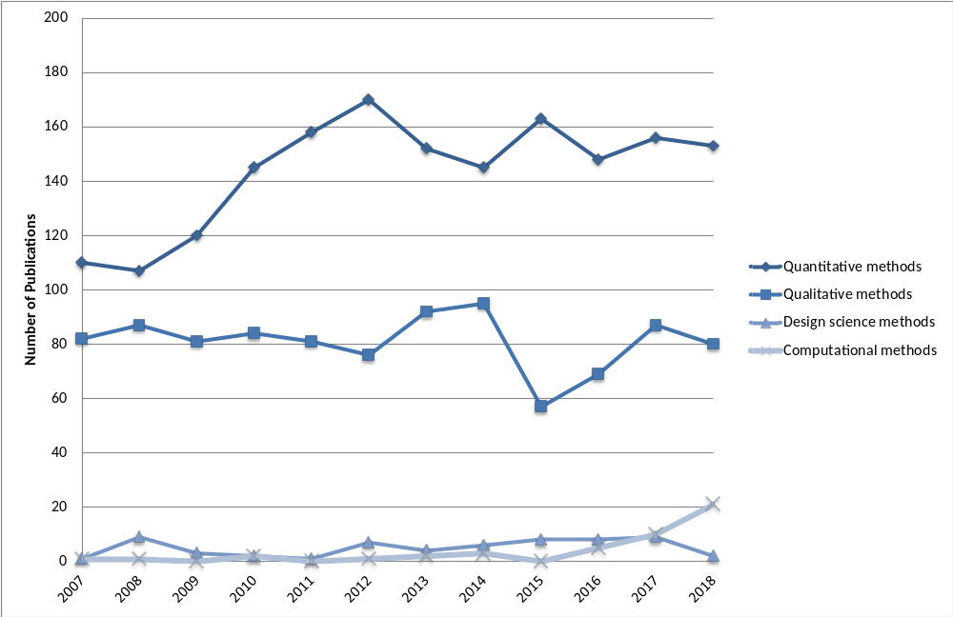
Research Methods in Use in IS Research
Mazaheri, E., Lagzian, M., & Hemmat, Z. (2020). Research Directions in Information Systems Field, Current Status and Future Trends: A Literature Analysis of AIS Basket of Top Journals. Australasian Journal of Information Systems, 24. https://doi.org/10.3127/ajis.v24i0.2045.

Slide 56
Research Strategy Differences
Requirement | Qualitative | Quantitative | Design Science
Controllability | Low | Medium to high | High
Deductibility | Low | Medium to high | Very low
Repeatability | Low | Medium to high | High
Generalizability | Low | Medium to high | Low to very low
Explorability | High | Medium to low | Medium to low
Complexity | High | Medium to low | Medium to high

Slide 57
The role of literature in choosing a research design
Three types of knowledge are relevant to doing research:
  Knowledge about the domain and topic of interest that relate to your chosen phenomena
  Knowledge about relevant theories and available evidence that help you frame questions and phenomena, and
  Knowledge about relevant research methods that you can apply to develop new knowledge, build innovative artefacts, or articulate new questions

Slide 58
Knowing this literature already during the planning of your research is essential.
The literature informs the extent, type, and nature of potential research problems.
The literature informs where gaps of knowledge are about a particular phenomenon or question and where other problems with the extant knowledge are (e.g., inconsistency, false assumptions, inconclusiveness).
The literature informs the extent to which current theories can explain the particularities of a phenomenon or problem and where they fail to do so adequately.
The literature contains strategies and methodologies that have been used to research the same phenomena or problem and similar phenomena or problems.
The literature contains theories that can be used to frame an investigation.
The literature contains the current body of knowledge about research methodologies that are available.

Slide 59
Examples: Theory and Method Knowledge in IS research
A Wiki on Theories used in IS research
  https://is.theorizeit.org/wiki/Main_Page
Online resources for different methods:
  Qualitative: https://www.qual.auckland.ac.nz/
  Quantitative: http://www.janrecker.com/quantitative-research-in-information-systems/
  Design Science: http://desrist.org/design-research-in-information-systems/

Slide 60
End of Chapter 3
© Copyright 2021 Jan Recker. All Rights Reserved.

