Slide 1
Scientific Research in Information Systems: A Beginner’s Guide (2nd edition)
Teaching Materials
Created by Professor Jan Recker

Slide 2
Copyright Notice & Citation
© Copyright 2021 Jan Recker. All Rights Reserved.
Recker, J. (2021): Scientific Research in Information Systems: A Beginner’s Guide.
2nd edition, Springer.
Available at Springer, Amazon, and other booksellers

Slide 3
Overview
Content
Part 1: Basic Principles of Research
Part 2: Conducting Research
Part 3: Publishing Research

Slide 4
Chapter 4:
Theorising

Slide 5
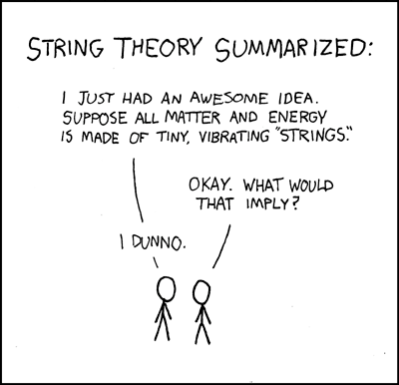
What is Theory?

Slide 6
What is Theory?
Warm-Up Example
Many parents believe in the predictive power of names – a child cannot prosper unless it is hitched to the right name.
The belief is that the right name leads to economic prosperity
(ie success).
Examples:
  New York, 1958: Robert Lane called his baby son Winner – and later, a boy he called Loser.
  In 2006, a man in Madrid named his Son with all the first names from the then-current Real Madrid soccer team.
  An Indian-born Sikh cab driver in New York changed his name to Michael Goldberg.

Slide 7


What is Theory?
And guess what!
A study of California birth registry data from all year since 1961 shows that indeed the name correlates with economic prosperity
  On average, a boy called Jake will tend to earn more money and get more education than a boy called DeShawn.
Would DeShawn be better off if he changes his name to Jake?
Jake
DeShawn

Slide 8
What is Theory?
Theory: Looking for the Reason of the discerned pattern
The names are not the reason for the differences in education and income, they are one manifestation of an underlying reason:
  Parents with different socio-economic status choose different names for their babies
  The name is a reflection of the socio-economic status, not the cause.
  Parents’ socio-economic status is a good predictor of offsprings’ socio-economic status

Slide 9
What is Theory?
Example data
High-income boy names
  Benjamin
  Samuel
  Jonathan
  Alexander
  Andrew
Low-income boy names
  Cody
  Brandon
  Anthony
  Justin
  Robert
A narrative of the analysis is included in Freakonomics
- both the book and the movie ;)

Slide 10

…is something we use all the time in our everyday life
“Theory”
“Why do I feel unwell?”
We all use theory to construct explanations about the social world in which we live…
Which, in a way, is what researchers also try to do…
“Why are my friends behaving oddly?”
In a slightly different way, of course…
“Why do I have to go to school?”

Slide 11
What is Theory?
A first definition
A proposed explanation of empirical phenomena, made in a way consistent with the scientific method
(a method of inquiry based on gathering observable, empirical and measurable evidence subject to specific principles of reasoning).
Example:
  Theory in medicine involves trying to understand the causes and nature of health and sickness.
  Design theory in medicine is trying to make people healthy.
  These two are related but can be independent, because it is possible to research health and sickness without curing specific patients, and it is possible to cure a patient without knowing how the cure worked.
And in your work?

Slide 12
What is Theory?
A more formal definition
Theory is about the connections among phenomena, a story about why acts, events, structure, and thoughts occur.
Theory emphasizes the nature of causal relationships, identifying what comes first as well as the timing of such events.
Theory delves into underlying processes so as to understand the systematic reasons for a particular occurrence or nonoccurrence.
Theory usually is laced with a set of convincing and logically interconnected arguments.
Theory has implications
  that we may have not seen with our naked (or theoretically unassisted) eye.
  that may run counter to our common sense.
Ref: Sutton and Staw (1995)

Slide 13
What is Theory?
Theory can be about explaining as well as designing
A theory can describe, explain or predict (“make sense of”) phenomena we observe
  an account to describe, for instance,
    Why analysts make errors in process models.
    How top management commitment to BPM changes over time.
    What factors contribute to successful organizational change.
Great examples:
  Lauren Slater: “Opening Skinner's Box: Great Psychological Experiments of the Twentieth Century”. Norton & Company, 2005.
    Causes of drug addiction, bystander intervention, cognitive dissonance, the neural basis of learning

Slide 14
What is Theory?
Theory can be about explaining as well as designing
A theory can be used to guide the design of artefacts
  E.g., in education: Progressive Learning
  Assumption: Humans are social animals.
    (an organism that is highly interactive with other members of its species to the point of having a recognizable and distinct society)
  Theoretical premise: Humans learn best in real-life activities with other people.
  Design implication:
    Teaching materials should not just provide reading and drill, but also real-world experiences and activities that centre on the real life of the students.
    Key design principle: Learning by Doing!

Slide 15
What Theory is Not
Data: sets of evidence, observations, or arguments do not make up theory.
Idiographic: an explanation of a single situation or phenomenon, in whatever detail, is not theory.
Description or prediction: classifications or occurrence claims still operate at the observational, empirical level only.

Slide 16
What Theory is Not
Design: The construction of an artefact, however novel and useful it may be, in itself is not theory.
Self-perpetuating: Theory is not and should not be an activity that is an end in itself.
Universal. Theories, while striving for comprehensiveness, have their share of limitations in the form of leading assumptions and boundary conditions.

Slide 17

Levels of Theory
High-Level Theories
Theory
Focus on trying to explain how and why the world is ordered
Comes in a variety of shapes and sizes…
Mid-Range Theories
What makes up organizations?
Focus on trying to explain some general aspect of social behaviour
Low-Level Theories
Why do girls achieve higher educational qualifications than boys?
Focus on trying to explain a specific aspect of social behaviour.
Why do I always fall asleep in math lessons?

Slide 18
Some Guidelines around Theory Levels
If you understand the basic principles of High-level theories you will find it easier to understand other types of theory.
This is because Mid-range and Low-level theories are often based on the principles underpinning High-level theories.
High level theories are usually known by their more-common label of “Perspectives”
A “perspective”, for our current purposes, is simply a way of looking at and understanding the world or social constructions within it.
Different researchers, working within different perspectives, construct different theories about the nature of that world…

Slide 19

And in Information Systems?

Slide 20
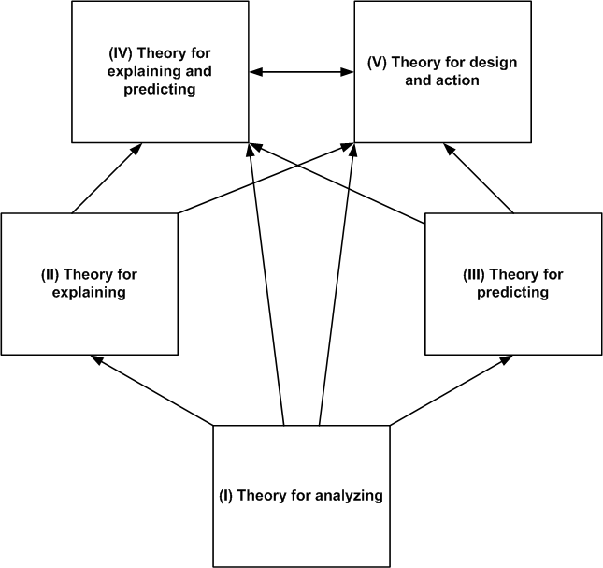
Types of Theory
Analyzing and describing – What is?
Understanding – How and Why?
Predicting – What is and what will be?
Explaining and predicting (“traditional theory”) – What is, how, why, and what will be?
Design and action – How to do something?

Slide 21
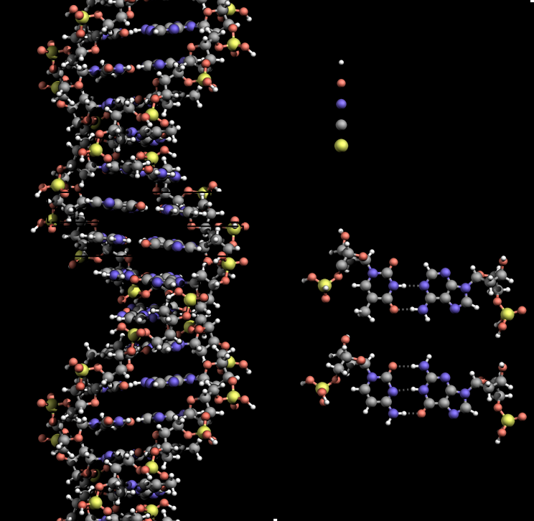
Examples – Type I Theory
DNA double helix
  A model that describes the structure of the genetic instructions used in the development and functioning of all known living organisms
Do you know other examples?
Gregor’s Types of Theory;
Animal Classes

Slide 22
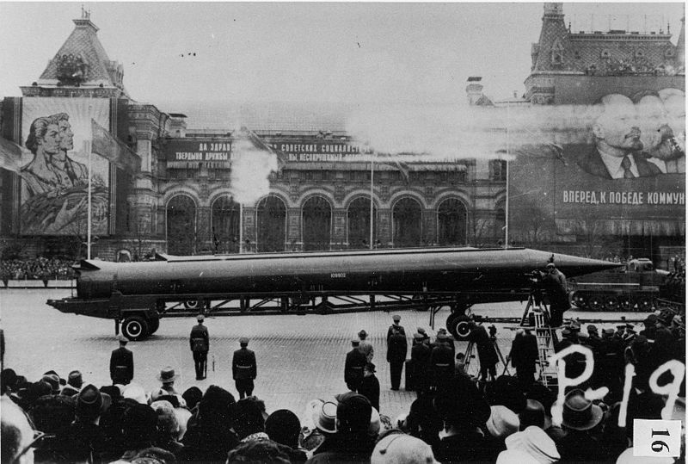
Examples – Type II Theory
Essence of Decision: Explaining the Cuban Missile Crisis
  A model that explains an account of the confrontation among the Soviet Union, Cuba and the United States in October 1962 through an organizational process and governmental politics model
  Showed that the prevalent explanation (mutually assured destruction as a barrier to nuclear war) was unfounded.
Do you know other examples?
Adaptive Structuration Theory;
Complex Systems Theory

Slide 23
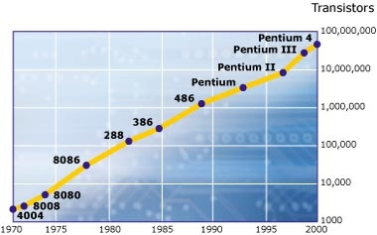
Examples – Type III Theory
Moore’s Law
  Predicts that the number of transistors that can be placed inexpensively on an integrated circuit doubles approximately every two years.
  Also holds (mostly) for other electronic devices, such as processing speed, memory capacity, sensors and even the number and size of pixels in digital cameras
Do you know other examples?
Organizational Size and Innovativeness
Predictive Analytics
Process Mining

Slide 24
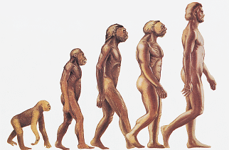
Examples – Type IV Theory
Theory of Evolution
  Explains and predicts the process of change in all forms of life over generations, by means of mutations, genetic drift and natural selection.
Theory of Representation
  Models the desirable properties of information systems at a deep level and predicts consequences when these properties are not met.
Do you know other examples?
TAM, Innovation Diffusion Theory

Slide 25
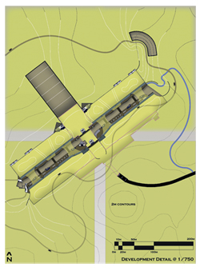
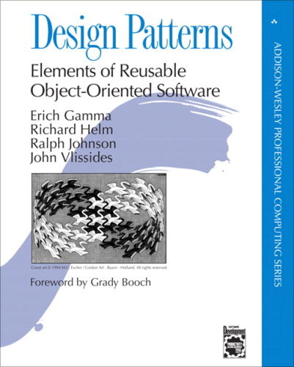
Examples – Type V Theory
Design Theory of Architecture
  consists of all the knowledge that the architect uses in his work, including how to select the best site and the most suitable construction materials, and advice on how to design practical buildings, up to the ease of maintenance and reparations.
Gamma’s Design Patterns
  Describes describing recurring solutions to common problems in software design.
Do you know other examples?
Progressive learning theory;
Tailorable Technology Design Theory

Slide 26

What are the building blocks of theory?

Slide 27
Four building blocks of Theory
What (constructs),
How (relationships),
Why (justification), and
Who, Where, When (boundary conditions)
(Whetten 1989)

Slide 28
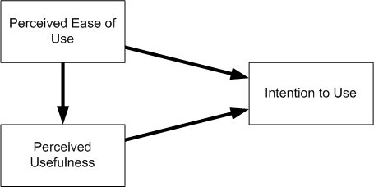
Example: Technology Acceptance Model
A theory that predicts why people intend to use information technologies:
  Because they believe the technology will be useful to their work
  Because they believe the technology will be easy to use.

Slide 29
Example: TAM
What (constructs)
  Perceived Usefulness, Perceived Ease of Use, Usage Intention
How (relationships)
  e.g., PEOU leads to PU leads to Usage Intention
Why (justification)
  e.g., principles of cognitive dissonance: humans adjust their behaviors to be consonant with their perceptions and beliefs
Who, Where, When (boundary conditions)
  not in original theory paper

Slide 30
Interlude: How can you contribute to theory?
What (constructs)
  Adding new constructs to TAM (such as habit, emotion, playfulness, anxiety)
How (relationships)
  Identifying new relationships (e.g., between PU and Anxiety)
Why (justification)
  Evidencing other principles for relationships (e.g., expectation-confirmation behavior)
Who, Where, When (boundary conditions)
  for different types of systems (IT-agnostic),
  PU/PEOU influences change over time,
  differences in gender, culture and so forth

Slide 31

Exercise
Let’s find a theory we are all familiar with, and dissect the building blocks.
  What (constructs)
  How (relationships)
  Why (justification)
  Who, Where, When
  (boundary conditions)

Slide 32
Nomological Nets
Specifies the roles and relationships of nets of constructs in a theoretical model.
We can classify constructs in relation to their purpose in our theory as independent, dependent, mediating, or moderating variables.

Slide 33
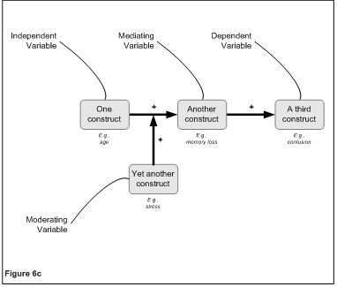
Nomological Nets

Slide 34

Nomological Nets
Exercise
Let’s populate a nomological net for an established, well-known area.
In IS research
In other research areas

Slide 35

Theorizing

Slide 36
The most important Principles about Theorizing
Theory is always an simplification
  it should not be more complex than the phenomenon to be investigated
A strong theory is an idealization
  the idea of free competition in markets
  the idea of a rational human decision-making

Slide 37
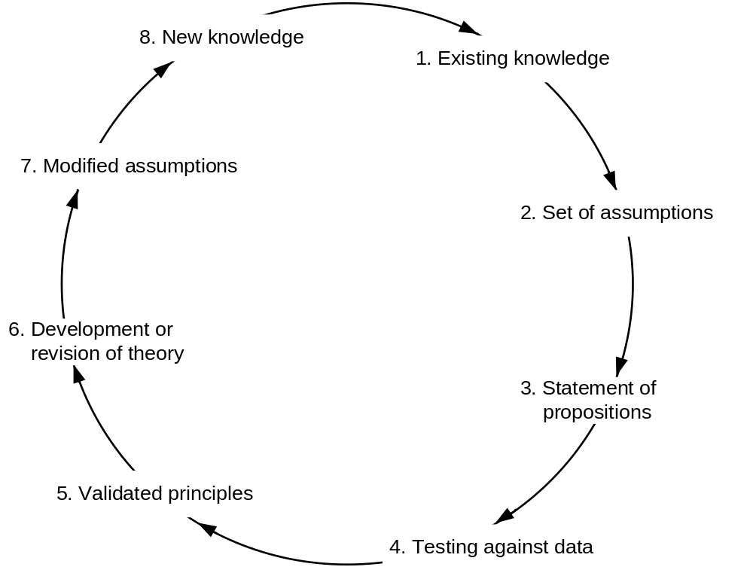
The General Nature of Theorizing

Slide 38
Theorizing – Basic Principles
Theorizing is the application or development of theoretical arguments to make sense of a real account (e.g. an observed phenomenon).
Can be inductive, deductive or abductive.
Can be dependent on data analysis, creative thinking, inspiration, or good luck.

Slide 39
How To Theorize – an Example
Start with an observation.
  For example, think about being in college. You're in class, and the guy next to you - who is obviously a football player - says an unbelievably dumb thing in class. So you ask yourself: Why?
Football players are dumb.
This is a theory.
It is not a very good one, but it is a start. What would make it better?
This material draws liberally from Lave & March,
An Introduction to Models in the Social Science
(some changes have been made)

Slide 40
Generalization and Explanation
One thing would be to make it a little more general. Theories that are too narrow and specific are not very interesting, even if they are correct.
Theories should be about classes of things (Volkswagen cars), not the things (my New Beetle) themselves. If we abstract further, we can find more general kinds of classes (cars in general) than specific types of classes (only Volkswagen cars).
So, we could say:
Athletes are dumb.

Slide 41
Generalization and Explanation
Athletes are dumb.
This statement is about a class of people (athletes) rather than a specific type of athlete (a football player). That’s more general. That’s good.
But the theory still has no sense of process, of explanation. It says, athletes have this property of being dumb, and that's why they ask dumb questions. Dumb begets dumb. That’s descriptive (how) but not explanatory (why).

Slide 42
Circularity and Falsifiability
There is also circularity in the example. What do we mean when we say that a person is dumb?
  Practically speaking, it means that they consistently behave dumbly.
  Dumbness cannot be observed or measured directly.
  The only way we can know whether people are dumb is by what they say and do. Yet what we are trying to explain is a dumb thing that they said. So in effect we are saying that they say dumb things because they say dumb things.
Circularity prevents theories from being falsifiable.
  E.g. Rain Dance Ceremony theory: if you perform the Rain Dance Ceremony and all the participants are pure of heart, it will rain the next day.
This theory is not falsifiable because if you perform the ceremony and it rains, the theory is confirmed. If you perform the ceremony and it doesn't rain, that suggests that one of the participants was not pure of heart, and again the theory is confirmed.

Slide 43
Explanation and Process
A good theory has a sense of process. It describes a mechanism by which A makes B happen, like the way the gears in a car transfer the rotation in the engine to a rotation of the tires.
Can we build an explanatory process into our athlete theory?
A suggestion:
To be a good athlete requires lots of practice time; being smart in class also requires study time. Amount of time is limited, so practicing a sport means less studying which means being less smart in class.

Slide 44
Implications and Fertility
The focus of the theory now is a mechanism, not an enduring property of a class of people (athletes). This means that we can apply the same reasoning to other people and other situations:
There is limited time in a day, so when a person engages in a very time-consuming activity, such as athletics, it takes away from other very time-consuming activities, such as studying.
An implication of this theory is now that we should also observe that good musicians (who practice many hours a day) should also be dumb in class. If we don't find this, the theory is wrong.
A good theory is general enough to generate implications for other groups of people and other contexts, all of which serve as potential tests of the theory. That is, the theory is fertile.

Slide 45
Alternative Theories
We have conceived a potential explanation of the phenomenon by imagining the observation as the outcome of a (hidden) process.
We may call it the Limited Time Theory.
Often, we find that this is but one possible explanation:
Excellence Theory
  Everyone has a need to excel in one area. Achieving excellence in any one area is enough to satisfy this need. Football players satisfy their need for accomplishment through football, so they are not motivated to be smart in class.
Jealousy Theory
  We are jealous of others’ success. When we are jealous, we subconsciously lower our evaluation of that person’s performance in other areas. So we think football players ask dumb questions.

Slide 46
Expectations → Hypotheses
We can use the fertility and non-circularity of all these theories to help test and choose among them.
We need to study different contexts to see how our theories explain observations:
  How do football players behave (or appear to behave) in class out of season?
  Do athletes who do not look like athletes – not unusually big (like football) or tall (like basketball) or fat (like sumo wrestling) - appear to ask dumb questions?
Expectations of our theories:
Question | Limited Time | Excellence | Jealousy
Football players ask dumb questions out of season? | No | Yes | Yes
Will athletes who do not look like athletes ask dumb questions? | Yes | Yes | No

Slide 47
A Critical Stage
The expectations of our theory lead to testable hypotheses.
How do you test these hypotheses?
  E.g. in our example?
Question | Limited Time | Excellence | Jealousy
Football players ask dumb questions out of season? | No | Yes | Yes
Will athletes who do not look like athletes ask dumb questions? | Yes | Yes | No

Slide 48
Two Approaches to Theorizing
From Theory to Data
  Typically called the ‘traditional’ scientific process
  You start with a theory
  You develop a modification or an extension of it
  Then you collect data specifically to test/falsify the predictions
    Example: Recker, J., Rosemann, M., Green, P., Indulska, M. (2011): Do Ontological Deficiencies in Modeling Grammars Matter? Management Information Systems Quarterly, Vol. 35, No. 1, pp. 57-79.
  Typical methods:
    E.g., survey, experiment

Slide 49
Two Approaches to Theorizing
From Data to Theory
  Often equated (falsely) with inductive and interpretive research
  You start with data, with a study of something that is ‘really happening’
  You examine whether there is no theory to explain what you observe
  You start developing a novel theoretical account, “grounded” in the data
    Example: Seidel, S., Recker, J., vom Brocke, J. (2013): Sensemaking and Sustainable Practicing: Functional Affordances of Information Systems in Green Transformations. Management Information Systems Quarterly, Vol. 37, No. 4, pp. 1275-1299.
  Typical methods:
    E.g., case studies, grounded theory

Slide 50
Practical Suggestions to Theorizing
should be well-argued
  data-inspired or (theoretical/logical) arguments-inspired
should be insightful
challenges existing beliefs and offers a set of new beliefs, which
should have (surprising) implications that make sense
Sensemaking!

Slide 51
How do we know you have a good theory?
If you have answer to the following questions:
  Is your account insightful, challenging, perhaps surprising, and – importantly – does it seem to make sense?
  Does it connect disconnected or disconnect connected phenomena?
  Is your account (your arguments) testable (falsifiable)?
  Do you have convincing evidence to support your account?

Slide 52
How do we know you have a good theory?
If you have answer to the following questions:
  Is your account parsimonious?
  Are the arguments logical?
  What can you say about the boundary conditions of the theory?
  What are implications of your theory?
  (“if what you say is true then we should see/experience/witness/do the following: …”)

Slide 53
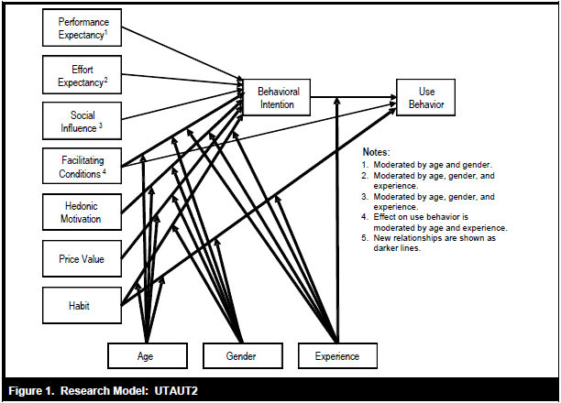
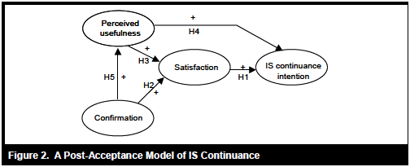
Good Theory – Two Contrasting Examples

Slide 54
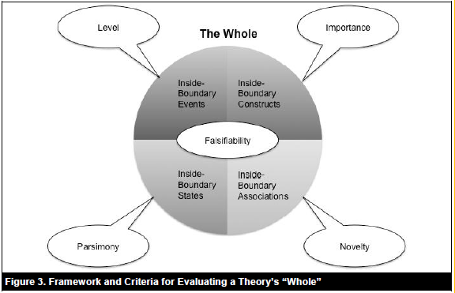
How do we evaluate theories?
Weber, R. "Evaluating and Developing Theories in the Information Systems Discipline," Journal of the Association for Information Systems (13:1) 2012, pp 1-30.

Slide 55
How do we advance theory?
Advance: the further development or re-development of an existing theory
  Intension: clarification/development of the set of concepts a theory uses to derive its explanation
  Extension: further development to the set of phenomena that a theory explains
  IE: both intension and extension
Kaplan, A. The Conduct of Inquiry: Methodology for Behavioral Science Transaction Publishers, Piscataway, New Jersey, 1998.

Slide 56
Where can I get help?
Theories Used in IS Research (wiki page)
  http://www.fsc.yorku.ca/york/istheory/wiki/index.php/Main_Page
INN
  http://inn.theorizeit.org/

Slide 57
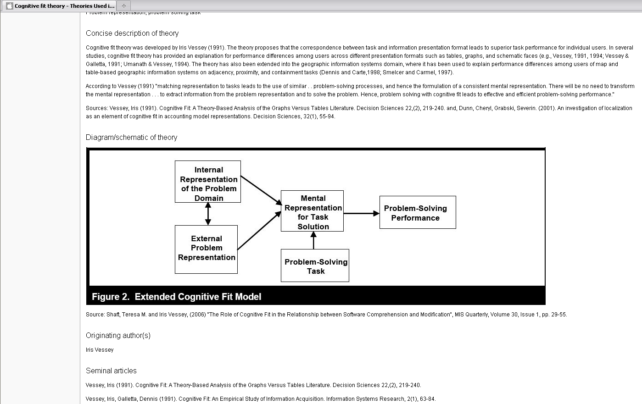
Example Wiki Page - Cognitive Fit Theory

Slide 58
Relevant readings (selection)
Gregor, S. "The Nature of Theory in Information Systems," MIS Quarterly (30:3) 2006, pp 611-642.
Weber, R. "Editor's Comments: Theoretically Speaking," MIS Quarterly (27:3) 2003, pp iii-xii.
Whetten, D.A. "What Constitutes a Theoretical Contribution?," Academy of Management Review (14:4) 1989, pp 490-495.
van de Ven, A. "Nothing Is Quite So Practical as a Good Theory," Academy of Management Review (14:4) 1989, pp 486-489.
Weick, K.E. "Theory Construction as Disciplined Imagination," Academy of Management Review (14:4) 1989, pp 516-531.
Weick, K.E. "What Theory is Not, Theorizing Is," Administrative Science Quarterly (40:3) 1995, pp 385-390.
Weber, R. (2012). "Evaluating and Developing Theories in the Information Systems Discipline", Journal of the Association for Information Systems (13)1, pp. 1-30

Slide 59
End of Chapter 4
© Copyright 2021 Jan Recker. All Rights Reserved.

