Slide 1
Scientific Research in Information Systems: A Beginner’s Guide (2nd edition)
Teaching Materials
Created by Professor Jan Recker

Slide 2
Copyright Notice & Citation
© Copyright 2021 Jan Recker. All Rights Reserved.
Recker, J. (2021): Scientific Research in Information Systems: A Beginner’s Guide.
2nd edition, Springer.
Available at Springer, Amazon, and other booksellers

Slide 3
Overview
Content
Part 1: Basic Principles of Research
Part 2: Conducting Research
Part 3: Publishing Research

Slide 4
Chapter 6:
Writing IS Research Articles

Slide 5
Scientific Writing
  Why publishing is important for scientists
  How scientific publishing works
  Writing a scientific paper
  Reviews and revisions

Slide 6
“As a scientist, you are a professional writer.”
Joshua Schimel, “Writing Science”, Oxford University Press.

Slide 7
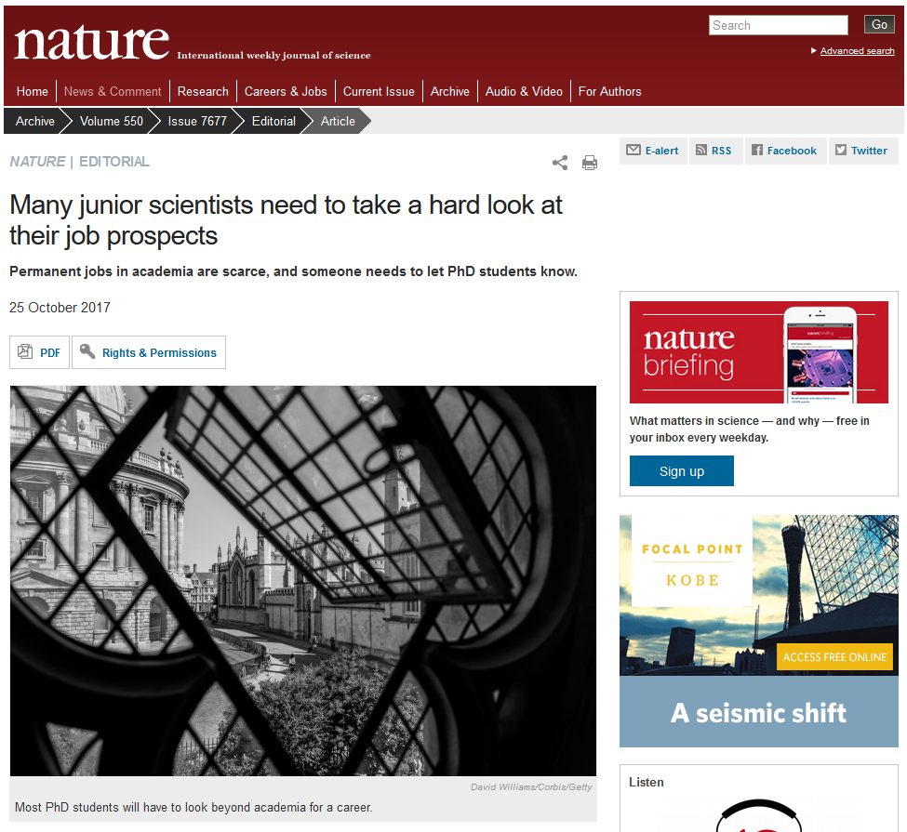
Science is a tough competition
Statistics say young researchers have a better chance of pursuing their chosen job than the young footballers. But not by much. Global figures are hard to come by, but only three or four in every hundred PhD students in the United Kingdom will land a permanent staff position at a university. It’s only a little better in the United States.
[…] Simply put, most PhD students need to make plans for a life outside academic science.
[…] it has been evident for years that international science is training many more PhD students than the academic system can support. Most of the keen and talented young scientists who responded to our survey will probably never get a foot in the door. Of those who do, a sizeable number are likely to drift from short-term contract to short-term contract until they become disillusioned and look elsewhere.“
https://www.nature.com/news/many-junior-scientists-need-to-take-a-hard-look-at-their-job-prospects-1.22879

Slide 8
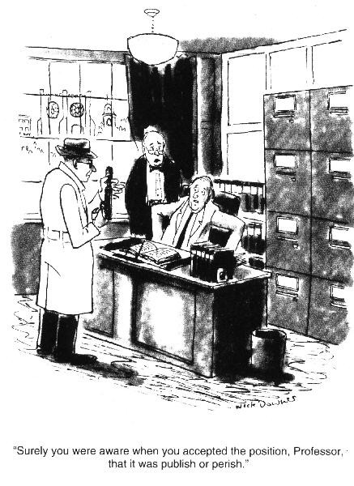
Publish or Perish

Slide 9
Publish or Perish
The purpose of an academic is to produce
and
disseminate research results.
Publications advertise your
skills
areas of interest
expertise
Publications allow your work output to be
evaluated
compared

Slide 10
Publish or Perish
What’s in it for the university?
  Publications advertise the strengths and areas of interest of the university
  Publications generate direct income from the federal government from publications
  Publications by research students are an indicator of research training success and help attract students
  Publications are a key requirement for course accreditations such as EQUIS or AACSB.
  ‘What helps you succeed helps us succeed!’

Slide 11
Scientific publications –why do they matter?
Papers are the format we choose to make our research outcomes persistent as additions to the body of knowledge.
Papers are the main proof of valid research activity.
Papers are the best way for you to market your skills and creativity.
Papers are the best mechanism for getting feedback about your research from others.
Papers helps you become a member of a research community and influence it.
Writing helps clarify your ideas and fit them into the current state of your field.
Writing keeps your teaching fresh.

Slide 12
You are what you publish!
Publications are the most important KPIs of an Academic. The number and quality of your publications will determine, at least to some degree, the level of success you will enjoy in your career.
  Number of peer-reviewed publications
    E.g., US Asst. Prof. minimum 8+ journal articles in 6 years to achieve tenure
    E.g., Uni Hamburg expects around 4 or so A+ journal articles for a W2 professor; 6 or more for a W3 professor.
  Quality of peer-reviewed publications
    Citations to your paper: they track which papers reference your paper
      Raw data
      H-index
      G-index
    The type and quality of the outlet in which your paper is published
      Journal Impact Factor
      Journal ratings

Slide 13

Publications matter to hiring and promotion/tenure

Slide 14
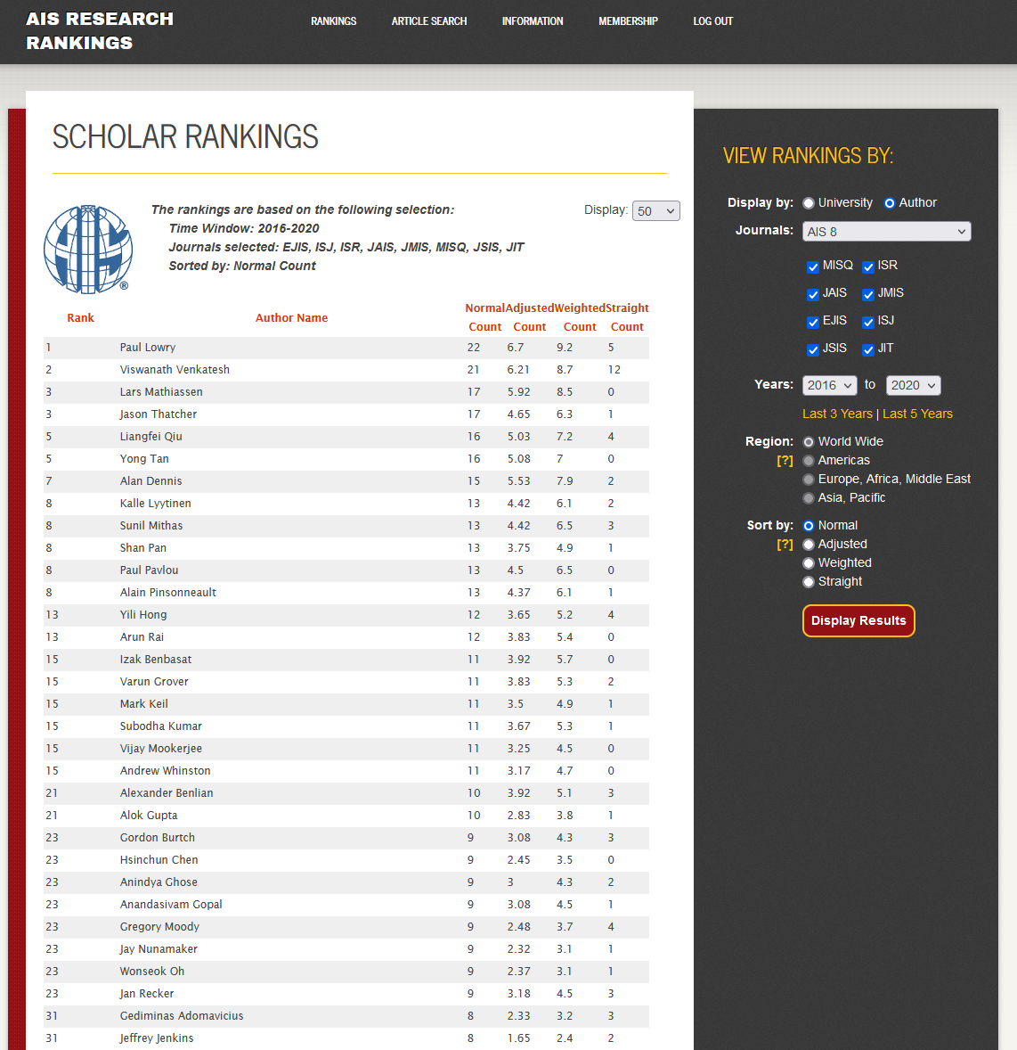
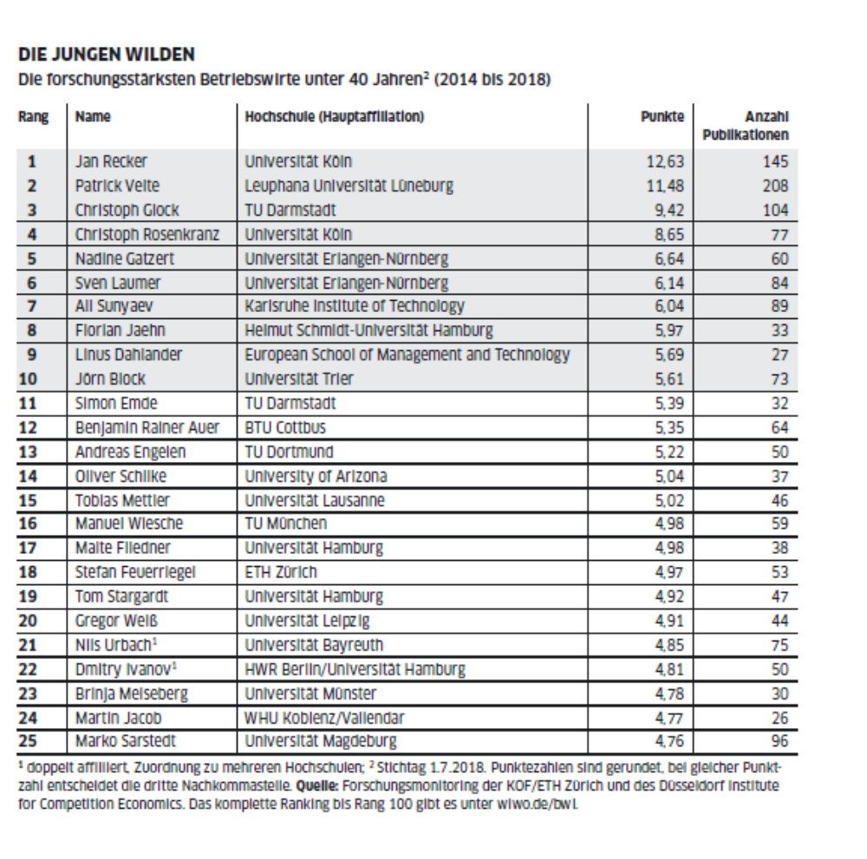
Academics are ranked, literally.
https://www.wiwo.de/erfolg/hochschule/bwl-ranking-jan-recker-wie-tickt-der-jungstar-der-bwl/23879002.html
https://www.aisresearchrankings.org/

Slide 15
A common misconception
Publish or perish is not about succeeding. It is about surviving.
Dissemination is not impact: You do not suceed as a scientist by getting papers published. You succeed by creating impact.
What is impact?
  Citations?
  Rankings?
  Tweets?
  Changes in the world that go back to your ideas?

Slide 16
Impact Metrics: Citation Data
Harzing’s Publish or Perish
  Displays citation data for articles, authors and/or outlets
    Raw data
    Indices
For example: H-index
  A researcher with an index of h has published h papers with at least h citations each.

Slide 17
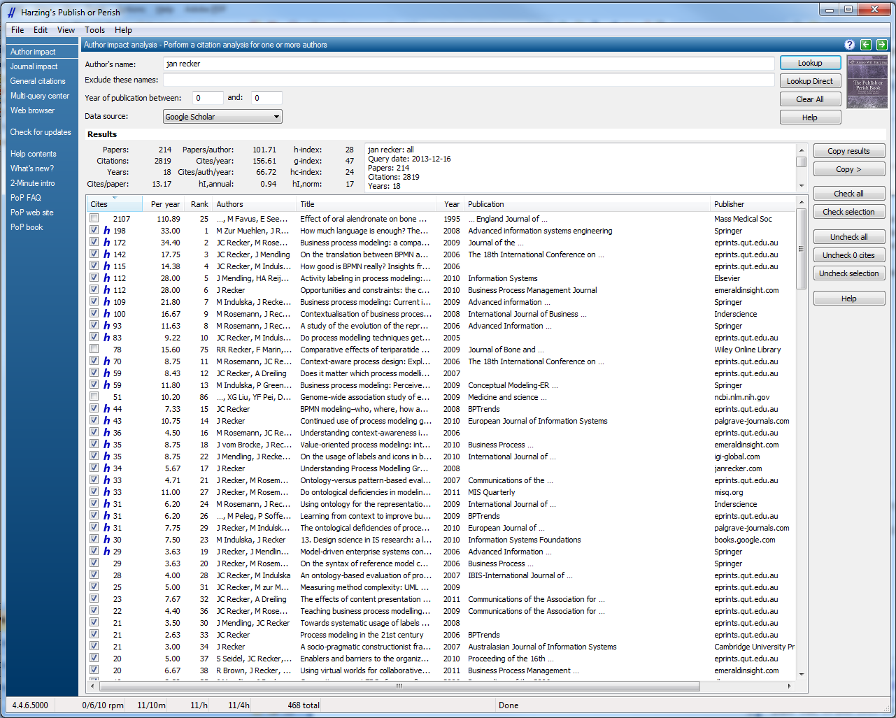
Metrics Example: Citation Data
- Harzing’s Publish or Perish
https://harzing.com/resources/publish-or-perish

Slide 18
Fact about academic impact/citations: Few publications matter!
30% papers are never cited
20-30% papers are highly cited – they attract 80% of citations

Slide 19
Citations and h-Index
h = 59

Slide 20
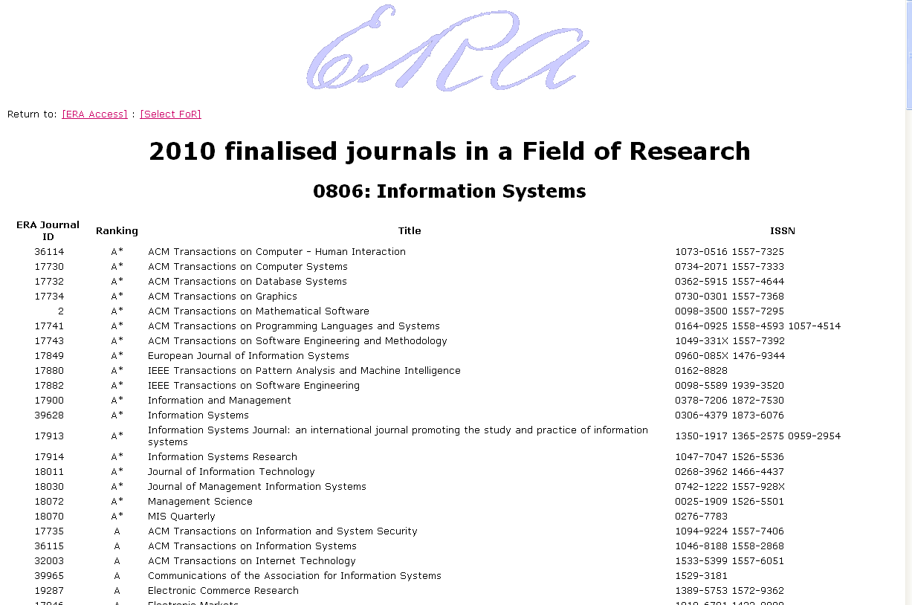
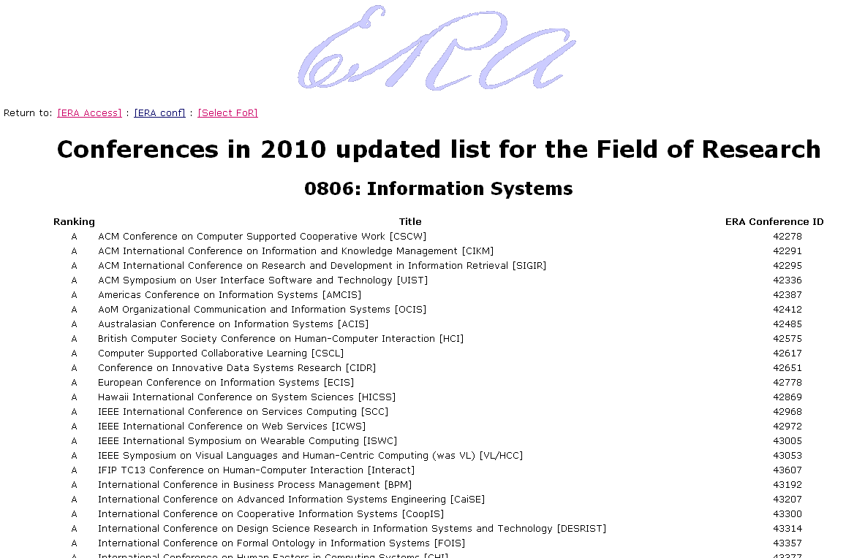
Official Ranking Lists for Scientific Publication Outlets (Conferences and Journals)
http://lamp.infosys.deakin.edu.au/era/

Slide 21
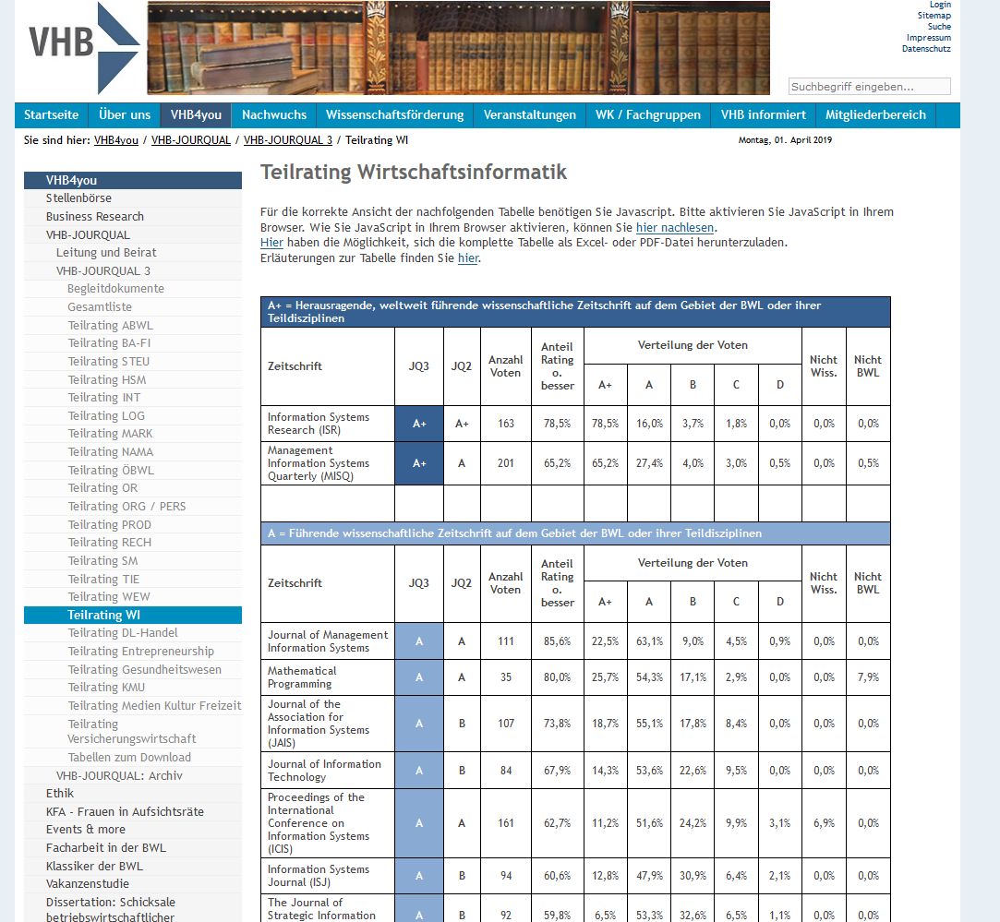
German variant: VHB Jourqual
https://vhbonline.org/vhb4you/jourqual/vhb-jourqual-3/teilrating-wi/

Slide 22

AIS Variant: The Senior Scholar’s Basket
https://aisnet.org/general/custom.asp?page=SeniorScholarBasket

Slide 23
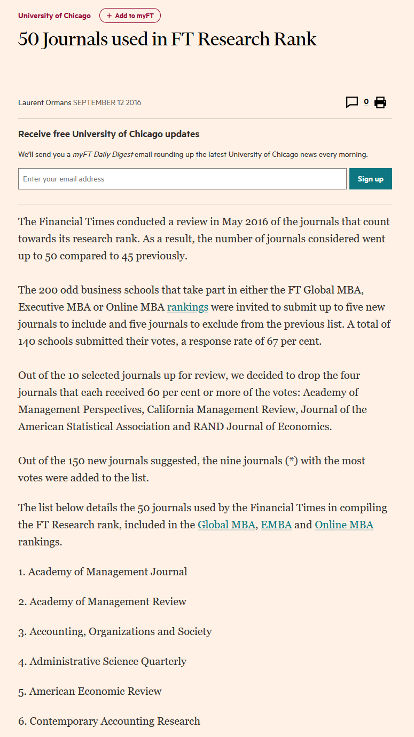
US Variant: FT50 Ranking
https://www.ft.com/content/3405a512-5cbb-11e1-8f1f-00144feabdc0

Slide 24
Metrics: Journal Impact Factor
The journal impact factor (IF) is a measure of the frequency with which the "average article" in a journal has been cited in a particular year.
  A = the number of times articles published in 2019 and 2020 were cited during 2021
  B = the total number of ‘citable items’ published by that journal in 2019 and 2020
  2021 impact factor = A / B

Slide 25
How scientific publishing works

Slide 26
Writing Scientific Papers:
What do we write about?
Research!
  What does that mean?
    The process and, importantly, the outcomes of a scientific activity.
      This typically means that we write about research that has been completed.
      Leads to publication bias: We typically only see “successful research” being published.
    Very often it is also one of the main ways in which we can paint a picture of ourselves as scholars.

Slide 27
Myth: You can publish anything anywhere
Publication outlets differ WIDELY in quality
  Good outlets will only accept good papers describing good research.
  Publish high-impact papers in high-quality outlets.
Open publishing process
  Once you publish, your ideas are out there!
  Can be good or bad for reputation
One shot option:
  Once you published a result, you can’t publish it again!

Slide 28
Publication Outlets
What different publication formats exist?
books
book chapters
journal articles
conference papers
workshop papers
technical reports
…
What are the differences?

Slide 29
The most important lessons from this session
Good paper
  Purposive
  Goals clearly defined.
  Reporting of procedures (including flaws) complete and honest.
  Objectivity clearly evident.
  Describe the use of appropriate analytical techniques.
  Conclusions limited to those clearly justified by the data / facts.
Good research
  Purposive
  Goals clearly defined.
  Procedure replicable.
  Objectivity clearly evident.
  Use appropriate analytical techniques.
  Conclusions limited to those clearly justified by the data / facts.

Slide 30
Two golden rules of publishing
You can write good papers only when you do good research.
You can waste good research by not writing about it well enough.

Slide 31
What is different in scientific publications from others?
Scientific publications are peer-reviewed.
  means writings are subjected to the scrutiny of experts in the same field before a paper will be published.
  requires a community of experts in a narrowly defined field who are qualified to perform impartial review.
  Most often double-blind review: authors and reviewers do not know each others’ identity.
The review process is managed by editors.
  typically a successful senior scientist familiar with the field of the manuscript.
  Makes decisions about the publication of the manuscript.

Slide 32
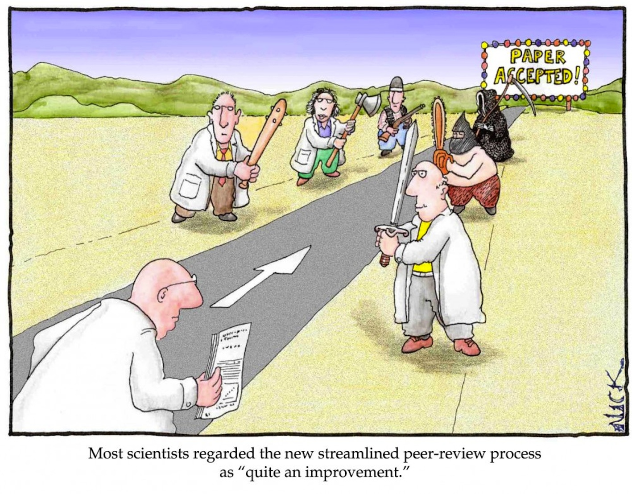
Peer review

Slide 33
Confessions
“It is natural to feel bad about rejections. Unfortunately, I get them all the time too. Academia is a pretty brutal profession in that regard and I wouldn’t want to convey otherwise.”

Slide 34

The review process depends on the editorial and review board structure

Slide 35
Different Board Structures
MISQ, ISR, ISJ
JAIS, JITTA
JMIS, EJIS, I&M, CAIS
EiC
EiC
EiC
SE
SE
AE
AE
Reviewers

Slide 36
Writing a Scientific Paper

Slide 37
How do we write a paper?
A scientific paper must contain enough information to enable peers (the scientific community) to:
  Assess observations/analyses/data/interpretations/conclusions
  Repeat the experiments/study if they want
  Evaluate intellectual processes (i.e. are the authors’ conclusions and interpretations valid?)

Slide 38
Process for writing a scientific paper
Develop an outline with a structure.
Revise the structure.
Start populating the sections.
  This typically is not sequential.
  The first paragraph of the Introduction is the hardest part
  of a paper to write.
  Methods is the easiest and can be started even
  when the research is unfinished.
Revise the sections.
Revise the paper/thesis.
Put it in a drawer, take it out, read again, revise again.
Submit.

Slide 39
Why the structure of a paper matters
Science is about new ideas in old formats.
Reviewers and readers are accustomed to certain ways of reading an article
  This is called a “script”
If they encounter a different script, they get scared.
Thus, in principle, we should follow established scripts and make only mindful variations.

Slide 40
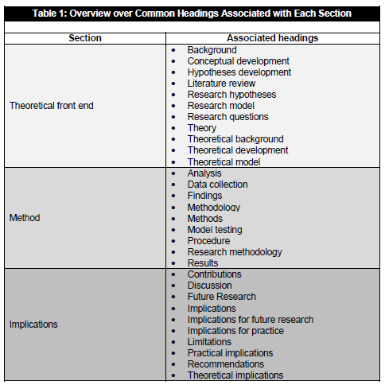
Macro-structure of many empirical papers
Tams, Stefan and Grover, Varun (2010) "The Effect of an IS Article’s Structure on Its Impact,“ Communications of the Association for Information Systems: Vol. 27, Article 10.

Slide 41
Structuring your Paper
The Typical Structure of a Research Paper:
  Introduction
  Theoretical Background/Literature Review
  Research Model/Hypotheses/Propositions
  Procedure/Approach/Methodology/Research Design
  Results
  Discussion of Results
  Implications – for Research and Practice
  Conclusion
Strange, J.R. and Strange, S.M. 1972. "How to read a scientific research report" in Reading for Meaning in College and After, Brooks/Cole: Monterey, pp. 54-66.

Slide 42
Examples
Generic Paper Structure | Example I (Recker et al., 2011) quantitative study published in MIS Quarterly | Example II (Seidel et al., 2013) qualitative study published in MIS Quarterly
Introduction | Introduction | Introduction
Theoretical Background/ Literature Review | Theory | Theoretical Background
Research Model/Hypothesis or Theory Development (where appropriate) | Proposition Development
Procedure/Approach/ Methodology/Research Design | Research Method | Research Method
Results/Findings/Outcomes | Scale Validation Results | Interpretation and Analysis of the Case An Integrated Model of Functional Affordances in the Sustainability Transformation Process Two Vignettes of Sensemaking and Sustainable Practicing
Discussion | Discussion (includes subsections for Limitations and Implications) | Discussion and Implications
Limitations and Implications for Research and Practice |  | Limitations
Conclusion | Conclusion | Conclusion

Slide 43

Filling the sections: What goes where?
Introduction
Background
Theory/Research Model
Method/Procedures/Approach/Methodology
Results
Discussion
Implications – for Research and Practice
Conclusion

Slide 44
Section: Introduction
Contains three parts, and three parts only:
  Motivation: What is your problem, and why is it a problem?
  Specification: what is your specific research question/research outcome? What is your research approach (in very general terms)?
  Outline: how will the paper tell us about what you did?

Slide 45
Section: Introduction
Tips
  Good introductions are SHORT. The rule of thumb is not more than 1.5 pages with 2.0 line spacing
  Place the study in the context of previous research but tell only what the reader needs to know to understand the present work.
  Either avoid jargon or explain it very clearly.

Slide 46
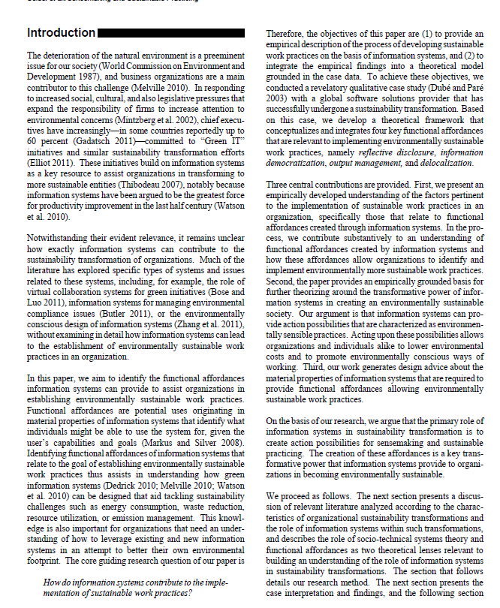
Example

Slide 47
Motivating a Paper:
The Gap vs the Hook
The Gap is usually the argument that something hasn’t been done yet.
  This is weak because some things shouldn’t be done.
The Hook is a strategy to find a problem that someone cares about
  Can be academic, theoretical, practical…
Grant, A.M., and Pollock, T.G. "Publishing in AMJ—Part 3: Setting the Hook " Academy of Management Journal (54:5) 2011, pp 873-879.

Slide 48
Good Gap versus Bad Gap
Bad Gap:
  “nobody has studied…”
  “the literature is silent on…”
Good Gap = Problem:
  Resolve a contradiction in the literature
  Extending the literature to account for specific, important phenomena / understandings / contexts (and why)
  Solve a puzzle for practice that is important but not addressed by the literature
  Show how existing literature may mislead our thinking

Slide 49
The Hook Formula for a Clear Introduction
Paragraph 1 – Hook Motivation, need, ‘hook’
Paragraph 2 – Gap Situate in research – identify opportunity
Paragraph 3 – Study How investigate? Process, context & why?
Paragraph 4 – Conclusion Findings, framework, contribution
Paragraph 5 – Outline Outline the paper: first …, second…, then… and , we conclude with…

Slide 50
The Formula in 9 Sentences
Hook
Gap
Study
Conclusion
Outline
Sentence stating what the domain is and why it is important.
What is the overall problem or situation in that domain
What are the conclusions of existing literature for that problem / situation in this domain?
What is the problem or issue with that existing literature?
Indicate that this study addresses that problem or issue and state how.
Describe the study, sample, and method for addressing that problem or issue.
Describe what you found.
State explicitly how these findings extend and contribute to existing knowledge.
Describe the overall outline of the paper.

Slide 51
Section: Background
Provides what is required to facilitate an understanding of your research processes and findings
Not more. Not less.
  Relevant theories
  Relevant concepts/terms that you need
  Relevant previous methods/algorithms/findings/arguments on which your work is based

Slide 52
Section: Background
What is it not?
  A recap or listing of all other works in the area,
  Every paper that you have read about the area,
  Criticism of all other works in the area, or
  A collection of term definitions.

Slide 53
Writing the Background Section
Tips
  Organise the section according to topics, not as a list of studies.
  Discuss related work, rather than just listing it.
  Explain how your work complements others’ work.
  Explain how your work contradicts previous work.
  Highlight areas in which your work builds on others’ work.
  Keep it concise.’
  My rule of thumb: you want to get to your own contributions no later than page 15!

Slide 54
The Background Section
- Example (1)
Our research mainly relates to semantic and pragmatic aspects of process models. We complement works that establish a connection between structural metrics and both understanding and error-probability [CGP+05, MRC07, MVD+08, GPP08] by investigating whether the verb-object labeling style might be superior to other styles. In contrast to previous works like [Mil61, SM01, MCH03] that recommend verb-object labels, we provide a sound empirical justification for this guideline.

Slide 55
The Background Section
- Example (2)
Recent research has started to examine process model understandability, for instance, the impact of process model structure, model user competency, and activity node labeling. While the impact of structural properties is clearly identified [4], it is also reported that model readers systematically overestimate their ability to draw correct conclusions from a model [3]. Furthermore, shorter activity labels have been found to be positively correlated with understanding [5]. This raises the question in how far a better representation of domain semantics in process models beyond the use of text labels only would improve understanding.
In our work we continue along this line of work towards more understandable process models. Current practice indicates that the labeling of activities is a rather arbitrary task in modeling initiatives and one that is sometimes done without a great deal of thought [8]. This can undermine the understandability of the resulting models in cases where the meaning of the labels is unclear, not readily understandable or simply counter-intuitive to the reader.

Slide 56
The Research Model/Theory/Hypotheses Development Section
This is where the magic happens but it’s not part of every paper.
This is NOT where you discuss an existing theory but where you develop NEW theory.
Introduces, arranges and argues an overview of the factors being studied in an empirical setting
  The independent and dependent factors in an experiment,
  The important theoretical constructs and their relationships in a field study, or
  The set of hypotheses or propositions to be tested/explored/falsified

Slide 57
Section: Research Model
How do we organize the research model section?
  Start with an overview of conceptual or research model being developed
  Discuss components of the model in paragraphs with relevant subheadings that reflect the model
  follow a disciplined structure that moves from concepts to associations to laws to boundaries
  Each hypothesis/proposition must be preceded by a strong argument as to why it should hold.

Slide 58
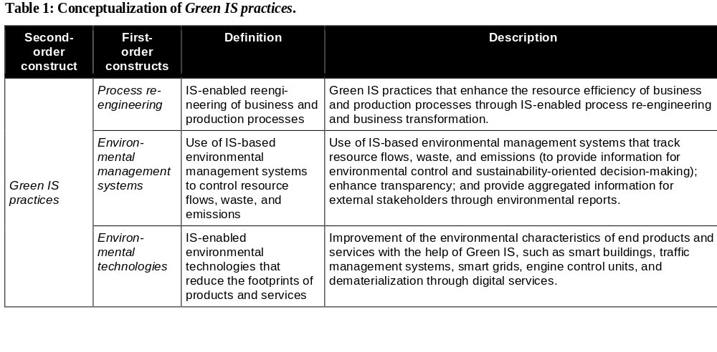
Tips for Theory/Model Development
Explain concepts or constructs in tables
Loeser, F., Recker, J., vom Brocke, J., Molla, A., and Zarnekow, R. 2017. "How It Executives Create Organizational Benefits by Translating Environmental Strategies into Green Is Initiatives," Information Systems Journal (27:4), pp. 503-553.

Slide 59
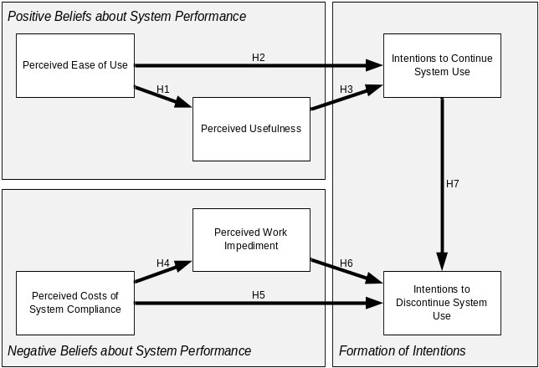
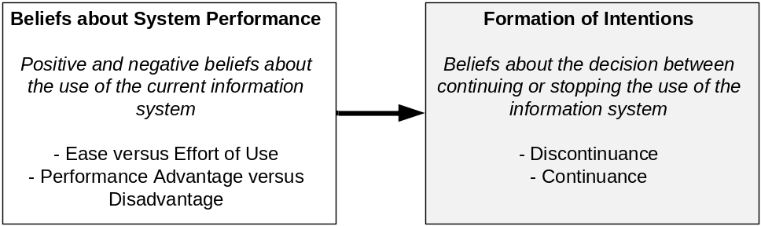
Tips for Theory/Model Development
Differentiate between conceptual level and empirical level
Recker, J. "Reasoning about Discontinuance of Information System Use," Journal of Information Technology Theory and Application (17:2) 2016, pp 101-126.

Slide 60
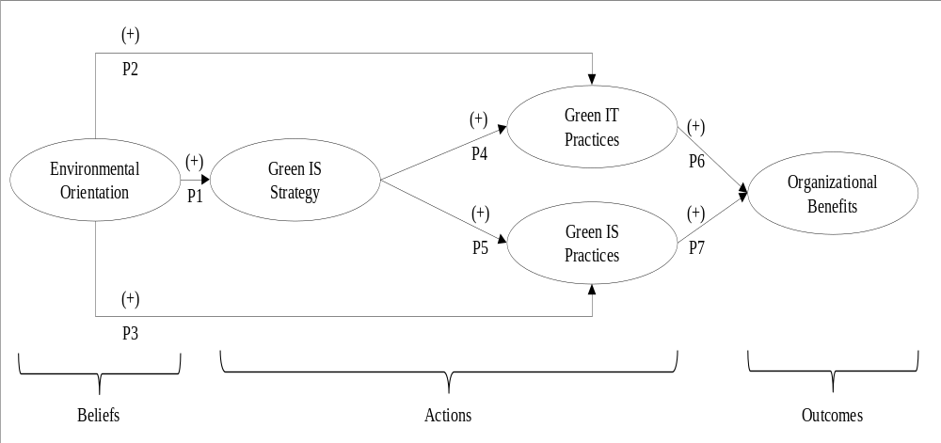
Differentiate between conceptual level and empirical level
Loeser, F., Recker, J., vom Brocke, J., Molla, A., & Zarnekow, R. (2017). How IT Executives Create Organizational Benefits by Translating Environmental Strategies into Green IS Initiatives. Information Systems Journal, 27(4), 503-553.

Slide 61
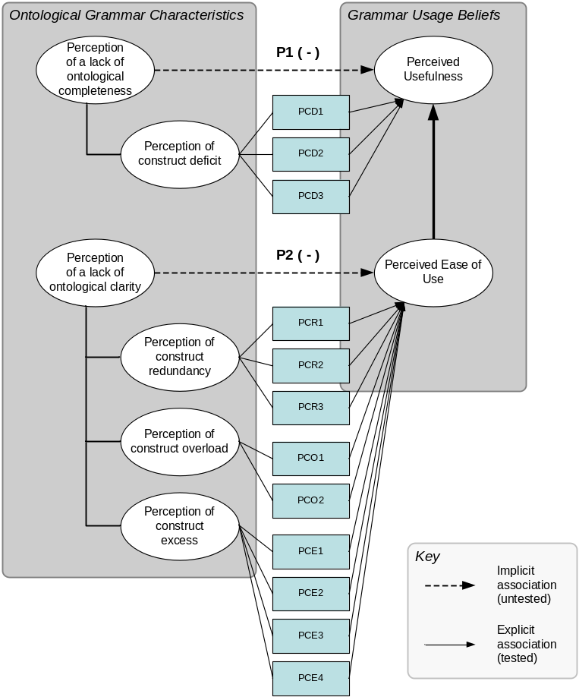
Differentiate between conceptual level and empirical level
Recker, J., Rosemann, M., Green, P., & Indulska, M. (2011). Do Ontological Deficiencies in Modeling Grammars Matter? MIS Quarterly, 35(1), 57-79.

Slide 62
Developing Hypotheses
A hypothesis must contain a justified theoretical argument for why you expect a certain phenomenon to occur (or not)
  No such thing as a self-evident hypothesis
Connect your hypotheses to existing research
  Include references to key literature in building your argument -- this literature should have been discussed in your background section
Keep your hypotheses simple but precise
  They should specify two (or more) key constructs and the relationship between them.

Slide 63
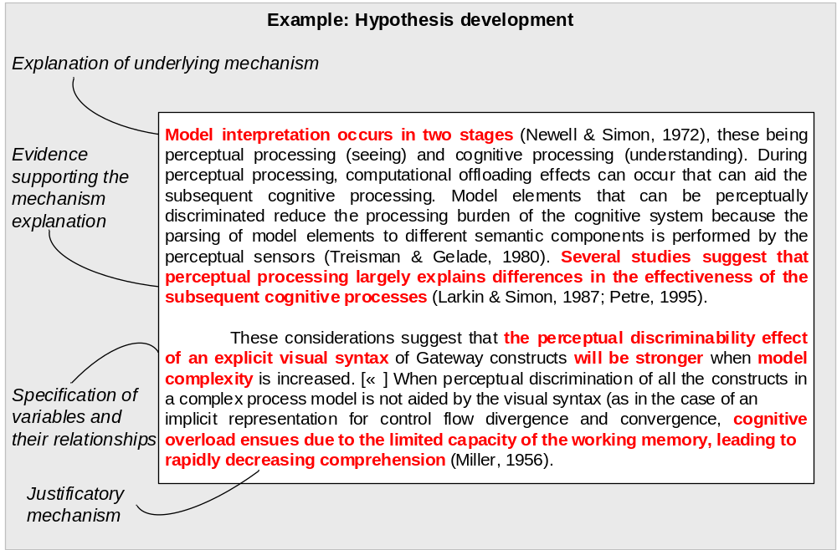
Example: Developing a hypothesis
Recker, J. (2013). Empirical Investigation of the Usefulness of Gateway Constructs in Process Models. European Journal of Information Systems, 22(6), 673-689.

Slide 64
Developing Hypotheses: Tips
Do not use words like "prove”. Instead use words like “suggest” or “support”.
  Hypotheses are never proven; only supported.
Explain your expectations clearly.
  Identify dependent and independent variables and the direction of expected relationships.
Make sure the relationships between the variables are testable.

Slide 65
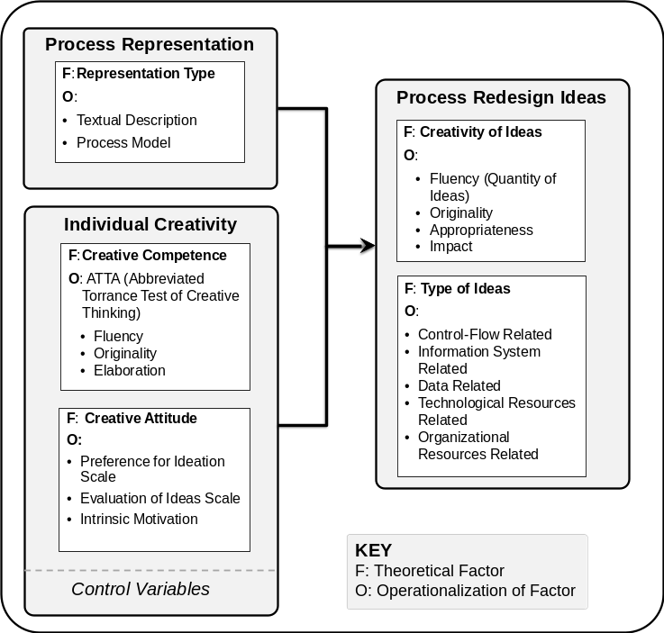
Example: Presenting a research framework
The model shown in Figure 1 frames our primary research interest: the influence of the type of process representation on the creativity and type of the process-redesign solutions. Based on findings in the literature on how individual characteristics relate to creative problem-solving processes, the model acknowledges the relevance of the individual as a creative person by using creative competence [16] and creative attitude [4] as control variables.
…
Based on our model, we present two sets of hypotheses that describe our expectations about the effects of a type of representation in a process-redesign task on the solutions conceived in this task. First, we explore whether the quantity and quality of process-redesign solutions varies.
Figl, K., and Recker, J. 2016. "Process Innovation as Creative Problem-Solving: An Experimental Study of Textual Descriptions and Diagrams," Information & Management (53:6), pp. 767-786.

Slide 66
Section: Method/Approach/Research Design
In this section, you describe how your research was carried out.
Describe it in such a way that another research can repeat your work based on your description (to meet the requirement of replicability).
This section should follow a well-established script and is relatively easy to write.
  Experiment paper: experimental design, variables and measures, materials, tasks, procedures, and participants.
  Survey paper: design, measures, sampling strategy, procedures, and validation of measures.
  Qualitative paper: empirical setting, modes of data collection, and processes and techniques employed in data analysis.
  Design science papers: overview, meta-requirements or design principles, artefact description, and evaluation.

Slide 67
Section: Method/Approach/Research Design
Typical key elements
  Research strategy
  Research materials
  Case sites
  Scope of data collection
  Sampling strategy
  Participant selection
  Measurement strategy
  Analysis strategy

Slide 68
Section: Results/Findings
Only contains a description of findings.
Should contain just factual result reporting (in the past tense) including statistical (or other) tests, but no discussion.
Writing, statistics and graphs should be presented as simply as possible.
  Try to make figure legends self-contained so that reference to the text is unnecessary.
Do not present irrelevant data to which the Discussion will not refer and vice versa.
This section is easy to write, and quite methodical – check published papers that use a method similar to yours.

Slide 69
Section: Discussion
When most people read a paper, they read the Abstract first, then the Introduction, some graphs or tables and then the Discussion.
Therefore, the Discussion should begin by summarising the main findings.
Then: we interpret the findings
  This is about sensemaking of the findings or results: What do they actually mean? Why did you get the results that you obtained?
    Explaining the results: why did you find what you found?
    Abstracting the results to concepts: what does it mean in a larger view?
    Theorizing the results: what do the results tell us about the existing/new theory?
Keep the discussion to the results, i.e., do not go beyond the data.
Use present tense.

Slide 70
Section: Discussion
When most people read a paper, they read the Abstract first, then the Introduction, some graphs or tables and then the Discussion.
Therefore, the Discussion should begin by summarising the main findings.
Then: we interpret the findings
  This is about sensemaking of the findings or results: What do they actually mean? Why did you get the results that you obtained?
    Explaining the results: why did you find what you found?
    Abstracting the results to concepts: what does it mean in a larger view?
    Theorizing the results: what do the results tell us about the existing/new theory?
Keep the discussion to the results, i.e., do not go beyond the data.
Use present tense.

Slide 71
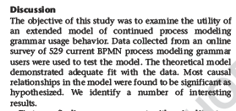
Examples – Summarizing the key findings
This study provides empirical results on the associations that two types of characteristics of the BPMN modeling grammar, i.e., perceptions of a lack of ontological completeness and ontological clarity, have with user beliefs about the usefulness and ease of use of the modeling grammar.

Slide 72
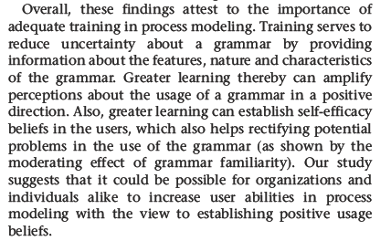
Examples – Interpreting the key findings
While we found that users who did not use constructs that are classified as excess had higher perceptions of the ease of use of the grammar, the differences in PEOU ratings between the groups were not always significant.
One possible interpretation of these results is that some of the excess constructs in BPMN (e.g., Association Flows or Text Annotations) are used by modelers to mitigate or mask other deficiencies (e.g., construct deficit or overload). These workarounds may distort the theoretically hypothesized results, in that users may have positive usage perceptions about some of the excess constructs. For example, a modeler may find the excess construct Text Annotation useful because it allows them to handle other deficiencies of the grammar (for instance, those relating to the deficit for articulating business rules).
We further found that, when model complexity is increased, syntactic effects related to the perceptual discriminability of the Gateway constructs have a positive effect on model interpretability, over and above the effects of the constructs’ ontological deficiencies on a semantic level. Given that ‘typical’ process models found in industry practice are quite complex and may involve up to thousands of activities and related objects such as data and applications (Mendling, Reijers, & van der Aalst, 2010), this finding is significant in that it underlines the importance of perceptual, syntactic considerations in the design of process models that are readily and intuitively perceptible by the intended audiences. Our results suggest that potential semantic deficiencies of these models (in terms of the precision of the clarity of their specification) can be positively mitigated through appropriate visual means, e.g., by selecting easily distinguishable shapes for better perceptual discrimination.

Slide 73
Section: Implications
This section is absolutely important. It should be explicit in the structure.
Good journals demand specific implications for ongoing research and practice.
Implications for Practice
  Detail how the study findings change/impact the way that important stakeholders work in actual practice.
Implications for Research:
  What have we found that can guide future research
    E.g., a new measurement instrument
    E.g., a new theory
    Potential extensions of the study
  What are future research opportunities that continue from the study described
    New questions that arise from the way the research question was answered in the paper.

Slide 74
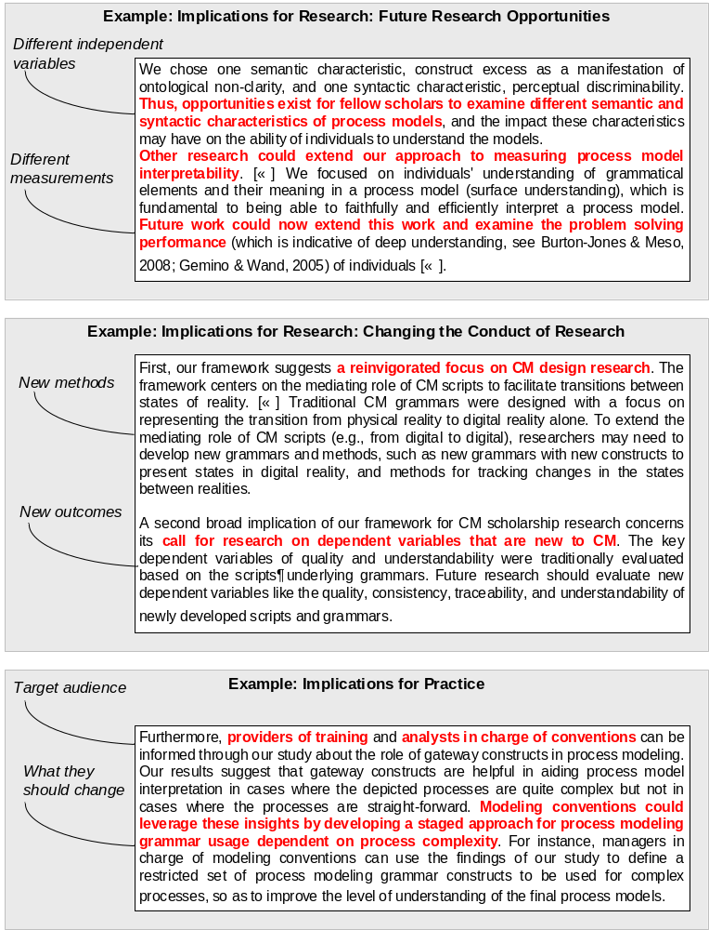
Example

Slide 75
Section: Conclusion
Provides the closing frame to a paper.
Is often little more than one abstract statement.
Recaps very briefly the key contributions of the paper, without going into detail.
Reflects about the research presented in the paper.
Never introduces new material or findings.
Rule of thumb: don’t cite anything!

Slide 76
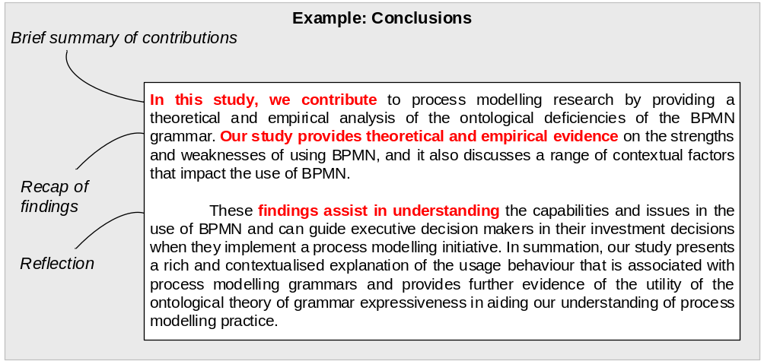
Example

Slide 77
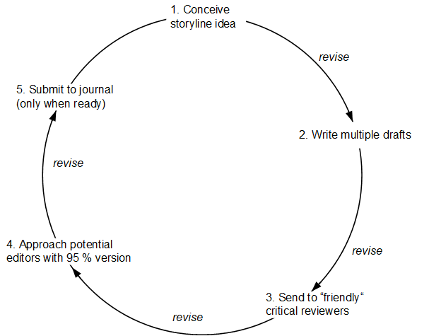
Wrap-Up: The Article Writing Life-Cycle
Conceive idea
  Revise
Write multiple drafts
  revise
Send to “friendly” critical reviewers
  revise
Approach potential editors with 95% draft
  revise
Submit
  only when ready

Slide 78
Handling Reviews and Revisions

Slide 79
What happens when you submit your manuscript?
Submission is commonly by electronic upload. Most journals use ManuscriptCentral; or EES or something similar.
A journal editor will determine if your manuscript content is potentially suitable for publication in the journal.
If it is, the manuscript will generally be sent to senior/associate editors and/or two or more reviewers.

Slide 80
Why Editors Desk-Reject Papers
Lack of fit to the journal
  Doesn’t cite ANY papers in the journal
  If substantive journal: paper is about a different domain
  If general-level: paper is not general enough
Important: lack of fit is not an evaluation of quality!

Slide 81
Why Editors Desk-Reject Papers
Lack of Likelihood
  Will the paper have a good chance of successfully traversing the review process?
  What are the odds that the paper will receive only rejects?
  Protection of scarce resources: the reviewers!

Slide 82
Why Editors Desk-Reject Papers
Lack of Formalities
  Do papers adhere to the submission requirements?
  Depends on journals: some are VERY strict.
  Is the language good enough?
  Don’t take this lightly.

Slide 83
If not: wait… for the editor’s decision
1. Rejection – the paper is not accepted by the journal – the editor will tell you why. This decision is final.
2. Request to revise and resubmit - The manuscript is denied publication in its current state, but the editors and reviewers feel that a reworked manuscript may possibly be accepted if submitted to the journal again for new evaluation, typically by the same editor and reviewers.
- often distinguishs between major or minor revisions
3. Acceptance or conditional acceptance - the editor has decided that the paper can be published as is, or with changes so minor that it does not require further review.
- Usually only about 5-10% of submissions get accepted by (good) journals.

Slide 84
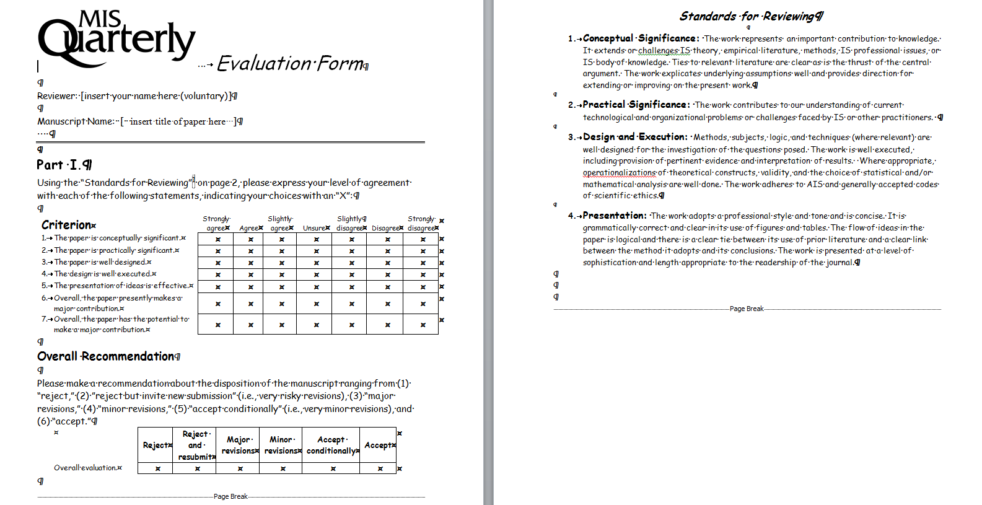
Understanding Reviews

Slide 85
Revising a paper based on reviews.
Don’t be precious – get published.
If the paper is rejected – determine why.
If there are legitimate flaws – fix them.
Do not resubmit the same flawed manuscript somewhere else.
If you are asked to revise and resubmit – do it.
Take all editorial and reviewer comments seriously.

Slide 86
Revision Management
Put the reviews aside for a while.
  All initial reviews are critical
  (you will very rarely accepted straightaway – it only happened to me once)
  You will probably have some strong negative reactions to a review.
  After several days/week, they will look more manageable.
Read the reviews.
  You need to truly and fully understand each and every comment.
  Read the reviews several times.
  Develop a strategy
Tabulate reviews.
  Create a table for the editors and reviewers and copy and paste each “block” of review comments into a separate row.
  Have three columns, one for the comment, one for the response, and one for notes and discussion within the research team.
  Mark them as “quick fixes” (easy to handle) and “major pieces of work”.
  Indicate the type of revision required: (a) change the research, (b) change the presentation of research, or (c) a suggestion that cannot be handled given the research conducted.

Slide 87
Revision Management
Revise the paper.
  Changes will have to be made to the document.
  Changes will be more, or less, ranging from changing/inserting/deleting paragraphs/figures/tables of some sections, to writing a completely new manuscript.
  Don’t be afraid to make big changes to a manuscript. A major revision should always look like one.
  Some suggest completely re-writing a paper from scratch for major revisions – and in my experience this can often be necessary.
Write a response letter.
  Write point-by-point responses to all comments made.
  Write the response letter by perusing the revision table.
  Include a pre-amble that expresses your gratitude towards the editor and reviewers for considering your manuscript and investing their time to give you and assisting you to improve your work.
  Outline the strategy your pursued in your revision.
  Summarize the main changes made.

Slide 88
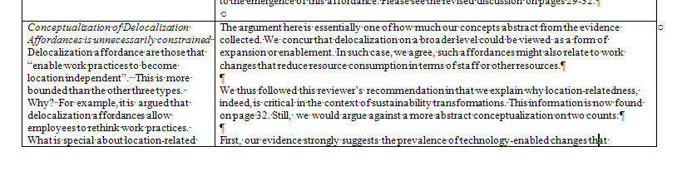
Examples for Response Letters
1) Expansive
Interprets review comment
Outlines revision alternatives
Justifies chosen revision
Describes revision.

Slide 89
Examples for Response Strategies
2) Concise
Is direct and blunt.
Only states what has
been/not been done.
Doesn’t go into detail.
Offers brief justification.
Comment:
Do program chairs adjust for the tracks that accept too few or too many papers?
Response:
We do not have concrete data to answer this issue. We believe based on our own experiences in conference chairing and reviewing that this is often the case. However, we do not have data on this and therefore we have made no changes to the paper based on this comment.

Slide 90
Example: Revision Cover Letter
Response to the Comments by the Editors
Submission to the [JOURNAL], [SubmissionID]
[Paper Title]
Dear Editorial Team
Many thanks for providing us with constructive and comprehensive feedback about our submission. We found the responses very valuable in further improving our theoretical model and data analysis, as well as in revising the way we describe our research in the manuscript. We detail our responses in the tables below.
In summary, our main changes are as follows:
We expand on the conceptual foundation for our work and provide more precise and explicit construct definitions.
We expanded on the discussion of findings, with a particular view on improving on managerial implications and design advice that follows from our work.
We tested alternative conceptualizations and measurement models to examine the suggestions by the reviewer and to attest to the validity of our proposed model.
We revised the structure and content of our manuscript and streamlined the flow of the paper by moving details about our analyses to a separate appendix.
We are confident that these changes significantly improved the paper and we hope that our efforts become evident from the responses below as well as the revised manuscript itself.
We look forward to receiving your feedback.
Best regards,
[the authors]

Slide 91
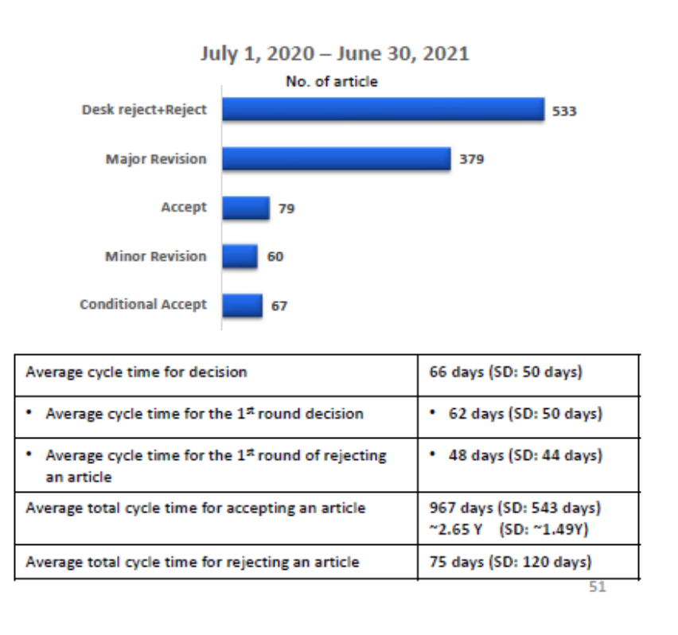
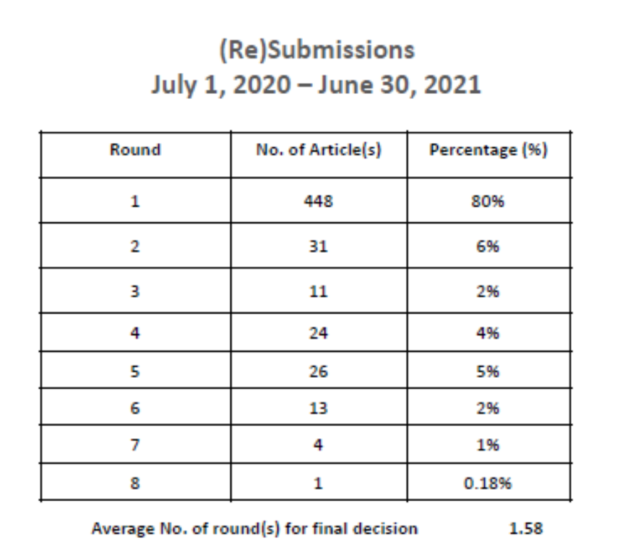
Some statistics about the review/revision process in IS journals

Slide 92
End of Chapter 6
© Copyright 2021 Jan Recker. All Rights Reserved.

