Slide 1
Scientific Research in Information Systems: A Beginner’s Guide (2nd edition)
Teaching Materials
Created by Professor Jan Recker

Slide 2
Copyright Notice & Citation
© Copyright 2021 Jan Recker. All Rights Reserved.
Recker, J. (2021): Scientific Research in Information Systems: A Beginner’s Guide.
2nd edition, Springer.
Available at Springer, Amazon, and other booksellers

Slide 3
Overview
Content
Part 1: Basic Principles of Research
Part 2: Conducting Research
Part 3: Publishing Research

Slide 4
Chapter 7:
Ethical Considerations

Slide 5
Scientific Ethics
  The role of ethics
  Fundamental principles of scientific ethics
  Ethics and scientific conduct
  Ethics and scientific writing

Slide 6
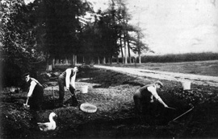
Charles Dawson
a paleontologist who in the late 19th century ade a number of seemingly important fossil discoveries, which he named after himself (e.g., Plagiaulax dawsoni, Iguanodon dawsoni, and Salaginella dawsoni)
He became considerably famous, was elected a fellow of the British Geological Society and appointed to the Society of Antiquaries of London.
His most famous discovery (in 1912) was the “Piltdown Man“ – a fossil from a new species that represented the missing link between man and ape.

Slide 7
In the 1950s researchers realized the piltdown man fossil did not represent the missing link, but rather an elaborate fraud in which the skull of a medieval human was combined with the jawbone of an orangutan and the teeth of a fossilized chimpanzee.
The bones were chemically treated to make them look older, and the teeth had even been hand filed to make them fit with the skull.
In the wake of this revelation, at least 38 of Dawson's finds have been found to be fakes, created in his pursuit of fame and recognition.

Slide 8
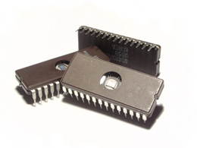
These things do not happen anymore or they don‘t happen where you live?
In 2001, German physicist Jan Hendrik Schön appeared
to produce a series of breakthrough discoveries in the area
of electronics and nanotechnology.
Schön and two co-authors claimed to have produced a molecular-scale alternative to transistors used commonly in consumer devices.
Schön received a number of outstanding research awards.
The work was deemed one of the "breakthroughs of the year" by Science.
https://www.visionlearning.com/en/library/Process-of-Science/49/Scientific-Ethics/161

Slide 9
Schön‘s story continued
Other scientists could not replicate the work by Schön.
Others noticed that an identical graph of data appeared in several different papers of Schön.
His employer (Bell Laboratories) started an investigation. Schön claimed not to have logs or notebooks and that he „had to erase all data“ from his computers.
His papers were retracted, his doctoral degree from the Uni Konstanz was revoked, he was fired, and was banned from working in science für eight years.

Slide 10
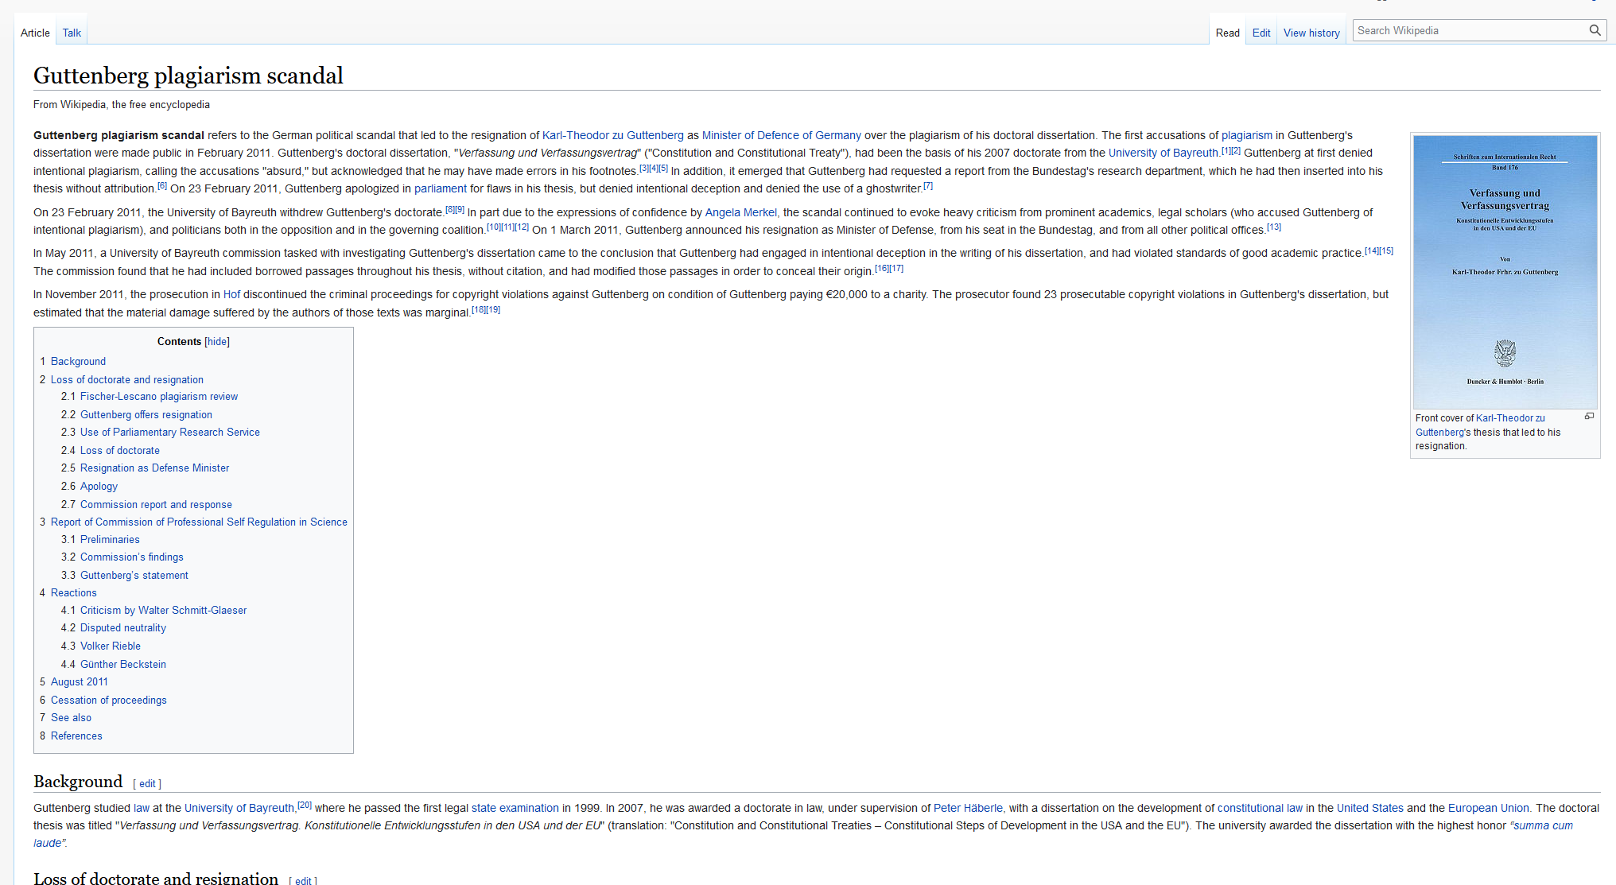
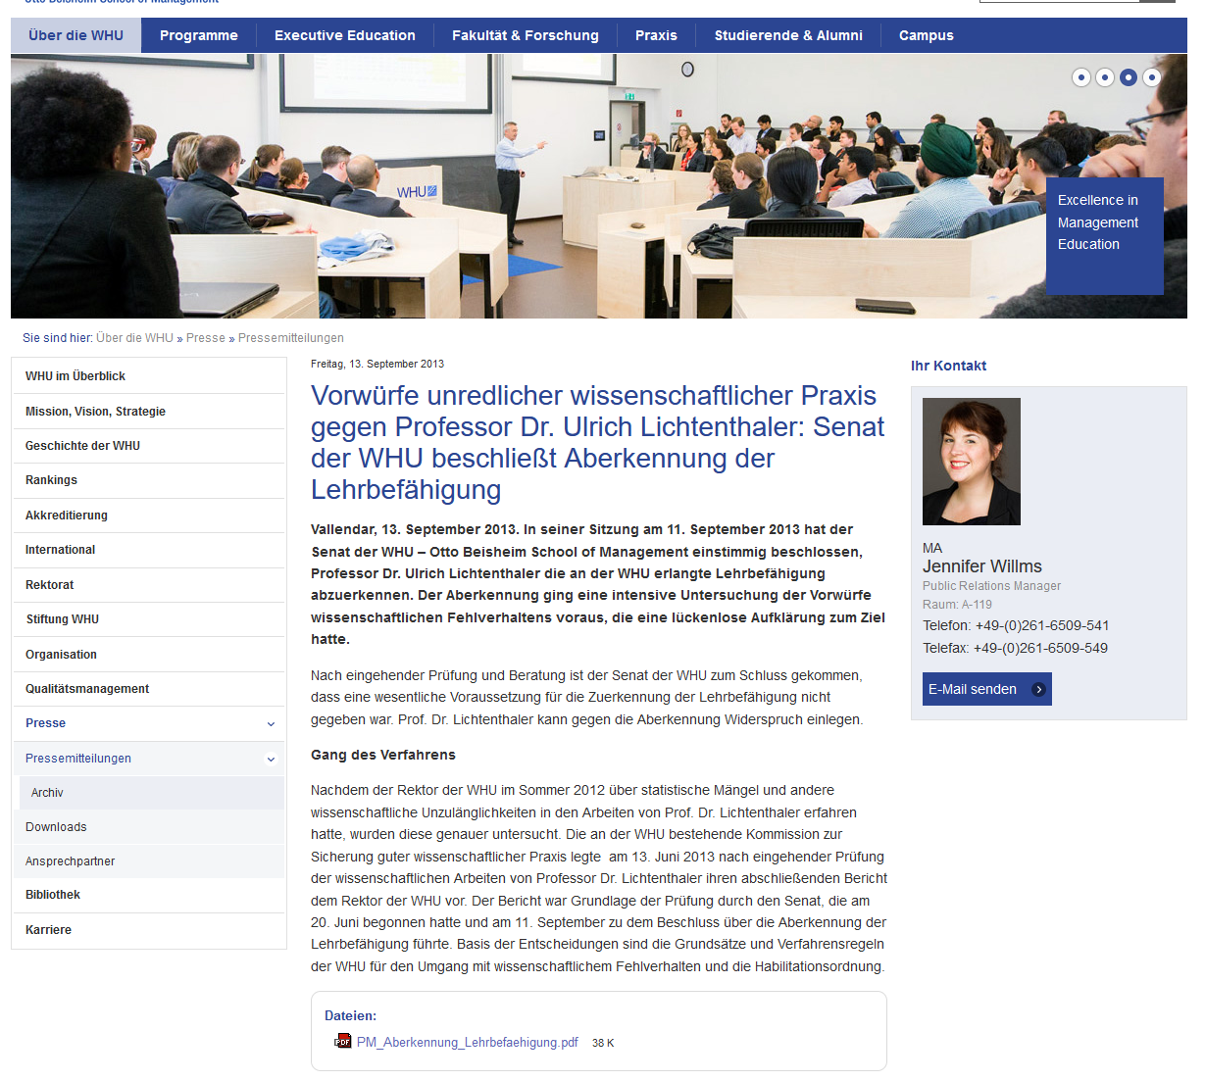
Such examples exist everywhere and all the time
https://en.wikipedia.org/wiki/Guttenberg_plagiarism_scandal
http://www.whu.edu/ueber-die-whu/presse/pressemitteilungen/aktuelles-einzelansicht/article/vorwuerfe-unredlicher-wissenschaftlicher-praxis-gegen-professor-dr-ulrich-lichtenthaler-senat-der/

Slide 11
Ethics
A branch of philosophy that addresses questions about morality, that is, concepts like good and bad, right and wrong, justice and injustice, and virtue and evil.
Ethics are defined as a set of moral obligations that define the principles of right and wrong conduct in a community or profession, and which can be used by individuals to guide their choices and behaviours.
Many professions and communities have formalized ethical codes to guide professionals in their field
  The Hippocratic Oath: doctors should „do no harm“ to their patients.
  Professional engineers code of ethics: „hold paramount the safety, health, and welfare of the public.”
  First law of robotics: “A robot may not injure a human being.”
Ideally, ethical principles become ingrained in everyday professional practices – part of the way a profession is practiced.
A breach of ethics is considered a very serious offence – punishable within the profession and sometimes also by law.

Slide 12
Key concepts in ethics
Ethical behavior describes a set of actions that abide by certain rules of :
  Responsibility means accepting the potential costs, duties, and obligations of one’s decisions.
  Accountability means being answerable to others for decisions made and actions taken.
  Liability means accepting responsibility and accountability so individuals can recover damages done to them through breaches of responsibility.
  Due diligence means investigating or exercising care to ensure individuals can examine or appeal how responsibility, accountability, and liability are applied.

Slide 13
Key goal in scientific ethics
Maintaining “honesty and integrity” in all stages of scientific conduct.
  includes all aspects of scientific activity, such as experimentation, testing, education, data collection, data analysis, data storage, data sharing, peer review, etc.
  Also other activities that have a direct bearing on science, such as government funding or staffing of research teams.

Slide 14
Six Fundamental Ethical Principles for Scientific Research
Scientific honesty
  Scientists should not commit scientific fraud by, for example, fabricating, “fudging,” trimming, “cooking,” destroying, or misrepresenting data.

Slide 15
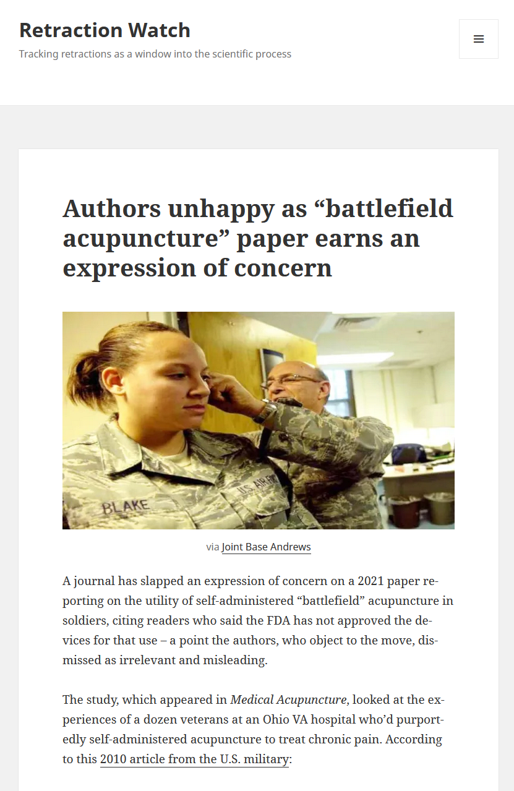
Example Implementation
Scientific honesty
https://retractionwatch.com/
  a blog that reports on retractions of scientific papers and on related topics.

Slide 16
Six Fundamental Ethical Principles for Scientific Research
Carefulness
  Scientists should avoid careless errors and sloppiness in all aspects of scientific work.

Slide 17
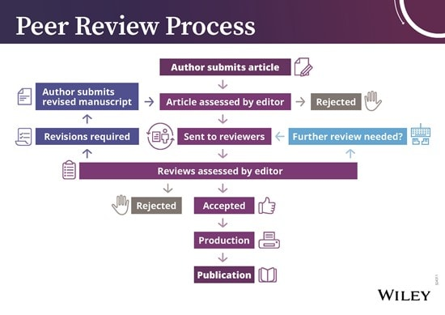
Example Implementation Carefulness
Academic peer review processes

Slide 18
Six Fundamental Ethical Principles for Scientific Research
Intellectual freedom
  Scientists should be free to pursue new ideas and criticize old ones and conduct research on anything they find interesting.

Slide 19
Example Implementation Intellectual Freedom
Tenure / “Verbeamtung”
  an indefinite appointment that can be terminated only for cause or under extraordinary circumstances that provides sufficient protection for scientists to pursue their ideas
    e.g., in Germany: salary, health cover, pension, rooms, assistants, budget, etc.
  Objective: to safeguard academic freedom for all who teach and conduct research in higher education.
  Provides conditions for scientitss to pursue research and innovation and draw evidence-based conclusions free from corporate or political pressure.
  Should faculty members possibly lose their positions because of their speech, publications, or research findings, they cannot properly fulfill their core responsibilities to advance and transmit knowledge.
  Not without controversy, e.g., the lectures of Prof Dr Bernd Lucke at the University of Hamburg in 2019
    https://www.uni-hamburg.de/en/newsroom/im-fokus/2019/1022-fragen-antworten-lucke.html
    https://www.tagesspiegel.de/wissen/massive-stoerung-bei-vorlesung-von-afd-gruender-uni-hamburg-sagt-bernd-lucke-schutz-zu/25125924.html

Slide 20
Six Fundamental Ethical Principles for Scientific Research
Openness
  Whenever possible, scientists should share data, results, methods, theories, equipment, and so on; allow people to see their work; and be open to criticism.

Slide 21
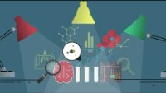
Example Implementation Openness
Open Science (e.g., https://www.cos.io/)
https://www.youtube.com/watch?v=9YuNGB3vNOw

Slide 22
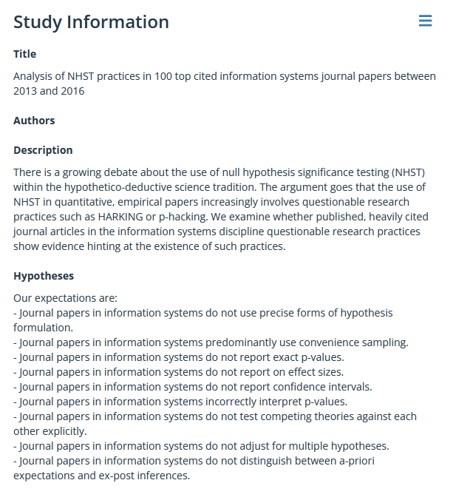
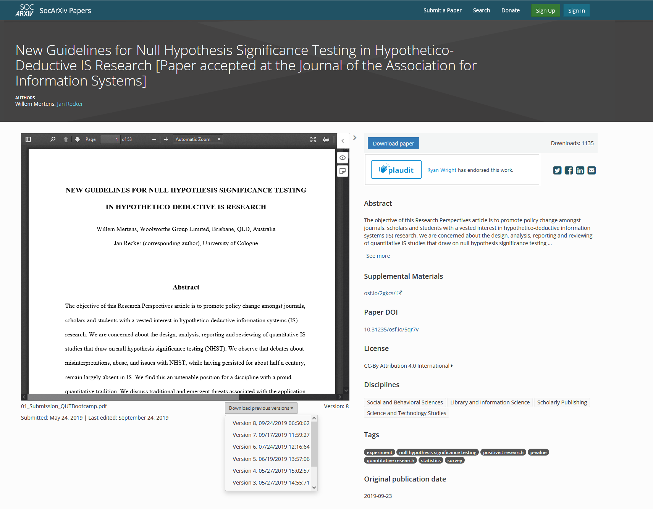
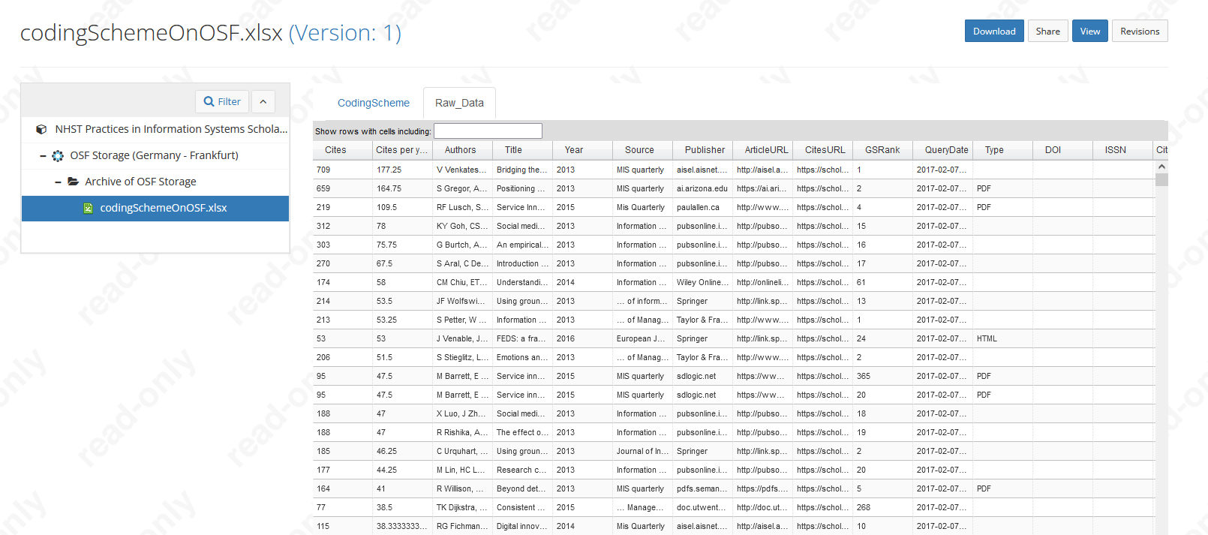
Example open science registration
Open registration of study, data, measurement, hypotheses, paper drafts
  https://osf.io/ecwsj
includes
  Hypotheses
  Coding Scheme plus raw data
    https://researchdatafinder.qut.edu.au/display/n8485
    https://osf.io/zg46t/
  Paper versions
    https://osf.io/preprints/socarxiv/5qr7v/

Slide 23
Six Fundamental Ethical Principles for Scientific Research
Attribution of credit
  Scientists should not plagiarise the work of other scientists. They should give credit where credit is due but not where it is not due.

Slide 24
Example Implementations Attribution of Credit
Grammarly Plagiarism checker
  https://www.grammarly.com/plagiarism-checker
https://de.wikipedia.org/wiki/Liste_deutscher_Dissertationen_mit_Plagiaten
  Franziska Giffey, Karl-Theodor zu Guttenberg, Annette Schavan, etc.

Slide 25
Six Fundamental Ethical Principles for Scientific Research
Public responsibility
  Scientists should report research in the public media when the research has an important and direct bearing on human happiness and when the research has been sufficiently validated by scientific peers.

Slide 26
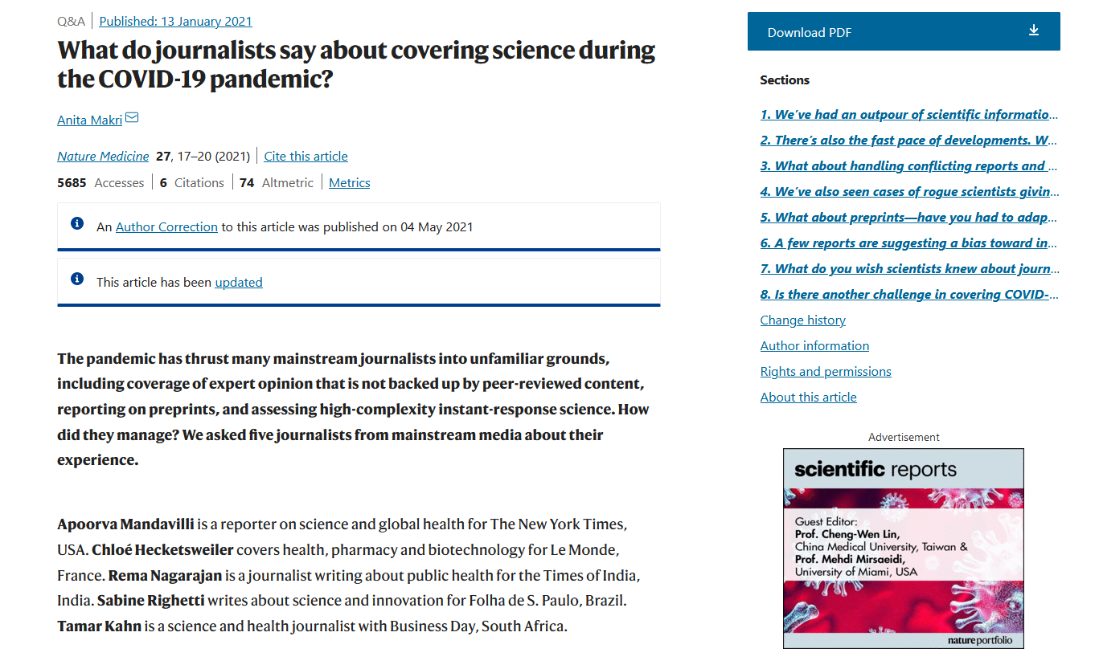
Example Public responsibility
https://www.nature.com/articles/s41591-020-01207-3

Slide 27
Ethical considerations for scientific conduct
All behaviors involved in the research process, such as developing a theory, collecting data, and testing hypotheses, are subject to ethical considerations, codified and uncodified, particularly ethics related to empirical data collection and human subjects.

Slide 28
Ethical considerations for scientific conduct
Research involving human subjects in institutions that receive federal research funding must receive ethical clearance by an independent review board.
IRB must approve any research with human subjects before it is initiated.

Slide 29
Ethical clearance considerations
An IRB evaluates
  the extent to which participation in a study
    is voluntary,
    does not exert physical or psychological stress, and
    not cause other kinds of damage to participants
  whether participants must give consent regarding
    how their data will be used
    how their data will be reported
    how the data will be protected in terms of anonymity or confidentiality
  whether participants have the right to withdraw from participation at any time.
  how data is stored and analysed
    Involves ownership, storage and backup, privacy, confidentiality, access, and reuse.

Slide 30
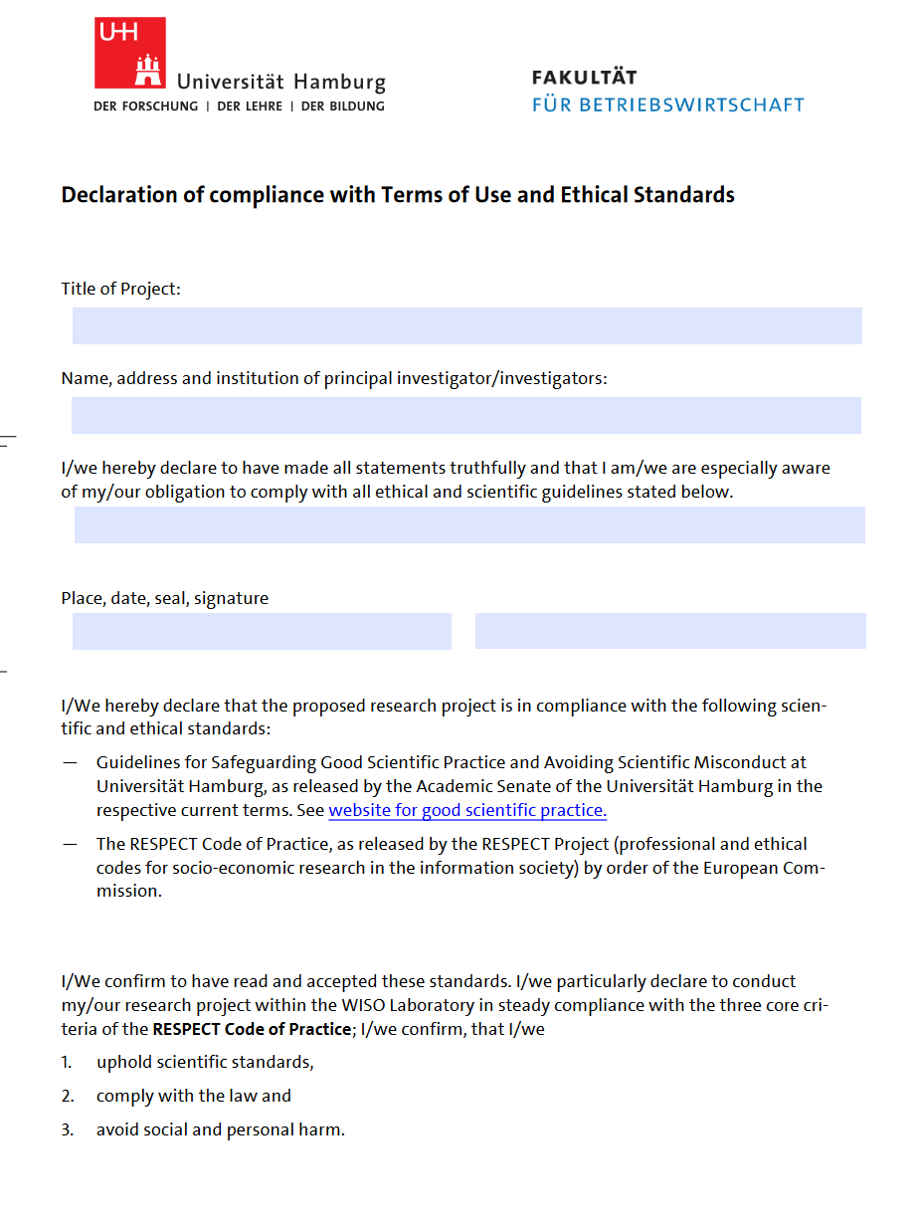
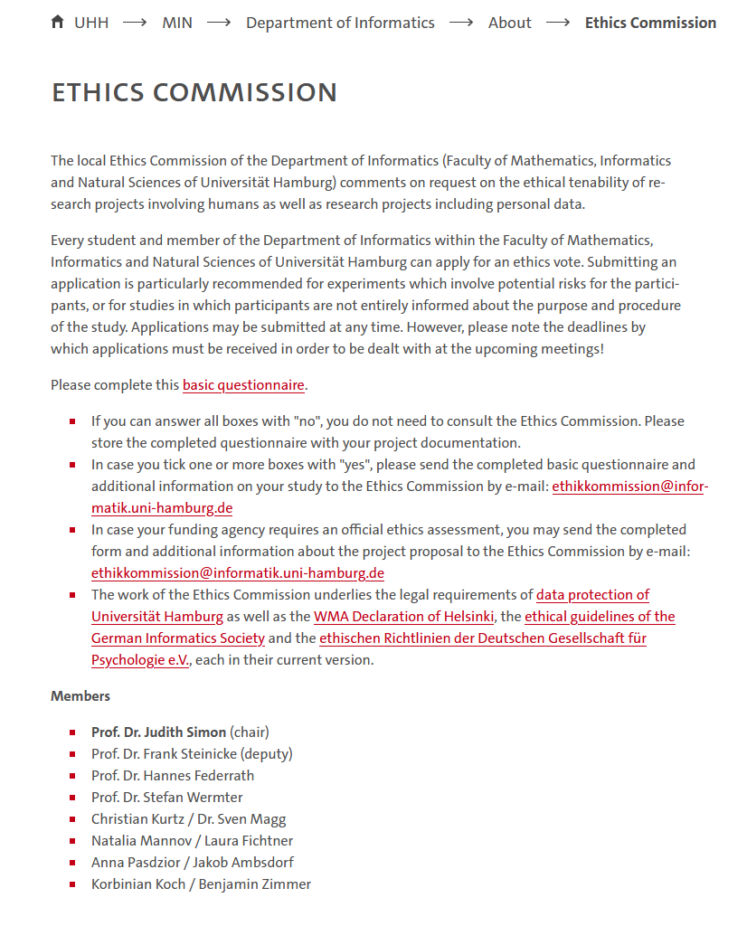
IRB at University of Hamburg
https://www.bwl.uni-hamburg.de/en/forschung/spiegel-researchdraft2020service.html
https://www.inf.uni-hamburg.de/en/home/ethics.html

Slide 31
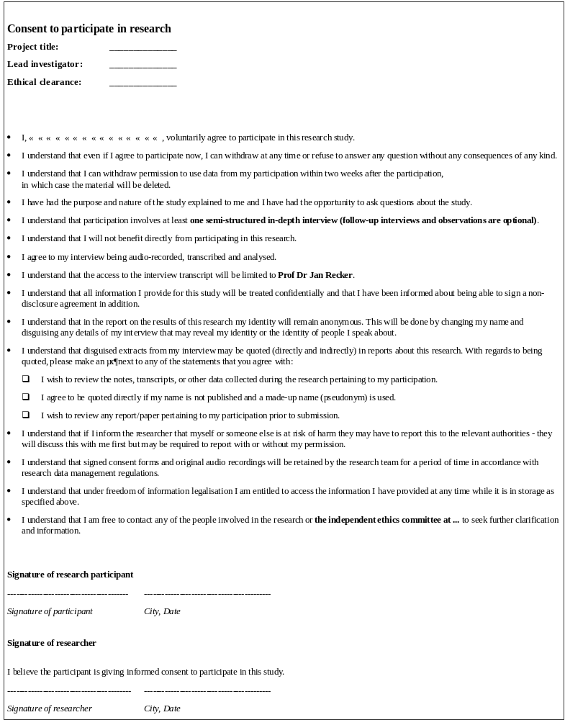
Example ethics consent form
Add project details and a unique reference to the ethical clearance provided by an independent ethics review board
Here you typically insert specifics about what participation actually means (e.g., being interviewed or completing a survey)
Here you specify who will be able to access the research data
Here you can list choices a participant has about his data will be used
Here you specify an independent third party that could be involved in the matter

Slide 32
Example: Facebook secret moods experiment and emotional contagion
https://www.theguardian.com/technology/2014/jun/29/facebook-users-emotions-news-feeds
https://www.theguardian.com/technology/2014/jun/30/facebook-emotion-study-breached-ethical-guidelines-researchers-say

Slide 33
Ethical considerations for scientific writing
A subset of ethical issues in scientific conduct that relates only to the reporting of research
Very important part of scientific ethics because it is typically only through reported research that an ethical issue is revealed
  we typically cannot learn about data fabrication or amendment until those data are disclosed.
  We cannot identify a lack of attribution of credit until an unnamed contributor sees it in writing

Slide 34
1. Plagiarism
the wrongful appropriation, close imitation, or purloining and publication of another author’s language, thoughts, ideas, or expressions and their representation as one’s own work.
the act of passing off someone else's work as your own, whether intentionally or unintentionally.
The most common form of scientific misconduct.

Slide 35
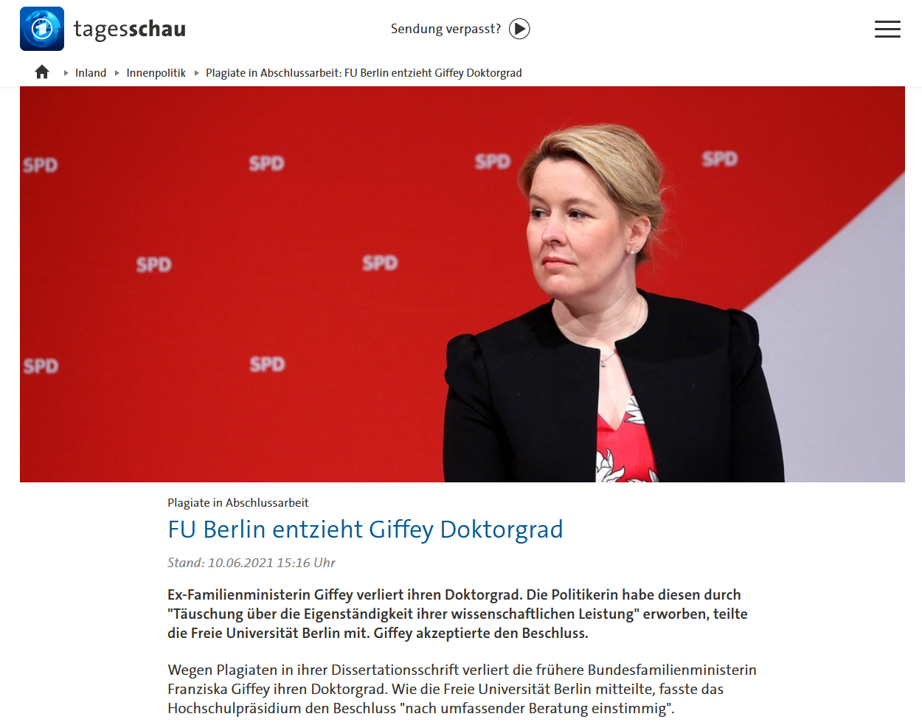
Plagiarism Examples
https://www.tagesschau.de/inland/innenpolitik/fu-berlin-giffey-doktorgrad-verlust-101.html

Slide 36


Plagiarism Examples

Slide 37

Plagiarism Examples
https://en.wikipedia.org/wiki/Sometimes_(Britney_Spears_song)

Slide 38
Forms of plagiarism
Intentional plagiarism
  a writer knowingly lifts text directly from other authors’ work without giving appropriate credit.
Duplicate publication
  an author submits for publication a previously published work as if it were original.
Self-plagiarism
  a writer copies large parts of an earlier manuscript word for word into a new manuscript.
  can occur when individuals pursue large programs of research over many years on the same topic, so they are constantly building on their own work and in their own language.

Slide 39
Protecting against plagiarism
Always acknowledge the sources of and contributions to your ideas.
Enclose in quotation marks any passage of text that is directly taken from another author’s work and acknowledge that author in an in-text citation.
Acknowledge every source you use in writing, whether you paraphrase it, summarise it, or quote it directly.
When paraphrasing or summarising other authors’ work, reproduce the meaning of the original author’s ideas or facts as closely as possible using your own words and sentence composition.
Do not copy sections of your previously published work into a new manuscript without citing the publication and using quotation marks.

Slide 40
2. Recognition of co-author contributions
Concerns the appropriate acknowledgement (not too much or too little) of collaborators’ substantial contributions to a piece of scholarly work.
An ethical issue that appears frequently in scientific work because collaboration is the norm, not the exception.
  Working alone means less productivity
  Working alone means having to do every thing well
  Collaboration means sharing workload, complementing skills, broadening the domain of interest
Recognizing co-author contributions appropriately be difficult to deal with because the correct attribution of credit sounds easy but is hard to identify in practice.
Making co-authorship decisions is important because on the one hand co-authorship confers credit to individuals for their contribution to academic tasks, which can have academic, social, and financial implications; but on the other hand, co-authorship also implies responsibility and accountability for published works.

Slide 41
Four ethical issues relating to co-authorship
Coercion authorship
  occurs when intimidation is used to gain authorship credit, such as when a senior person pressures a more junior person to include the senior person’s name on a paper to which he or she has not contributed enough to qualify for authorship.
Gift authorship
  Occurs when individuals are given recognition as co-authors without having made substantial contributions, often for reasons like acknowledging friendship, gaining favour, or giving the paper more legitimacy by adding well-known senior researchers to the list of authors.

Slide 42
Four ethical issues relating to co-authorship
Mutual support authorship
  occurs when two or more authors (or author groups) agree to place their names on each other’s papers to enhance their perceived productivity. The “authors” can count both publications towards their own list of papers, receive citations for both papers, and so forth.
Ghost authorship
  occurs when papers are written by people who are not included as authors or are not acknowledged. A typical form of ghost authorship involves using or hiring professional scientific writers, perhaps because the researchers feel they cannot write “well” or “scientifically.”

Slide 43
Managing coauthorship
Golden rule of publishing: Good papers built on good research.
  You can contribute in either or both areas.
Most important involved in the research process warrant co-author recognition when done by someone else but not all of them!
  Developing an original idea
  Designing a study
  Organizing data collection
  Collecting data
  Analyzing data
  Writing and revising a paper
  Sponsoring/funding the project
  Managing the project

Slide 44
My decision rules
A co-author has…
  made substantial contributions to the conception or design of the research or the acquisition, analysis, or interpretation of data for the research; and
  made substantial contributions to drafting the publication or revising it critically for important intellectual content; and
  given final approval of the version to be published; and
  agreed to be accountable for all aspects of the work, including being accountable for the parts of the work he or she has done, being able to identify which co-authors are responsible for other parts of the work, and having integrity about the contributions of other co-authors.
Authorship of a research output should not be claimed when
  participation rests solely in the acquisition of funding or the collection of data.
  General supervision of the research group does not justify authorship.
These are my criteria; they may or may not be yours. Rules change by country, institution, and sometimes persons.
E.g., the DFG (“Deutsche Forschungsgemeinschaft”) demands “participation in” rather then “contribution to” the points above.

Slide 45
Exercise: Recognizing co-authorship
Professor Smith, the head of the lab, is publishing a paper on the structure of chitin.
Professor Smith’s lab collaborated with a high profile lab group in Sweden that had already engineered and published the correct gene construct to express chitin in vitro, and who sent some of their materials to help Professor Smith’s team.
Professor Smith’s post‐doc, Mary, did the majority of the lab work, staying late and working long hours to get the necessary data. A final year PhD student, Jiang, and a technician, Oliver, both helped Mary do some of the technical work.
Professor Smith did not write any of the paper, but reviewed and edited Mary’s drafts that she sent to him. He is writing the cover letter and submitting the paper to Nature.
Mary wrote the bulk of the paper but for the Introduction she used paragraphs of text directly from Jiang’s unsubmitted, draft thesis.
Who should be listed as a co-author?

Slide 46
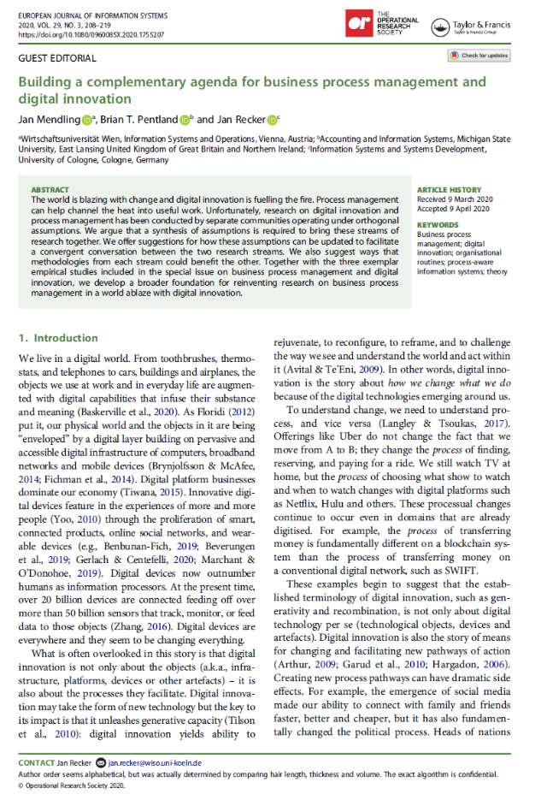
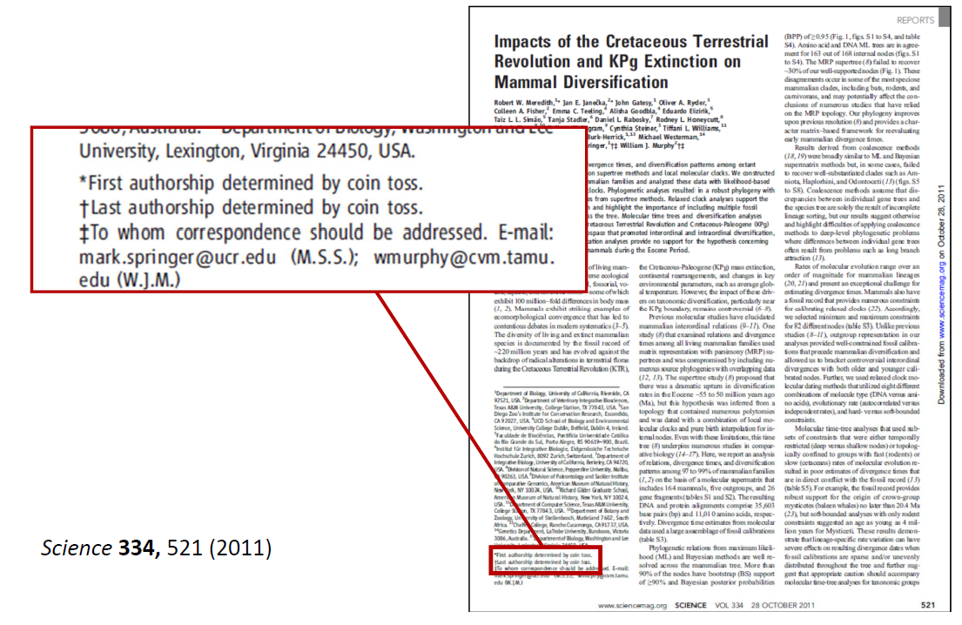
Authorship credit: what should be the order of authors?
Author order seems alphabetical, but was actually determined by comparing hair length, thickness and volume. The exact algorithm is confidential

Slide 47
Authorship credit: what is the order of authors?
The order of authors is entirely up to the authors.
Typical practices when it comes to putting the authors’ names on the paper…
  Most often, the first authors are the ones who did most of the work, with the authors listed in descending order of contributions
  Some put principal investigators at the end of the list
  Some groups do it alphabetically
  In some scientific fields the most highly credited author is the one whose name appears [first/last].
  Social scientists tend to place the authors’ names in alphabetical order regardless of the amount of effort that was contributed.
  Some journals allow annotations identifying one or two authors who did the majority of the work (this can be important for PhD thesis defenses or for job applications)

Slide 48
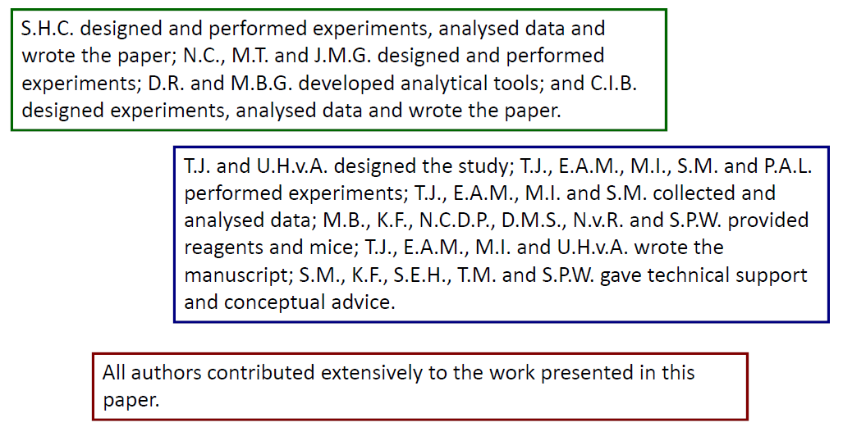
Examples

Slide 49
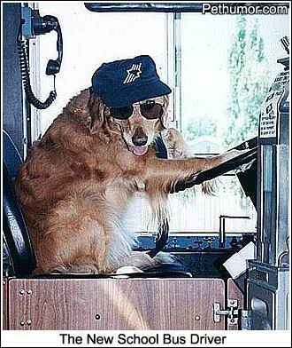
Hint: Identify the driver
Typically, research ownership is evident
Typically, papers are driven by an individual
  Major contribution to completing the first draft
  Handling the revisions
If not – discuss!
  Research ownership
  Data ownership?
  Paper ownership

Slide 50
A formal way of handling co-auhtor recognition: CRediT
CRediT (Contributor Roles Taxonomy)
A system introduced with the intention of recognizing individual author contributions, reducing authorship disputes and facilitating collaboration.
Defines a set of roles that individuals can occupy in a research process
CRediT statements can be included in submissions or in final papers
Example CRediT statement
  Zhang San: Conceptualization, Methodology, Software Priya Singh.: Data curation, Writing- Original draft preparation. Wang Wu: Visualization, Investigation. Jan Jansen: Supervision.: Ajay Kumar: Software, Validation.: Sun Qi: Writing- Reviewing and Editing.

Slide 51
CRediT roles
Term | Definition
Conceptualization | Ideas; formulation or evolution of overarching research goals and aims
Methodology | Development or design of methodology; creation of models
Software | Programming, software development; designing computer programs; implementation of the computer code and supporting algorithms; testing of existing code
Validation | Verification, whether as a part of the activity or separate, of the overall replication/ reproducibility of results/experiments and other research outputs
Formal analysis | Application of statistical, mathematical, computational, or other formal techniques to analyze or synthesize study data
Investigation | Conducting a research and investigation process, specifically performing the experiments, or data/evidence collection
Resources | Provision of study materials, reagents, materials, patients, laboratory samples, animals, instrumentation, computing resources, or other analysis tools
Data Curation | Management activities to annotate (produce metadata), scrub data and maintain research data (including software code, where it is necessary for interpreting the data itself) for initial use and later reuse
Writing - Original Draft | Preparation, creation and/or presentation of the published work, specifically writing the initial draft (including substantive translation)
Writing - Review & Editing | Preparation, creation and/or presentation of the published work by those from the original research group, specifically critical review, commentary or revision – including pre-or postpublication stages
Visualization | Preparation, creation and/or presentation of the published work, specifically visualization/ data presentation
Supervision | Oversight and leadership responsibility for the research activity planning and execution, including mentorship external to the core team
Project administration | Management and coordination responsibility for the research activity planning and execution
Funding acquisition | Acquisition of the financial support for the project leading to this publication

Slide 52

Managing co-authorship: Communicate early and openly
Open lines of communication throughout the research process are vital.
  You should talk openly and frankly.
  It’s the team’s responsibility to create a communication environment without fear of reprisal, demotion, or other punishment.
Most important part of this process:
  Voicing one’s investment,
  Creating transparency about publication strategies,
  Mutually recognizing each other’s goals,
  Building flexibility into the process, and
  Establishing commonly accepted criteria for making these basic decisions.

Slide 53
3. Honest reporting
An ethical standard that demands that research publications comply with expectations for transparency, openness, and reproducibility.
Typical ethical issues
  Publication bias
    systematic suppression of a certain type of research results in published papers, such as negative hypothesis tests or replications, or
    systematic preference given to innovative and novel findings rather than confirmations of known findings
  HARKing (hypothesizing after the results are known)
  p-Hacking (the misuse of data analysis to find patterns in data that can be presented as statistically significant)

Slide 54
Publication bias
occurs when the outcome of an experiment or research study influences the decision whether to publish or otherwise distribute it.
Known as the file-drawer problem: often investigators decline to submit results when they are found not to support initial hypotheses
Consequence: the publication of “negative” or “insignificant” results is impeded
Then, published studies are no longer a representative sample of the available evidence.

Slide 55
HARKing
The false portrayal of a post hoc hypothesis as if it were an a priori hypothesis.
  Can invalidates the idea of a priori hypothesis generation and subsequent testing.
  Can lead to scholars not communicating valuable information about what did not work
  Can lead to distorted publications limited to ideas and findings without a faithful representation of the scientific process through which these ideas were born.
  Risks increasing levels of Type 1 errors: if one attempts (too) many post hoc analyses on the same data, some tests will generate false positives simply by chance
  Risks favoring weaker theories that post hoc accommodate results rather than correctly predict them.

Slide 56
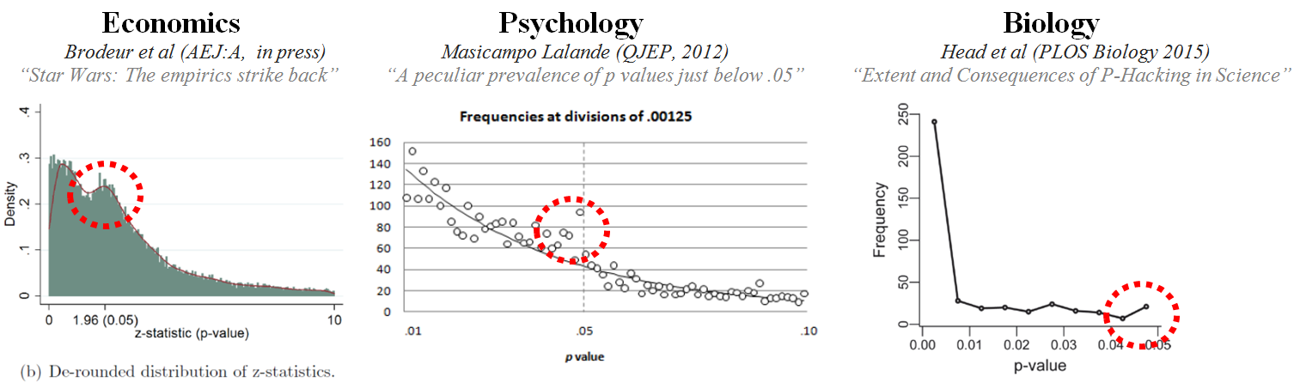
p-Hacking
occurs when researchers collect or select data or statistical analyses until nonsignificant results become significant.
Significant results increase the chance of being published but when published data are biased, data synthesis might lead to flawed conclusions.
Means that we do not know if the strength of the relationship found is purely an artifact of the sample, the
analytical method used, or legitimate judgment
calls made by the researcher.

Slide 57
Recommendations for honest reporting
Pre-registration: make hypotheses public prior to data colletion and analysis
Open science: publicly share raw data used in analysis
Register procedures: Make analyses (e.g., codes, programs) available to others
Conduct replications: repeat studies to see if results remain robust

Slide 58
4. Appropriate use of language
Refers to the wording of scientific reports so they are not biased in terms of gender, race, orientation, culture, or any other characteristics.
Stipulates using gender-responsible, ethnicity-responsible, and inclusive language wherever possible.
Guidelines:
  Specificity
    describe specific behaviours rather than stereotypes: e.g., calling a behavior “dominant and opinionated” instead of “typically male”.
  Labelling
    Refer to concrete labels rather than abstract class tags, e.g., referring to countries’ populations—Mexicans or Chinese—instead of classes like “Hispanics” or “Asians”
  Professional acknowledgments
    Use professional classifications, not personal labels, like “medical practitioner” or “doctor” instead of “female doctor.”

Slide 59
Summary: Ethics in information systems research
  The role of ethics:
    Professional code of conducts for IS scientists
  Fundamental principles of scientific ethics:
    Maintaining honesty and integrity through the scientific process
  Ethics and scientific conduct:
    Ethical clearance and independent ethics review
  Ethics and scientific writing:
    Plagiarism, publication bias, honest reporting and appropriate language.

Slide 60
End of Chapter 7
© Copyright 2021 Jan Recker. All Rights Reserved.

